Slide 1
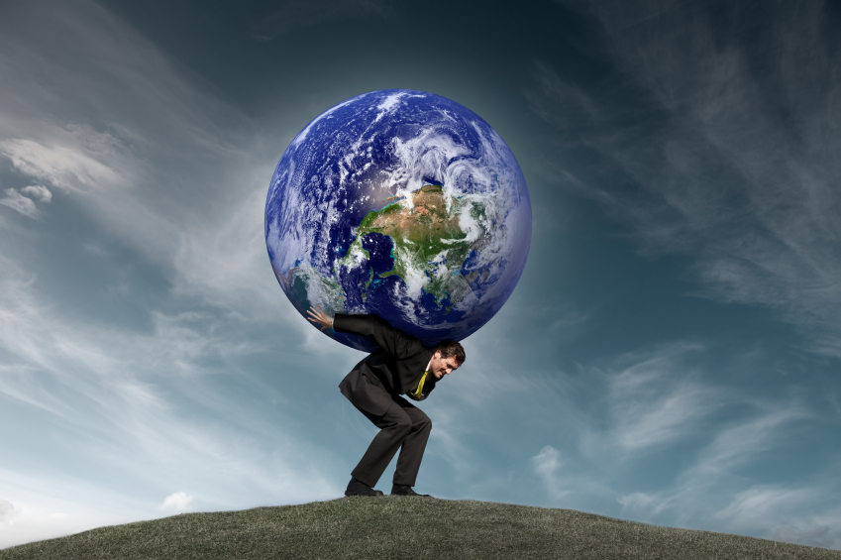
Chapter 9 - Stress

Slide 2
Have you ever wanted to do this? https://www.youtube.com/watch?v=-EyG_CYf-S0 – you don’t have to watch but the first few minutes to get my point regarding stress and how it impacts or emotions.
If you ask 10 people what stress is you will likely get 10 different answers. No one person reacts to stress the same. What is stressful for one person may be exciting to another person.
Example: Public performance such as concert, athletic event. They perceive the situation very different. Why?
How much is stress impacting our daily lives? Pay close attention to the highlighted information. See Doc 1
Stress – a state of physical and mental tension in response to a situation that is perceived as a threat or challenge.
Stressors – a factor that produces stress. (examples?)

Slide 3
Types of Stress
Acute – one singular event (almost being involved in a car accident)
Cumulative – a series of events (family member dies, fail a test, girl friend breaks up with you)
Chronic – prolonged daily pressure (expectations of making all As in school)
Eustress – an optimal level of stress that increases performance.
Distress – too much stress or poorly managed stress.

Slide 4
What happens in the brain when you are presented with a stressor? See Pic 2 Hypothalamus – initiates the release of hormones; epinephrine, norepinephrine, and cortisol. What happens to the body after the brain identifies a stressor? See Pic 1 Fight or flight response – this is an inborn, automatic, primitive response designed to help us survive. https://www.khanacademy.org/test-prep/mcat/processing-the-environment/stress/v/responding-to-stress Warning Signs and Symptoms of Over-Stress - See Doc 4

Slide 5
Managing Your Stress
Manage Your Stressors – recognize what produces your stress, prioritize your activities, build a daily plan.
Rest and Sleep – one of the most effective means of reducing stress and tension (see Steps for Behavior Change on pg. 258)
Exercise – light to moderate exercise may also reduce many types of stress and anxiety (30 minutes).
Use Relaxation Techniques – progressive relaxation, mediation, visualization.
Develop Spiritual Wellness
Develop a Support Network
Avoid Counterproductive Behaviors – tobacco, alcohol or drugs, poor eating patterns.

Slide 6
Article on 10 Stress Relievers
See Doc 2
Article on Stress Fighting Foods
See Doc 3

