Slide 1
Chapter 6 Improving Muscular Strength & Endurance
Lets go pumps some iron!

Slide 2
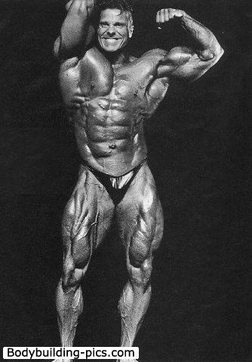
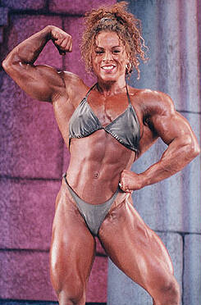
I don’t want to look like one of these… So I’m not going to lift weights.
These are not the normal results from Strength Training or Resistance Training.

Slide 3
Muscular strength and endurance are related, but they are not the same thing.
Muscular strength is the ability of a muscle to generate maximal force.
Muscular endurance is the ability of a muscle to generate force over and over again.
Generally increasing muscular strength will improve muscular endurance. However, improving muscular endurance does not significantly improve muscular strength.

Slide 4
Benefits of Strength Training
Reduces lower back pain and reduces the occurrence of joint and/or muscle injuries.
Helps prevent osteoporosis. See Doc 1
Improves posture and self-image.
Makes daily activities easier.
Increases resting energy expenditure (resting metabolic rate)

Slide 5
Resting Energy Expenditure (Resting Metabolic Rate)
Is the energy required to drive the heart and respiratory muscles and to build and maintain body tissues. An elevated metabolic rate allows the body to burn more calories throughout the day. Assisting in fat lose.
An increase of 1 pound of muscle mass elevates resting metabolism by 2-3%.
5 lbs. of muscle gain would lead to a 10-15% increase in resting metabolic rate.
This can play an important role in helping drop body fat.
Overall weight may stay the same but you have lost fat by gaining of muscle.

Slide 6
Structure & Function
About 600 skeletal muscles in the human body.
Main purpose is maintaining posture and provide force for physical movement.
Also helps regulate body temp by shivering.
The muscle is made up of fibers surrounded by fascia and attached to bones by tendons.
https://www.khanacademy.org/science/biology/human-biology/muscles/v/anatomy-of-a-muscle-cell

Slide 7
3 major categories of muscle exercise
Isotonic – movement of a body part occurs with muscle contraction.
Isometric – muscle tension occurs but there is no body movement.
Isokinetic – constant velocity of movement occurs with muscle contraction. https://www.youtube.com/watch?v=4q19ChKpDDc
Concentric action – positive work (see figure 4 - pg. 147)
Eccentric action – negative work (see figure 4 - pg. 147)

Slide 8
Types of muscle fibers
Slow-twitch: Aerobic (ATP) dark meat
Fast-twitch: Anaerobic (ATP) white meat
Intermediate: have both characteristics
*See the meat of a chicken in the book.
*Table 1 shows the comparisons.
Type of fibers usually match the athletic success type. Fiber type is strongly influenced by genetics. https://www.khanacademy.org/science/health-and-medicine/human-anatomy-and-physiology/introduction-to-muscles/v/type-1-and-2-muscle-fibers

Slide 9
Muscle Fiber recruitment
The more force needed the more fibers are recruited.
See Figure 5 on pg. 148 for the order in which muscle fibers are recruited as the intensity of exercise increases.
2 major physiological factors determine the amount of force a muscle can produce.
Size of the muscle
Number of fibers recruited
See Figure 6 pg. 149 for the relationship between muscle fiber recruitment and force.

Slide 10
Evaluating Muscle Strength & Endurance
Muscle strength is assessed by the one-rep max test.
Not the safest method of testing. Older and weaker.
Testing muscular endurance with push-up test, sit-up test, curl-up test.
New Military Testing - https://www.youtube.com/watch?v=uHkBDFaMmhw

Slide 11
Progressive Resistance Exercise – overload principle to exercise training.
Progressively increase the resistance.
Increase weight, reps, or sets.
Specificity of Training – development of specific muscle trained and the training intensity.
Only muscles being trained will improve.
Intensity will determine if the muscle adaptation is strength or endurance.

Slide 12
How the Body adapts
Muscle fiber recruitment is first thing that is changed from strength training.
Hypertrophy – an increase in muscle fiber size is the next thing that is changed from strength training.
Hyperplasia – an increase in the number of muscle fibers. Controversial evidence in these increases.
Increase in muscle size depends on diet, the muscle fiber type, blood levels of testosterone, and the type of training program.
The muscles and joints function at a higher level and range of motion if full range of motion is utilized.
Greater strength training gains occur in beginners.
Men and women will have similar gains during the beginnings of a program but after several months men will continue with greater gains due to the 20-30 times the amounts of testosterone.

Slide 13
Safety Concerns
Use spotters.
Use safety locks.
Warm-up properly.
Don’t hold your breath.
Controlled lifting.
Full range of motion.

