Slide 1
Section 5.5
Average Value of a Function

Slide 2
AVERAGE VALUE OF A FUNCTION
The average value of a function f over an interval $\left[a, b\right]$ is defined as
$$f_{ave}=\frac{1}{b−a}\int_{a}^{b}{f\left(x\right)dx} \\ =\frac{\int_{a}^{b}{f\left(x\right)dx}}{b−a}$$

Slide 3
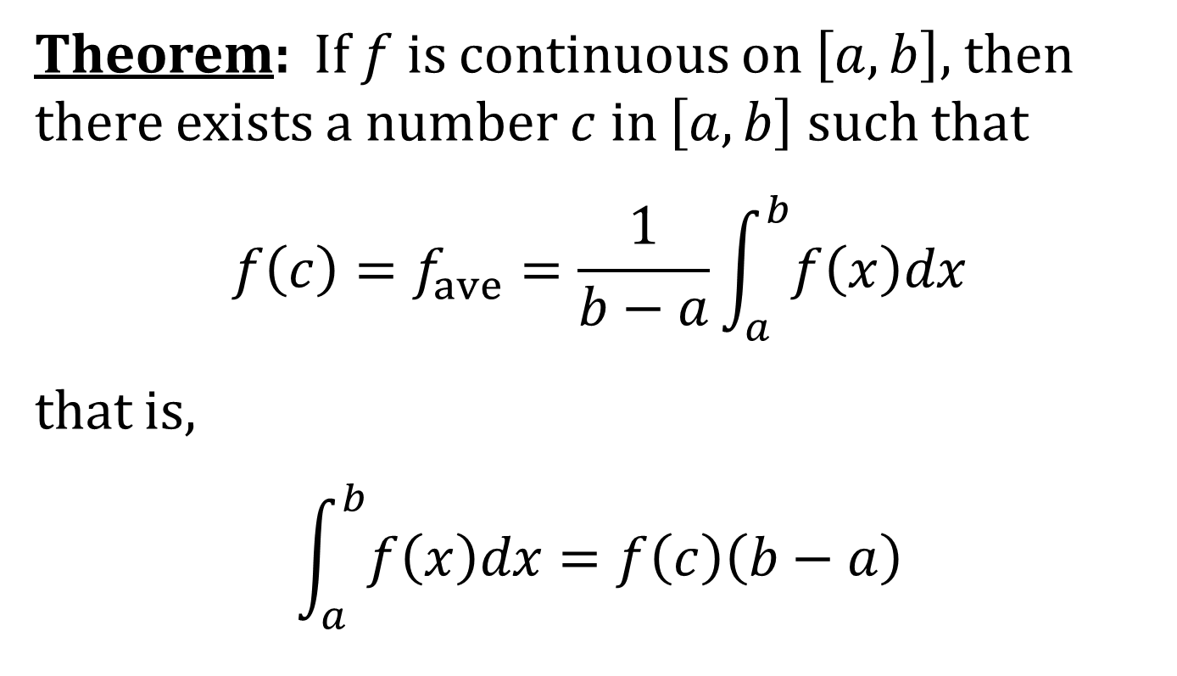
THE MEAN VALUE THEOREM FOR INTEGRALS
Theorem: If $f$ is continuous on $\left[a,b\right]$, then there exists a number $c$ in $\left[a,b\right]$ such that
$$f\left(c\right)=f_{ave}=\frac{1}{b−a}\int_{a}^{b}{f\left(x\right)dx}$$
that is,
$$\int_{a}^{b}{f\left(x\right)dx}=f\left(c\right)\left(b−a\right)$$

