Slide 1
Section 5.2
Volumes

Slide 2
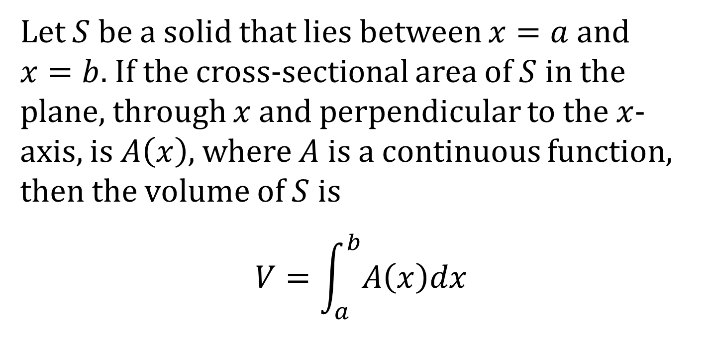
DEFINITION OF VOLUME USING VERTICAL SLICES
Let $S$ be a solid that lies between $x=a$ and $x=b$. If the cross-sectional area of $S$ in the plane, through $x$ and perpendicular to the $x$-axis, is $A\left(x\right)$, where $A$ is a continuous function, then the volume of $S$ is
$$V=\int_{a}^{b}{A\left(x\right)dx}$$

Slide 3
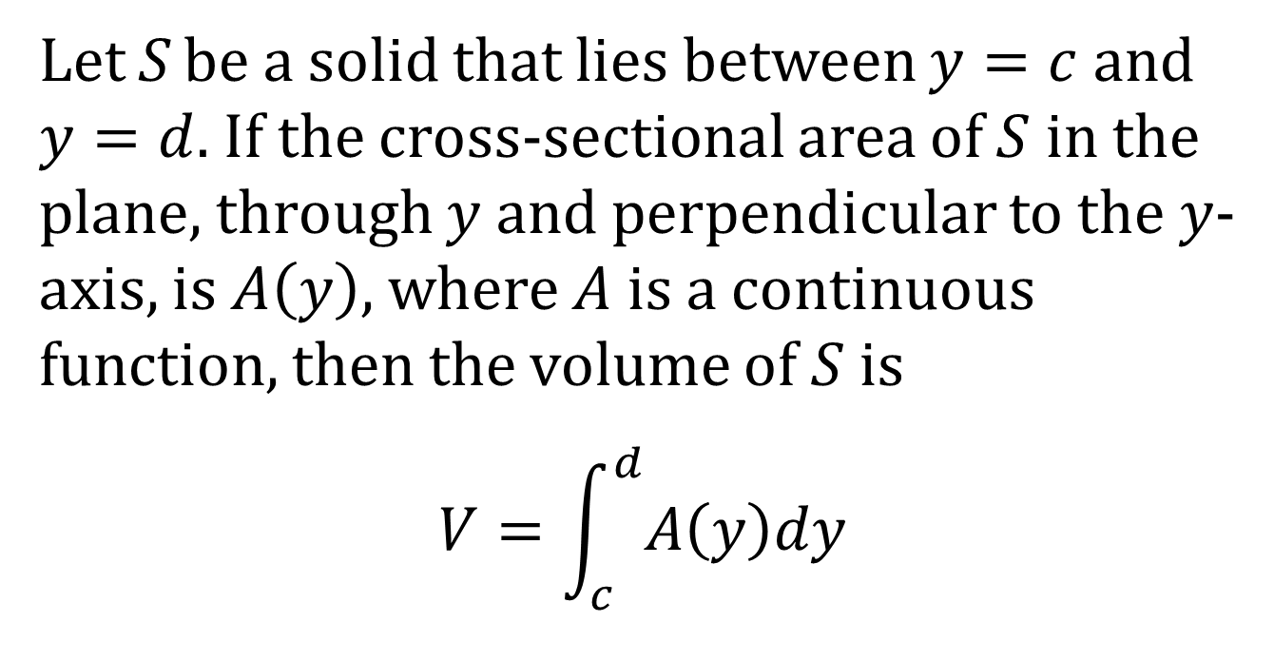
DEFINITION OF VOLUME USING HORIZONTAL SLICES
Let S be a solid that lies between $y=c$ and $y=d$. If the cross-sectional area of $S$ in the plane, through $y$ and perpendicular to the $y$-axis, is $A\left(y\right)$, where $A$ is a continuous function, then the volume of $S$ is
$$V=\int_{c}^{d}{A\left(y\right)dy}$$

Slide 4
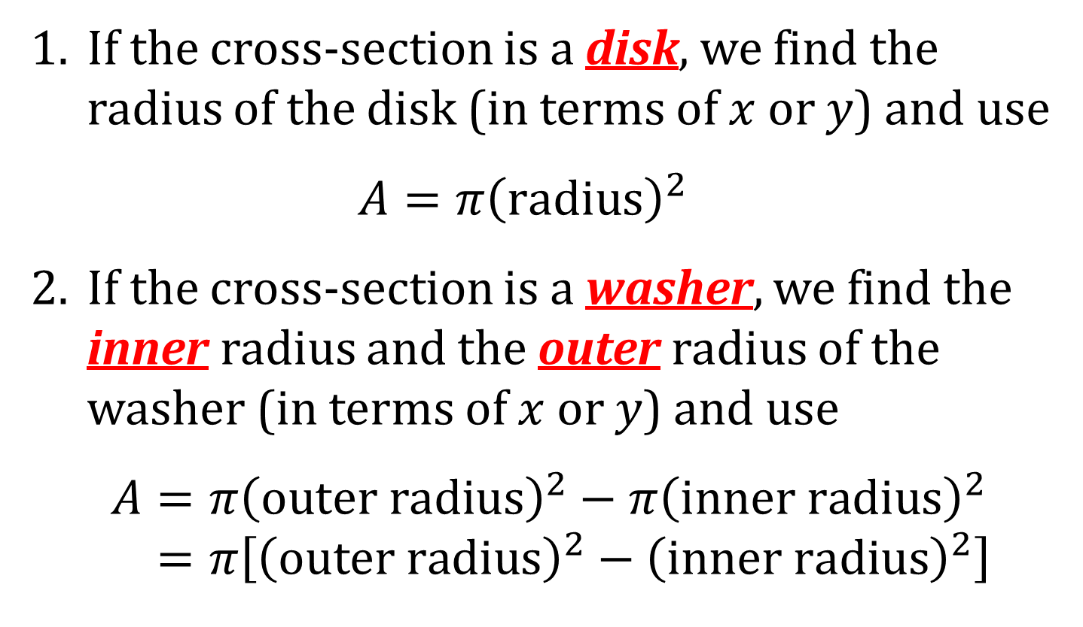
SOME USEFUL AREAS
1. If the cross-section is a disk, we find the radius of the disk (in terms of $x$ or $y$) and use
$$A=π{\left(radius\right)}^{2}$$
2. If the cross-section is a washer, we find the inner radius and the outer radius of the washer (in terms of $x$ or $y$) and use
$$A=π{\left(outer radius\right)}^{2}−π{\left(inner radius\right)}^{2} \\ =π\left[{\left(outer radius\right)}^{2}−{\left(inner radius\right)}^{2}\right]$$

Slide 5
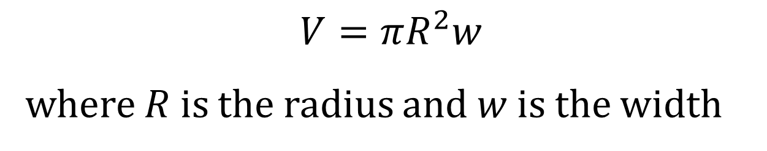
VOLUME OF A DISK
$$V=πR^{2}w$$
where $R$ is the radius and $w$ is the width

Slide 6
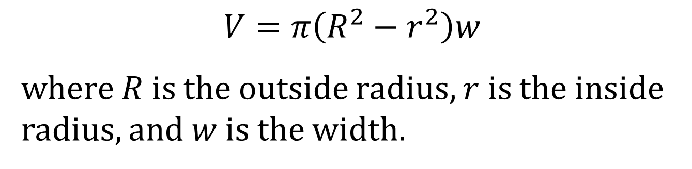
VOLUME OF A WASHER
$$V=π\left(R^{2}−r^{2}\right)w$$
where $R$ is the outside radius, $r$ is the inside radius, and $w$ is the width.

Slide 7
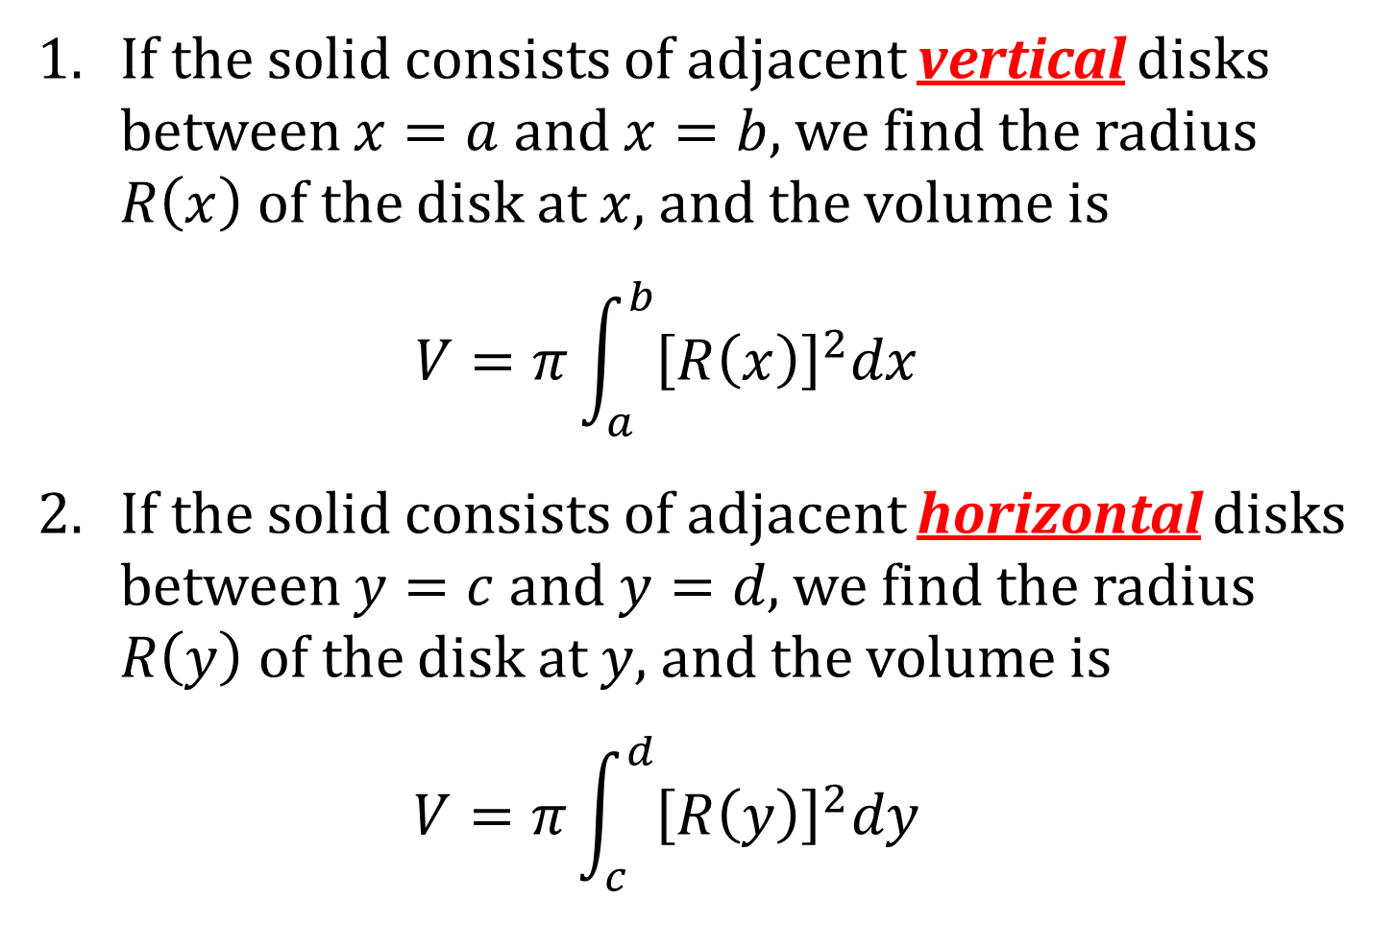
VOLUME BY DISKS
1. If the solid consists of adjacent vertical disks between $x=a$ and $x=b$, we find the radius $R\left(x\right)$ of the disk at $x$, and the volume is
$$V=π\int_{a}^{b}{{\left[R\left(x\right)\right]}^{2}dx}$$
2. If the solid consists of adjacent horizontal disks between $y=c$ and $y=d$, we find the radius $R\left(y\right)$ of the disk at $y$, and the volume is
$$V=π\int_{c}^{d}{{\left[R\left(y\right)\right]}^{2}dy}$$

Slide 8
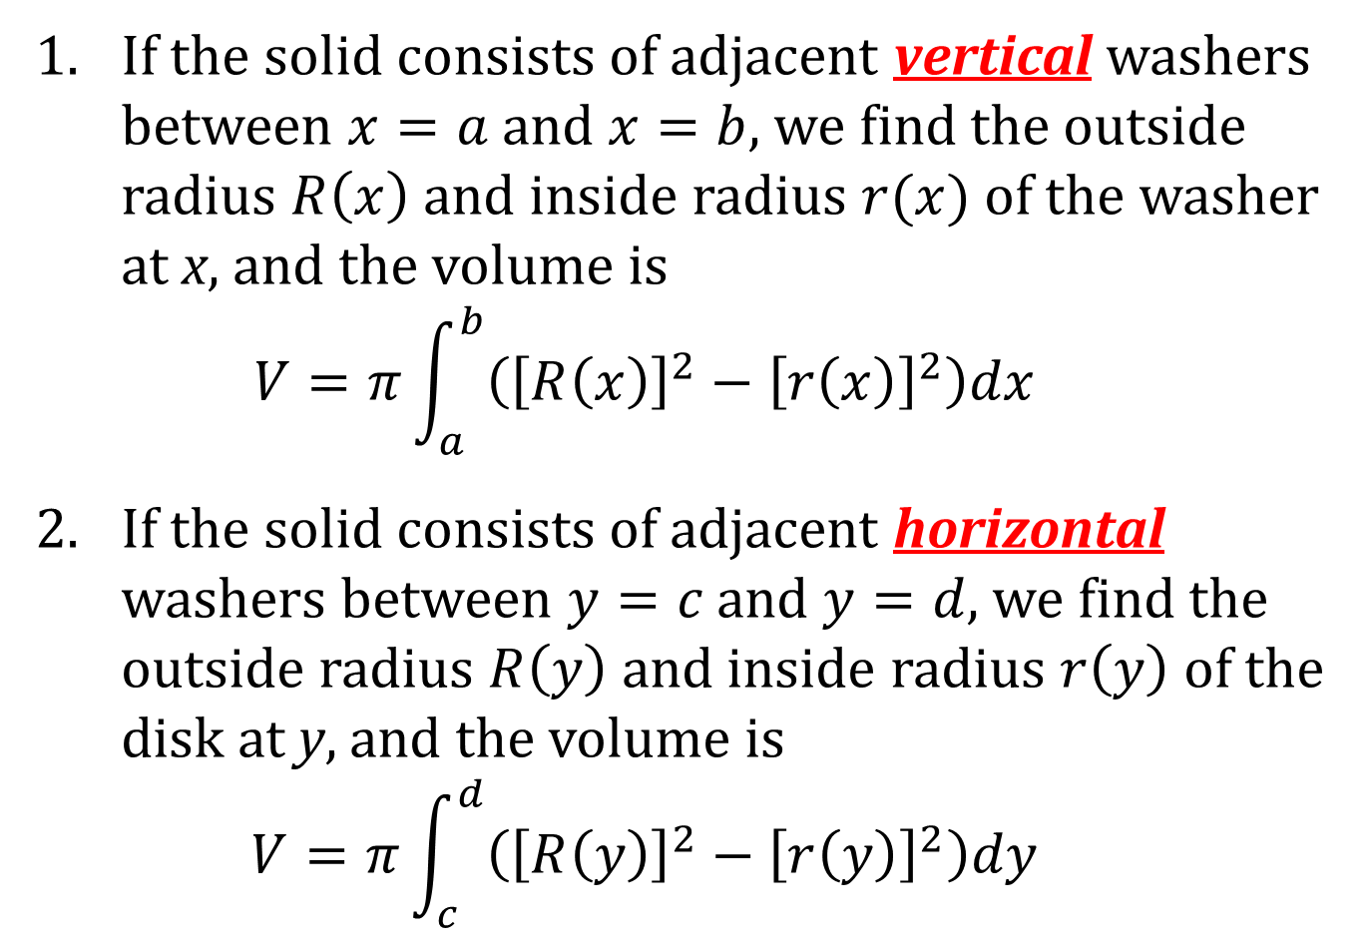
VOLUME BY WASHERS
1. If the solid consists of adjacent vertical washers between $x=a$ and $x=b$, we find the outside radius $R\left(x\right)$ and inside radius $r(x)$ of the washer at x, and the volume is
$$V=π\int_{a}^{b}{\left({\left[R\left(x\right)\right]}^{2}−{\left[r\left(x\right)\right]}^{2}\right)dx}$$
2. If the solid consists of adjacent horizontal washers between $y=c$ and $y=d$, we find the outside radius $R\left(y\right)$ and inside radius $r\left(y\right)$ of the disk at y, and the volume is
$$V=π\int_{c}^{d}{\left({\left[R\left(y\right)\right]}^{2}−{\left[r\left(y\right)\right]}^{2}\right)dy}$$

Slide 9
PROCEDURE FOR FINDING VOLUMES BY THE METHOD OF DISKS
Sketch the region. Label intersection points.
Draw a slice and label the outside radius, inside radius (if necessary), and width.
Sum the volume of all disks (or washers); that is, set up and evaluate a definite integral.

