Slide 1
Section 5.1
Area Between Curves

Slide 2
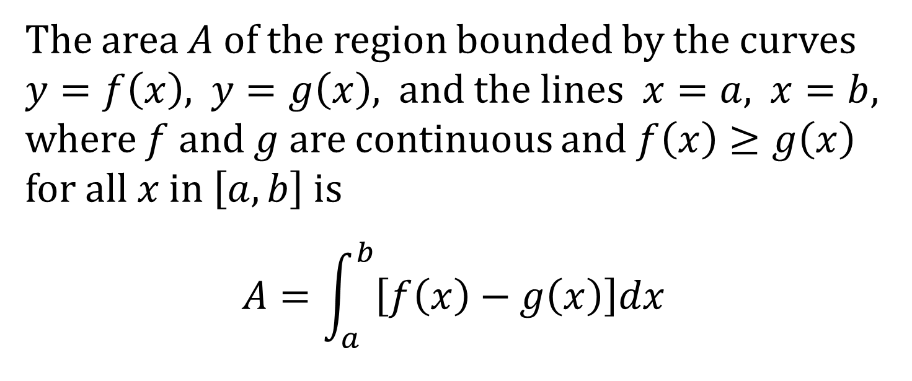
AREA BETWEEN CURVES USING VERTICAL SLICES, PART 1
The area $A$ of the region bounded by the curves $y=f\left(x\right)$, $y=g\left(x\right)$, and the lines $x=a$, $x=b$, where $f$ and $g$ are continuous and $f\left(x\right)≥g\left(x\right)$ for all $x$ in $\left[a,b\right]$ is
$$A=\int_{a}^{b}{\left[f\left(x\right)−g\left(x\right)\right]dx}$$

Slide 3
PROCEDURE FOR FINDING THE AREA
Sketch the region. Label intersection points, if any.
Slice it into thin pieces (rectangles); label a typical piece.
Sum the areas of all the rectangles; that is, set up and evaluate a definite integral.

Slide 4
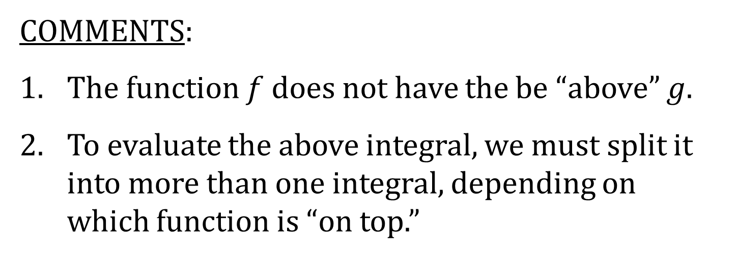
AREA BETWEEN CURVES USING VERTICAL SLICES, PART 2
The area between the curves $y=f(x)$ and $y=g(x)$ and between $x=a$ and $x=b$ is
$$A=\int_{a}^{b}{\left|f\left(x\right)−g\left(x\right)\right|dx}$$
COMMENTS:
1. The function $f$ does not have the be “above” $g$.
2. To evaluate the above integral, we must split it into more than one integral, depending on which function is “on top.”

Slide 5
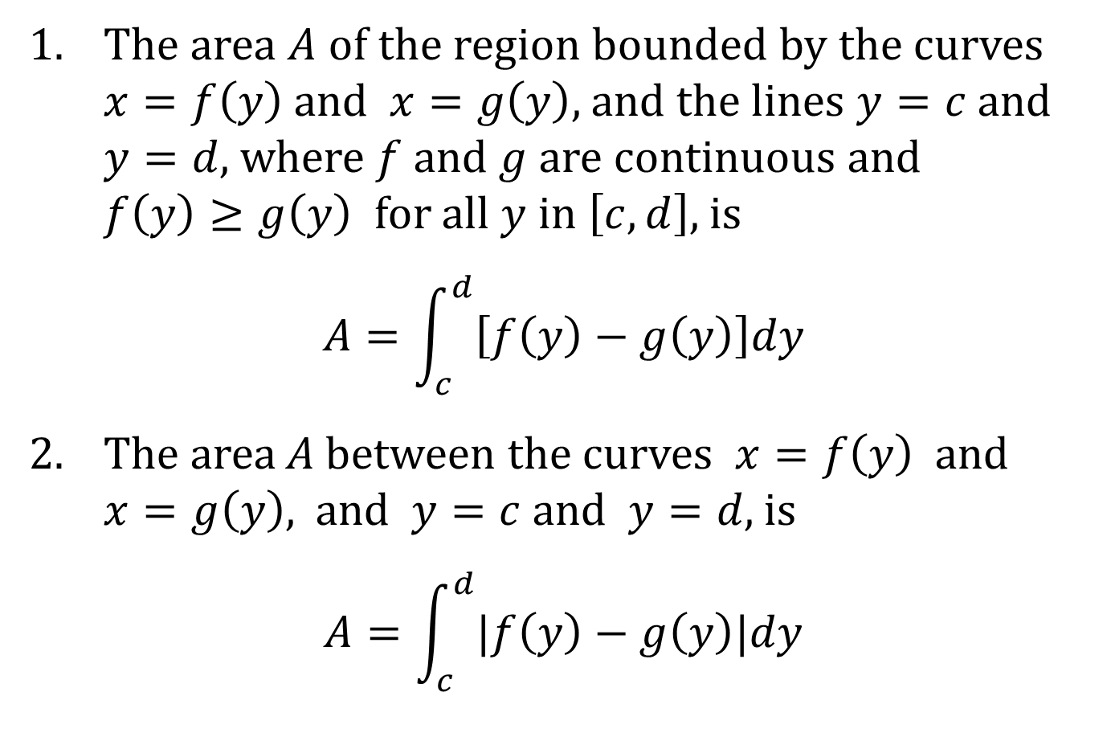
AREA BETWEEN CURVES USING HORIZONTAL SLICES
1. The area $A$ of the region bounded by the curves $x=f\left(y\right)$ and $x=g\left(y\right)$, and the lines $y=c$ and $y=d$, where $f$ and $g$ are continuous and $f\left(y\right)≥g\left(y\right)$ for all $y$ in $\left[c,d\right]$, is
$$A=\int_{c}^{d}{\left[f\left(y\right)−g\left(y\right)\right]dy}$$
2. The area A between the curves $x=f\left(y\right)$ and $x=g\left(y\right)$, and $y=c$ and $y=d$, is
$$A=\int_{c}^{d}{|f\left(y\right)−g\left(y\right)|dy}$$

