Slide 1
Section 4.5
The Substitution Rule

Slide 2
FINDING ANTIDERIVATIVES
Because of the Fundamental Theorem, it is important to be able to find antiderivatives. However, most antiderivatives are not easy to find. For example,
$$\int{4x^{3}\sqrt{1+x^{4}}dx}$$
To do this, we need something extra. We change from the old variable to a new variable through the use of differentials.

Slide 3
SUBSTITUTION
The process performed on the last problem is called u-substitution or simply substitution.

Slide 4
Substitution will work anytime we have a composite function with the derivative of the “inside” function multiplied; that is, when we have the form
$$\int{f\left(g\left(x\right)\right)g^{′}\left(x\right)dx}$$
If $F′(x)=f(x)$, then
$$\int{F^{′}\left(g\left(x\right)\right)g^{′}\left(x\right)dx}=F\left(g\left(x\right)\right)+C$$

Slide 5
THE SUBSTITUTION RULE
Theorem: If $u=g\left(x\right)$ is a differentiable function whose range is an interval I and $f$ is continuous on I, then
$$\int{f\left(g\left(x\right)\right)g^{′}\left(x\right)dx}=\int{f\left(u\right)du}$$
The Substitution Rule says: It is permissible to operate with $dx$ and $du$ after the integral as if they were differentials.

Slide 6
THE SUBSTITUTION RULE FOR DEFINITE INTEGRALS
Theorem: If $g′$ is continuous on $\left[a, b\right]$ and $f$ is continuous on the range of $u=g\left(x\right)$, then
$$\int_{a}^{b}{f\left(g\left(x\right)\right)g^{′}\left(x\right)dx}=\int_{g\left(a\right)}^{g\left(b\right)}{f\left(u\right)du}$$

Slide 7
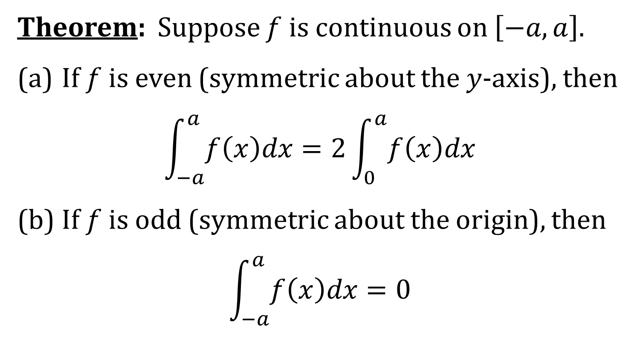
INTEGRALS OF SYMMETRIC FUNCTIONS
Theorem: Suppose $f$ is continuous on $\left[−a, a\right]$.
(a) If $f$ is even (symmetric about the $y$-axis), then
$$\int_{−a}^{a}{f\left(x\right)dx}=2\int_{0}^{a}{f\left(x\right)dx}$$
(b) If $f$ is odd (symmetric about the origin), then
$$\int_{−a}^{a}{f\left(x\right)dx}=0$$

