Slide 1
Section 4.4
Indefinite Integrals and
the Net Change Theorem

Slide 2
INDEFINITE INTEGRALS
Recall from Section 3.9 that we used the notation $A_{x}f\left(x\right)$ to mean find the antiderivative of $f(x)$. However, this is not the most common notation for taking the antiderivative. The notation commonly used is
$$\int{f\left(x\right)dx}$$
Another name for the antiderivative is the indefinite integral.

Slide 3
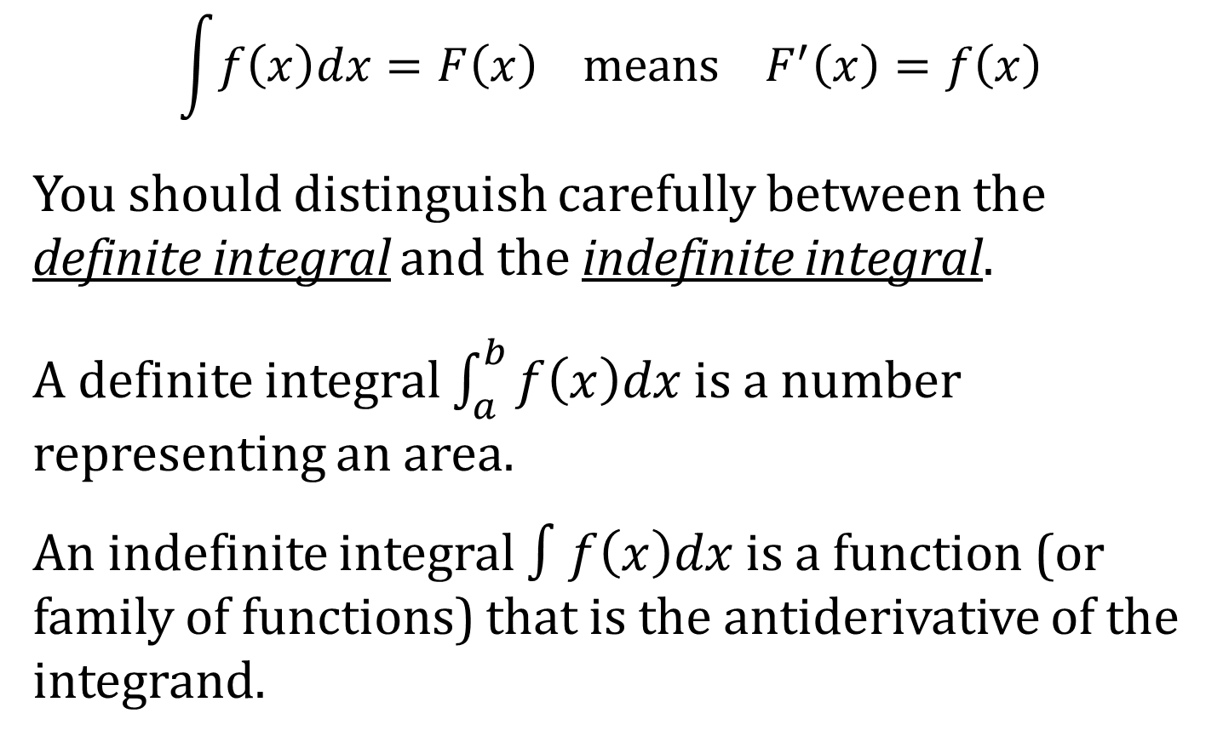
A REMARK ABOUT THE DEFINITE INTEGRAL
$$\int{f\left(x\right)dx}=F\left(x\right) means F^{′}\left(x\right)=f\left(x\right)$$
You should distinguish carefully between the definite integral and the indefinite integral.
A definite integral $\int_{a}^{b}{f\left(x\right)dx}$ is a number representing an area.
An indefinite integral $∫f\left(x\right)dx$ is a function (or family of functions) that is the antiderivative of the integrand.

Slide 4
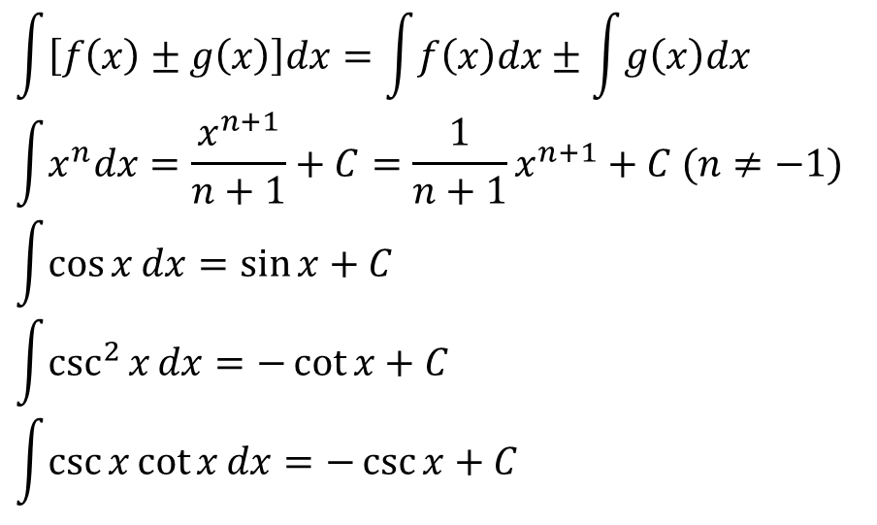
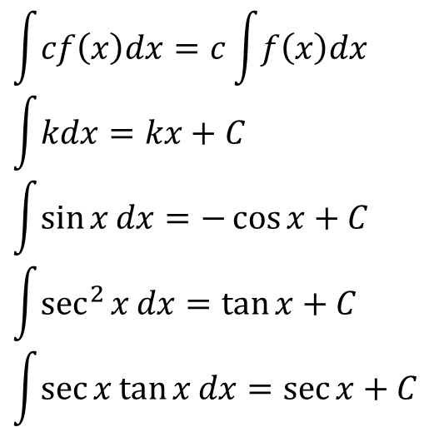
INDEFINITE INTEGRAL FORMULAS
$$\int{cf\left(x\right)dx}=c\int{f\left(x\right)dx}$$
$$\int{kdx}=kx+C$$
$$\int{\sin{x}dx}=−\cos{x}+C$$
$$\int{\sec^{2}{x}dx}=\tan{x}+C$$
$$\int{\sec{x}\tan{x}dx}=\sec{x}+C$$
$$\int{\left[f\left(x\right)±g\left(x\right)\right]dx}=\int{f\left(x\right)dx}±\int{g\left(x\right)dx}$$
$$\int{x^{n}dx}=\frac{x^{n+1}}{n+1}+C=\frac{1}{n+1}x^{n+1}+C (n≠−1)$$
$$\int{\cos{x}dx}=\sin{x}+C$$
$$\int{\csc^{2}{x}dx}=−\cot{x}+C$$
$$\int{\csc{x}\cot{x}dx}=−\csc{x}+C$$

Slide 5
THE NET CHANGE THEOREM
Theorem: The integral of a rate of change is the net change; that is,
$$\int_{a}^{b}{F^{′}\left(x\right)dx}=F\left(b\right)−F\left(a\right)$$

