Slide 1
Section 4.3
The Fundamental Theorem of Calculus

Slide 2
A FUNCTION DEFINED BY A DEFINITE INTEGRAL
The first part of the Fundamental Theorem of Calculus deals with functions defined by a definite integral.
Let $f\left(t\right)$ be a continuous function defined on the interval $\left[a,b\right]$. If x varies between $a$ and $b$, we can define the function $g$ by
$$g\left(x\right)=\int_{a}^{x}{f\left(t\right)dt}$$
The function $g$ is sometimes called an accumulation function since gives the “area accumulated so far.”

Slide 3
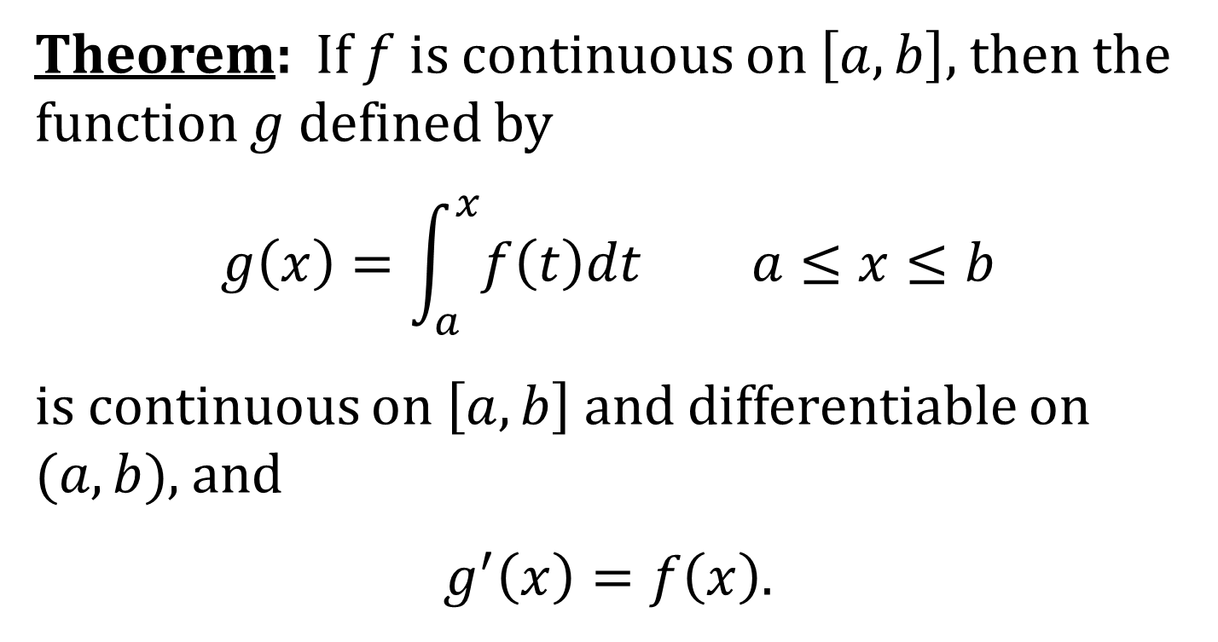
THE FUNDAMENTAL THEOREM OF CALCULUS, PART 1 (FTC1)
Theorem: If $f$ is continuous on $\left[a,b\right]$, then the function $g$ defined by
$$g\left(x\right)=\int_{a}^{x}{f\left(t\right)dt} a≤x≤b$$
is continuous on $\left[a,b\right]$ and differentiable on $(a,b)$, and
$g^{′}\left(x\right)=f\left(x\right)$.

Slide 4
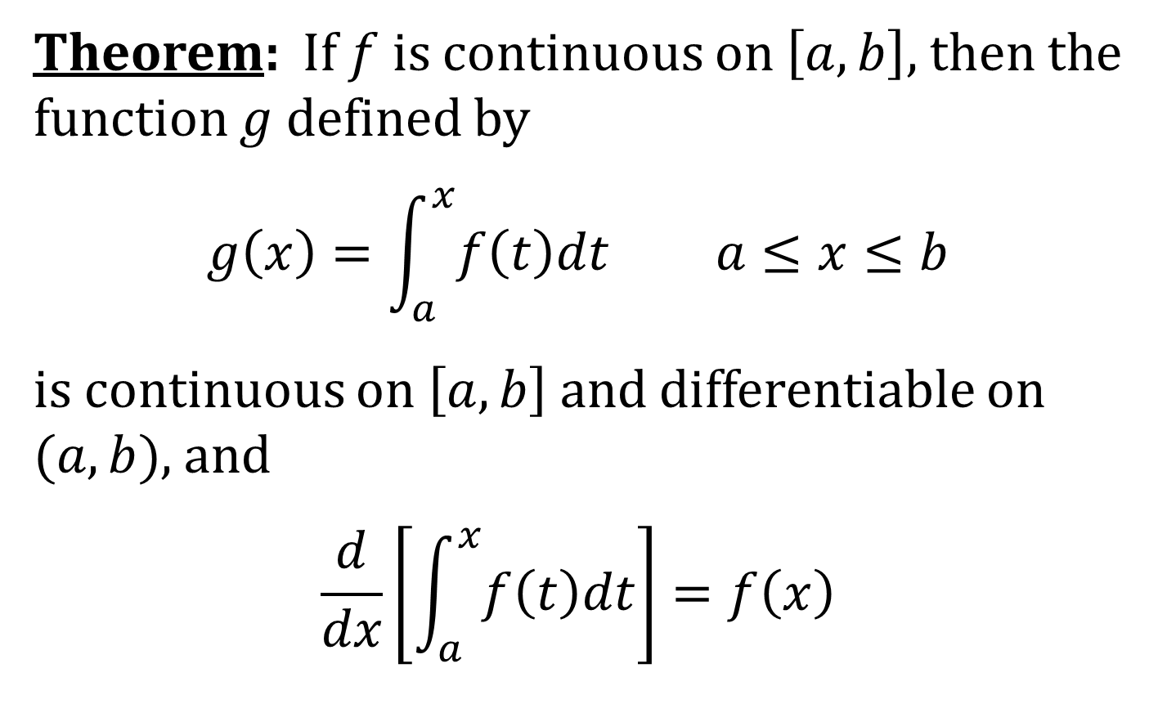
FTC1 IN LEIBNIZ NOTATION
Theorem: If $f$ is continuous on $\left[a,b\right]$, then the function $g$ defined by
$$g\left(x\right)=\int_{a}^{x}{f\left(t\right)dt} a≤x≤b$$
is continuous on $\left[a,b\right]$ and differentiable on $(a,b)$, and
$$\frac{d}{dx}\left[\int_{a}^{x}{f\left(t\right)dt}\right]=f\left(x\right)$$

Slide 5
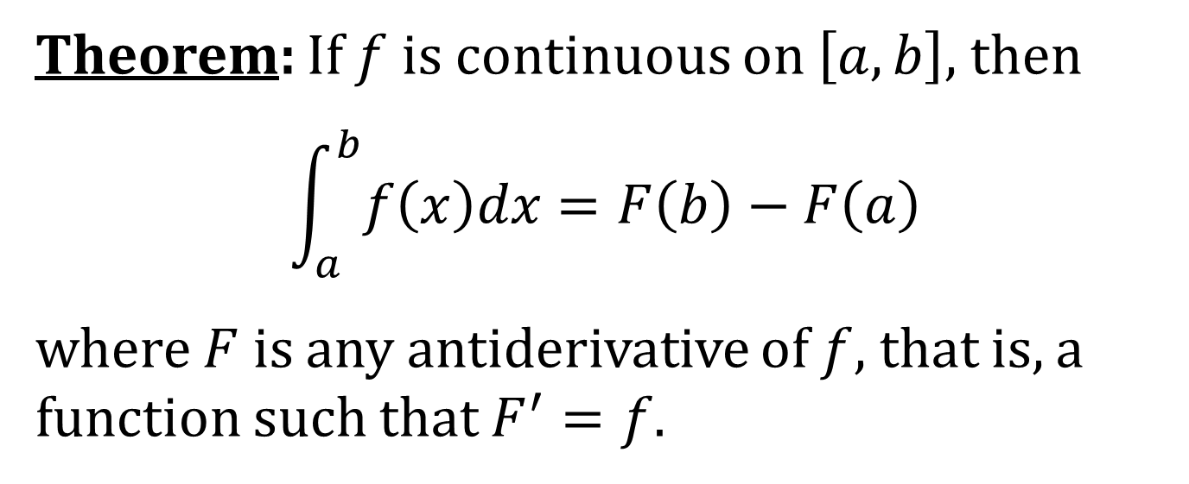
THE FUNDAMENTAL THEOREM OF CALCULUS, PART 2 (FTC2)
Theorem: If $f$ is continuous on $\left[a,b\right]$, then
$$\int_{a}^{b}{f\left(x\right)dx}=F\left(b\right)−F\left(a\right)$$
where $F$ is any antiderivative of $f$, that is, a function such that $F^{′}=f$.

Slide 6
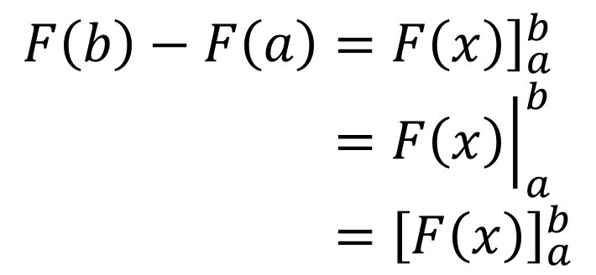
NOTATIONS FOR F(b) − F(a)
$$F\left(b\right)−F\left(a\right)={\left.F\left(x\right)\right]}_{a}^{b} \\ ={\left.F\left(x\right)\right|}_{a}^{b} \\ ={\left[F\left(x\right)\right]}_{a}^{b}$$

Slide 7
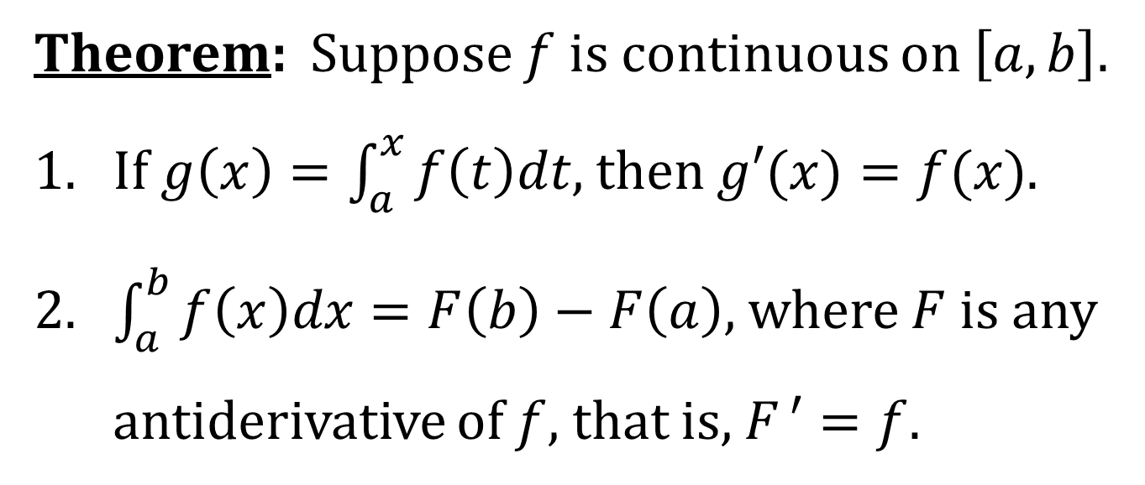
THE FUNDAMENTAL THEOREM OF CALCULUS
Theorem: Suppose $f$ is continuous on $\left[a, b\right]$.
1. If $g\left(x\right)=\int_{a}^{x}{f\left(t\right)dt}$, then $g′(x)=f(x)$.
2. $\int_{a}^{b}{f\left(x\right)dx}=F\left(b\right)−F\left(a\right)$, where $F$ is any
antiderivative of $f$, that is, $F ′=f$.

