Slide 1
Section 4.2
The Definite Integral

Slide 2
THE DEFINITE INTEGRAL
If $f$ is a function defined for $a≤x≤b$, we divide the interval $[a, b]$ into $n$ subintervals of equal width $Δx=\frac{b−a}{n}$. We let $a=x_{0},x_{1},x_{2},x_{3},…,x_{n}=b$ be the endpoints of these subintervals and we let $x_{1}^{∗},x_{2}^{∗}, …,x_{n}^{∗}$ be any sample points in these subintervals, so that $x_{i}^{∗}$ lies in the $i$th subinterval $\left[x_{i−1},x_{i}\right]$. Then the definite integral of $f$ from $a$ to $b$ is
$$\int_{a}^{b}{f\left(x\right)dx}=\lim_{n→∞}{\sum_{i=1}^{n}{f\left(x_{i}^{∗}\right)Δx}}$$

Slide 3
REMARKS
The symbol ∫ is called an integral sign.
In the notation $\int_{a}^{b}{f\left(x\right)dx}$, $f\left(x\right)$ is called the integrand, and $a$ and $b$ are called the limits of integration; $a$ is the lower limit and $b$ is the upper limit.
The symbol $dx$ has no official meaning by itself; $\int_{a}^{b}{f\left(x\right)dx}$ is all one symbol.
The procedure of calculating an integral is called integration.

Slide 4
THE RIEMANN SUM
The sum
$$\sum_{i=1}^{n}{f\left(x_{i}^{∗}\right)Δx}$$
from the definition of the definite integral is called a Riemann sum after the German mathematician Bernhard Riemann.

Slide 5
FUNCTIONS THAT ARE INTEGRABLE
Theorem: If $f$ is a continuous function on $\left[a,b\right]$, or if $f$ has only a finite number of jump discontinuities, then $f$ is integrable on $\left[a, b\right]$; that is, the definite integral $\int_{a}^{b}{f\left(x\right)dx}$ exists.

Slide 6
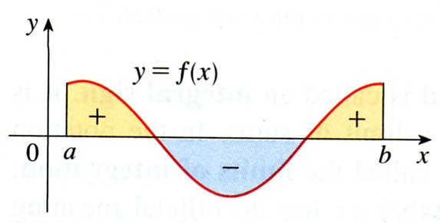
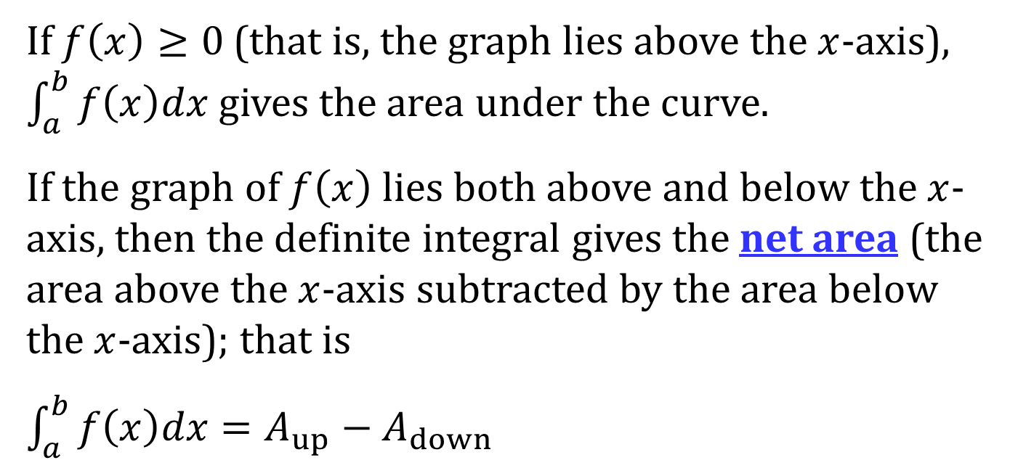
NET AREA
If $f\left(x\right)≥0$ (that is, the graph lies above the $x$-axis), $\int_{a}^{b}{f\left(x\right)dx}$ gives the area under the curve.
If the graph of $f\left(x\right)$ lies both above and below the $x$-axis, then the definite integral gives the net area (the area above the $x$-axis subtracted by the area below the $x$-axis); that is
$\int_{a}^{b}{f\left(x\right)dx}=A_{up}−A_{down}$

Slide 7
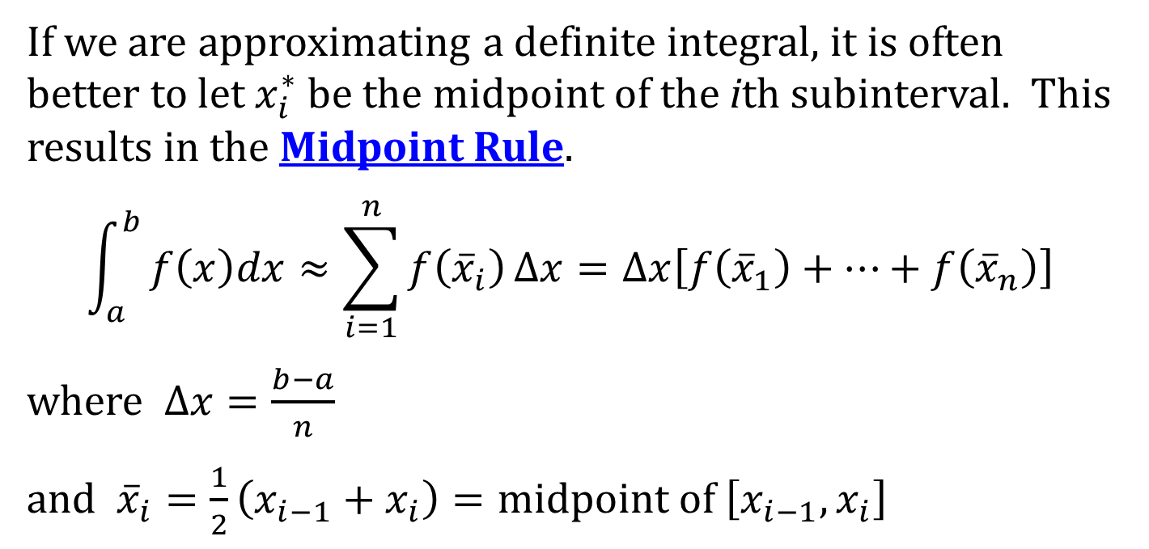
THE MIDPOINT RULE
If we are approximating a definite integral, it is often better to let $x_{i}^{∗}$ be the midpoint of the ith subinterval. This results in the Midpoint Rule.
$$\int_{a}^{b}{f\left(x\right)dx≈\sum_{i=1}^{n}{f\left({\overline{x}}_{i}\right)}Δx}=Δx\left[f\left({\overline{x}}_{1}\right)+⋯+f\left({\overline{x}}_{n}\right)\right]$$
where $Δx=\frac{b−a}{n}$
and ${\overline{x}}_{i}=\frac{1}{2}\left(x_{i−1}+x_{i}\right)=midpoint of \left[x_{i−1}, x_{i}\right]$

Slide 8
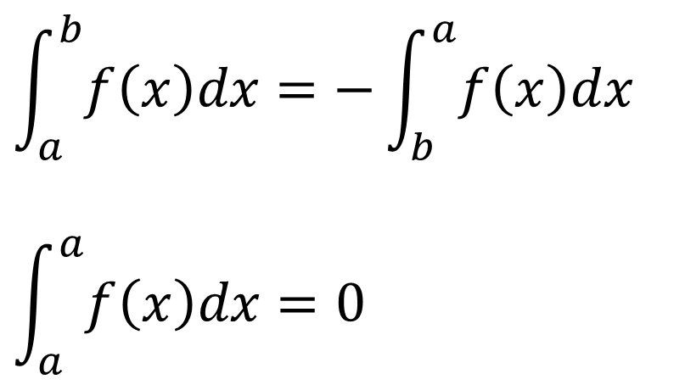
BASIC PROPERTIES OF THE DEFINITE INTEGRAL
$$\int_{a}^{b}{f\left(x\right)dx}=−\int_{b}^{a}{f\left(x\right)dx}$$
$$\int_{a}^{a}{f\left(x\right)dx}=0$$

Slide 9
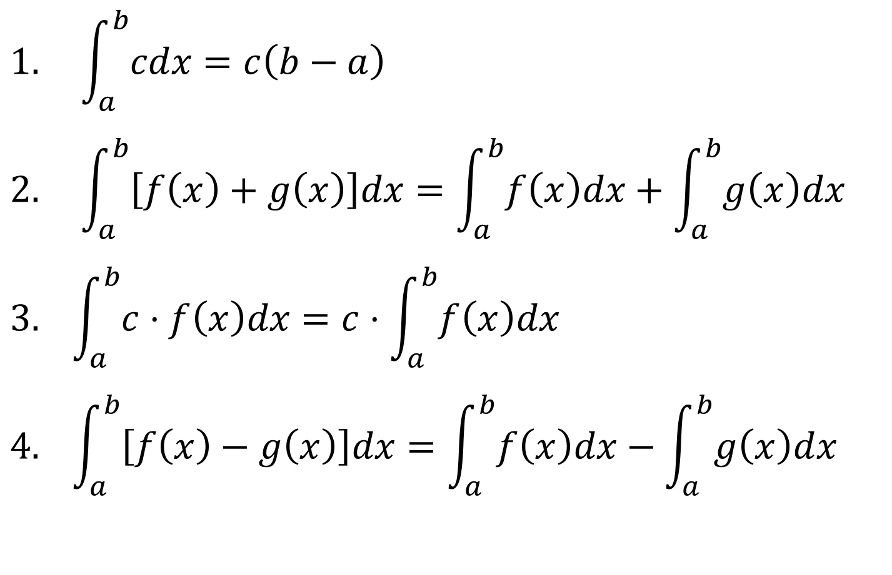
CONSTANT MULTIPLE AND ADDITION/SUBTRACTION PROPERTIES
$$1. \int_{a}^{b}{cdx}=c\left(b−a\right)$$
$$2. \int_{a}^{b}{\left[f\left(x\right)+g\left(x\right)\right]dx}=\int_{a}^{b}{f\left(x\right)dx}+\int_{a}^{b}{g\left(x\right)dx}$$
$$3. \int_{a}^{b}{c⋅f\left(x\right)dx}=c⋅\int_{a}^{b}{f\left(x\right)dx}$$
$$4. \int_{a}^{b}{\left[f\left(x\right)−g\left(x\right)\right]dx}=\int_{a}^{b}{f\left(x\right)dx}−\int_{a}^{b}{g\left(x\right)dx}$$

Slide 10
INTERVAL ADDITIVITY PROPERTY
$$5. \int_{a}^{c}{f\left(x\right)dx}+\int_{c}^{b}{f\left(x\right)dx}=\int_{a}^{b}{f\left(x\right)dx}$$

Slide 11
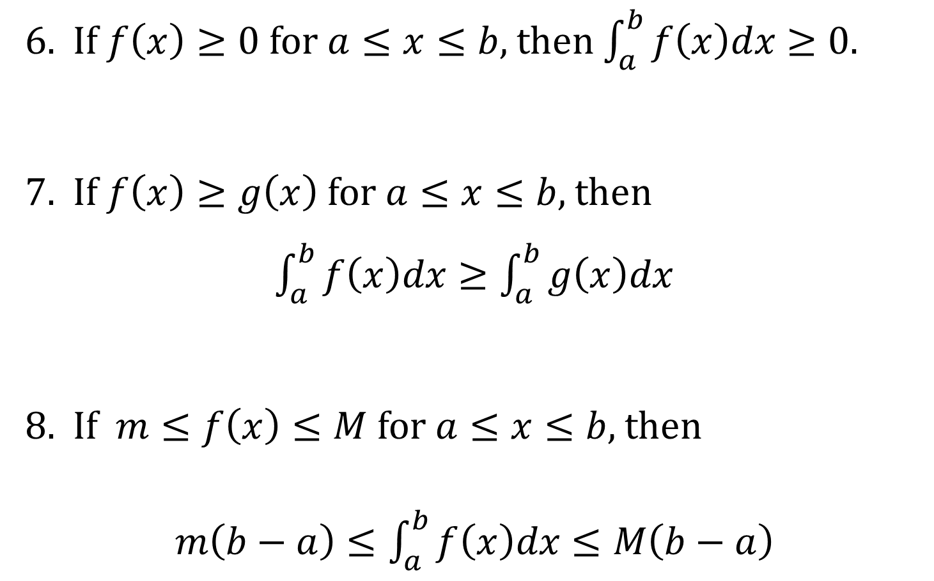
COMPARISON PROPERTIES
6. If $f\left(x\right)≥0$ for $a≤x≤b$, then $\int_{a}^{b}{f\left(x\right)dx}≥0$.
7. If $f\left(x\right)≥g\left(x\right)$ for $a≤x≤b$, then
$\int_{a}^{b}{f\left(x\right)dx}≥\int_{a}^{b}{g\left(x\right)dx}$
8. If $m≤f\left(x\right)≤M$ for $a≤x≤b$, then
$m\left(b−a\right)≤\int_{a}^{b}{f\left(x\right)dx}≤M\left(b−a\right)$

