Slide 1
Section 4.1
Areas and Distances

Slide 2
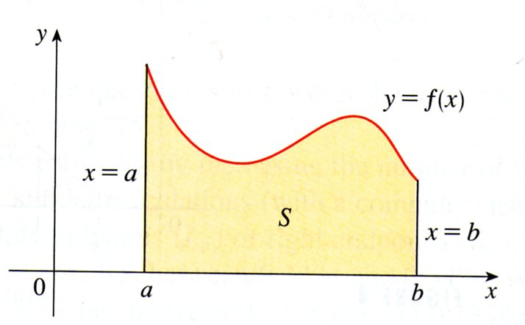
THE AREA PROBLEM
The area problem is to find the area of the region S that lies under the curve $y=f\left(x\right)$ from $a$ to $b$. See the figure below.

Slide 3
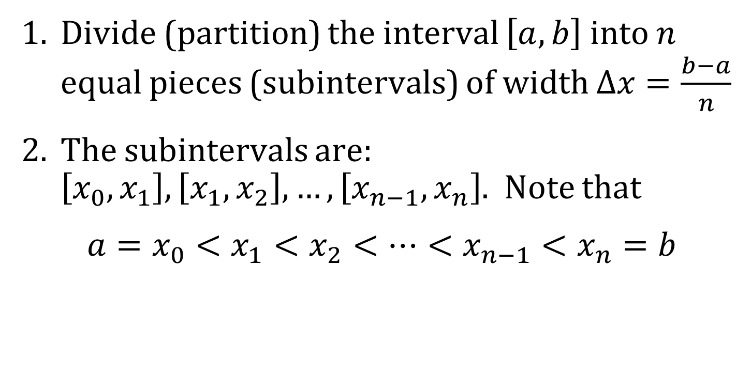
FINDING THE AREA UNDER A CURVE
1. Divide (partition) the interval $\left[a, b\right]$ into $n$ equal pieces (subintervals) of width $Δx=\frac{b−a}{n}$
2. The subintervals are: $\left[x_{0},x_{1}\right], \left[x_{1},x_{2}\right], …,\left[x_{n−1},x_{n}\right]$. Note that
$$a=x_{0}<x_{1}<x_{2}<⋯<x_{n−1}<x_{n}=b$$

Slide 4
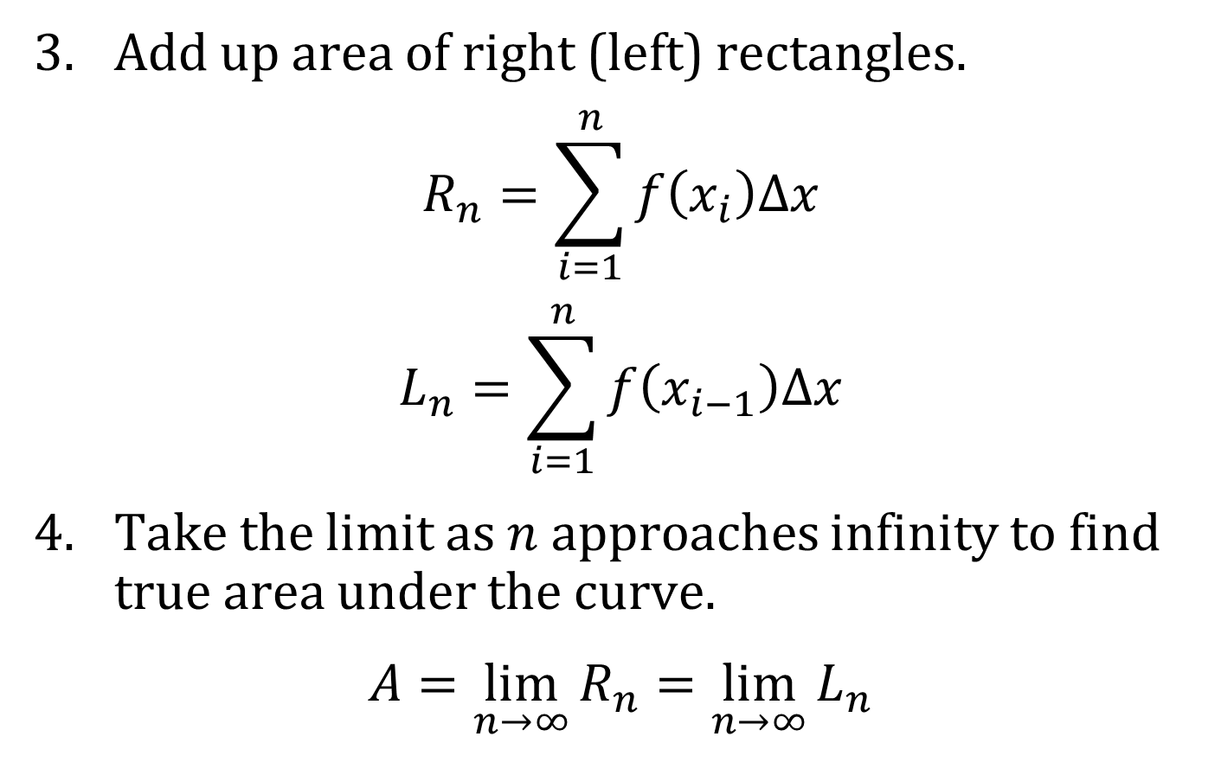
AREA (CONTINUED)
3. Add up area of right (left) rectangles.
$$R_{n}=\sum_{i=1}^{n}{f\left(x_{i}\right)Δx}$$
$$L_{n}=\sum_{i=1}^{n}{f\left(x_{i−1}\right)Δx}$$
4. Take the limit as $n$ approaches infinity to find true area under the curve.
$$A=\lim_{n→∞}{R_{n}}=\lim_{n→∞}{L_{n}}$$

Slide 5
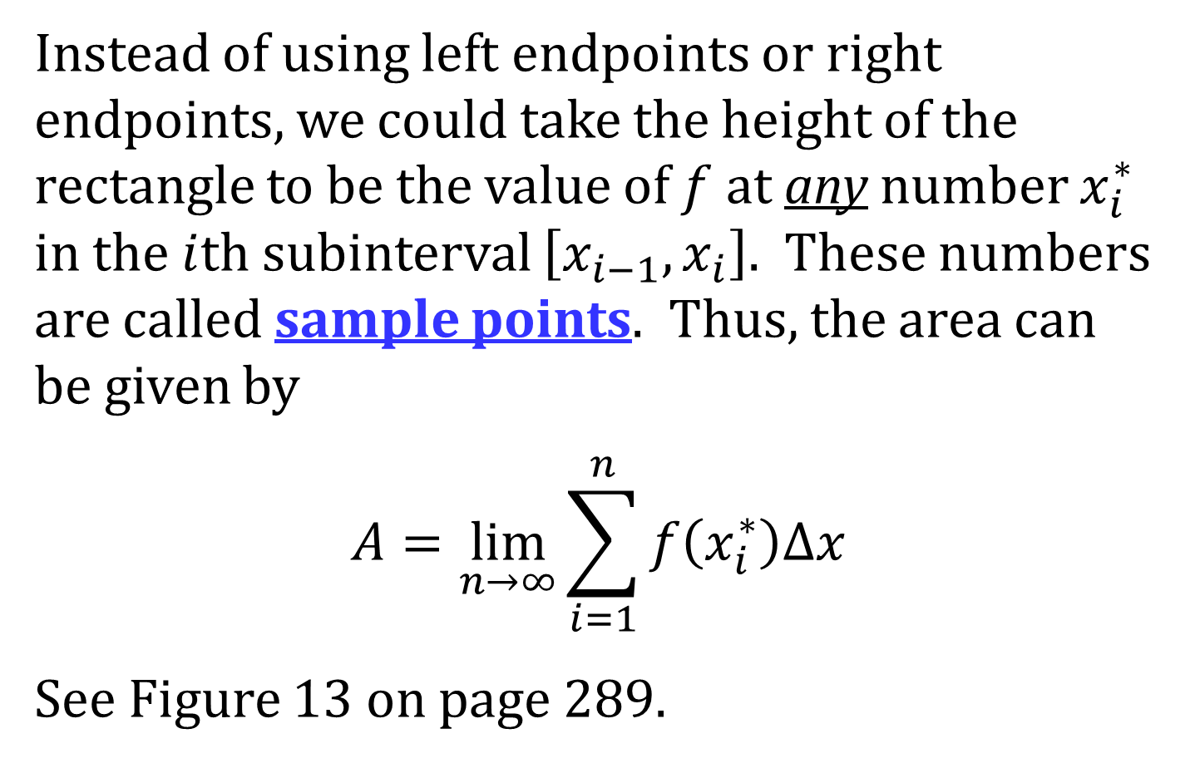
AREA
Instead of using left endpoints or right endpoints, we could take the height of the rectangle to be the value of $f$ at any number $x_{i}^{∗}$ in the $i$th subinterval $\left[x_{i−1},x_{i}\right]$. These numbers are called sample points. Thus, the area can be given by
$$A=\lim_{n→∞}{\sum_{i=1}^{n}{f\left(x_{i}^{∗}\right)Δx}}$$
See Figure 13 on page 289.

Slide 6
THE DISTANCE PROBLEM
The distance problem is to find the distance traveled by an object during a certain time period if the velocity of the object is known at all times.

Slide 7
EXAMPLE
Speedometer readings for a motorcycle at 12-second intervals are given in the table below. Find two estimates for the distance traveled by the motorcycle for this 60-second period.
$t$ (sec) | 0 | 12 | 24 | 36 | 48 | 60
$v$ (ft/sec) | 30 | 28 | 25 | 22 | 24 | 27

Slide 8
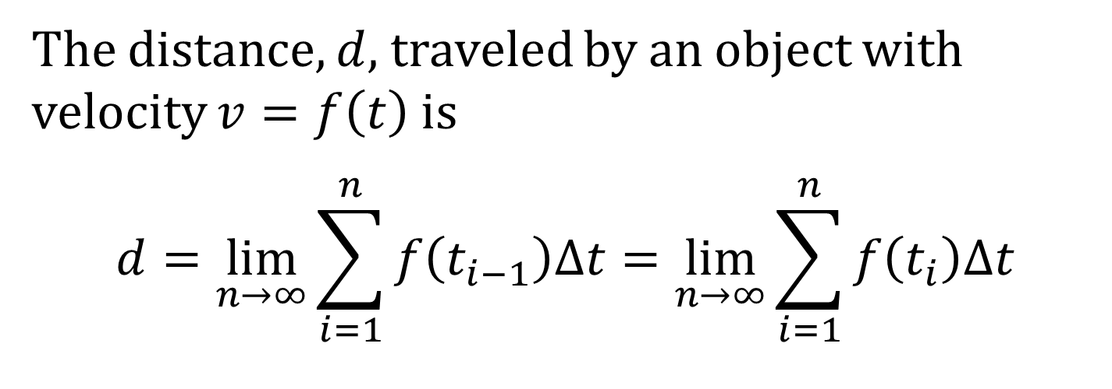
DISTANCE TRAVELED
The distance, $d$, traveled by an object with velocity $v=f\left(t\right)$ is
$$d=\lim_{n→∞}{\sum_{i=1}^{n}{f\left(t_{i−1}\right)Δt}}=\lim_{n→∞}{\sum_{i=1}^{n}{f\left(t_{i}\right)Δt}}$$

