Slide 1
Section 3.9
Antiderivatives

Slide 2
ANTIDERIVATIVES
Definition: A function $F$ is called an antiderivative of $f$ on the interval I if
$F^{′}\left(x\right)=f\left(x\right)$ for all $x$ in the interval I.

Slide 3
A NOTATION FOR THE ANTIDERIVATIVE
If the function $F\left(x\right)$ is an antiderivative of the function $f\left(x\right)$, we can use the following notation:
$$A_{x}f\left(x\right)=F\left(x\right)$$
For Example: Since $F\left(x\right)=x^{2}$ is an antiderivative of $f\left(x\right)=2x$, we can write
$$A_{x}\left(2x\right)=x^{2}$$

Slide 4
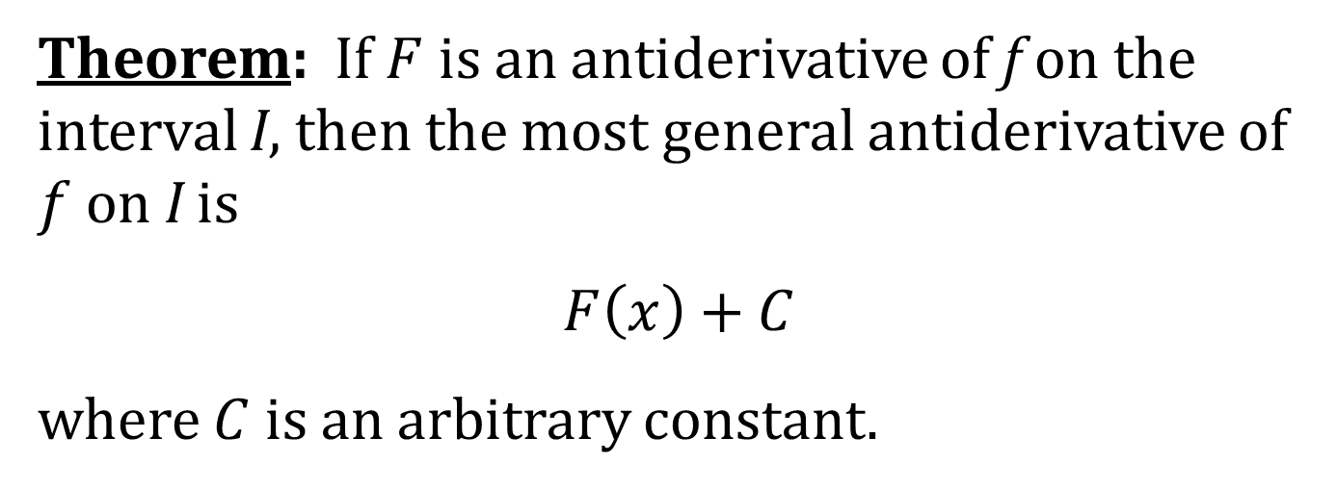
THE “GENERAL” ANTIDERIVATIVE
Theorem: If $F$ is an antiderivative of f on the interval I, then the most general antiderivative of $f$ on I is
$$F\left(x\right)+C$$
where $C$ is an arbitrary constant.
For Example: The most general antiderivative of $2x$ is $x^{2}+C$; that is,
$$A_{x}\left(2x\right)=x^{2}+C$$

Slide 5
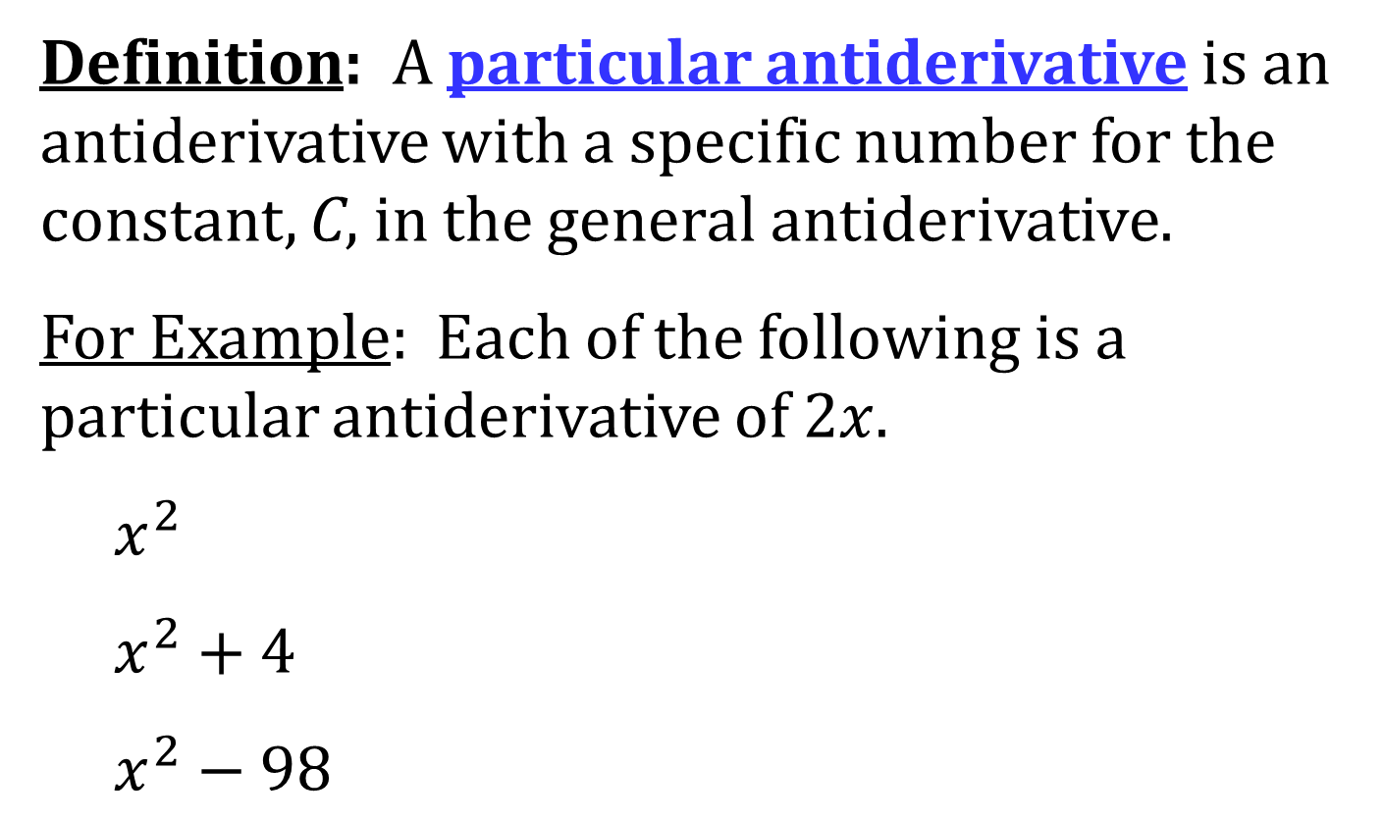
PARTICULAR ANTIDERIVATIVES
Definition: A particular antiderivative is an antiderivative with a specific number for the constant, C, in the general antiderivative.
For Example: Each of the following is a particular antiderivative of $2x$.
$x^{2}$
$x^{2}+4$
$x^{2}−98$

Slide 6
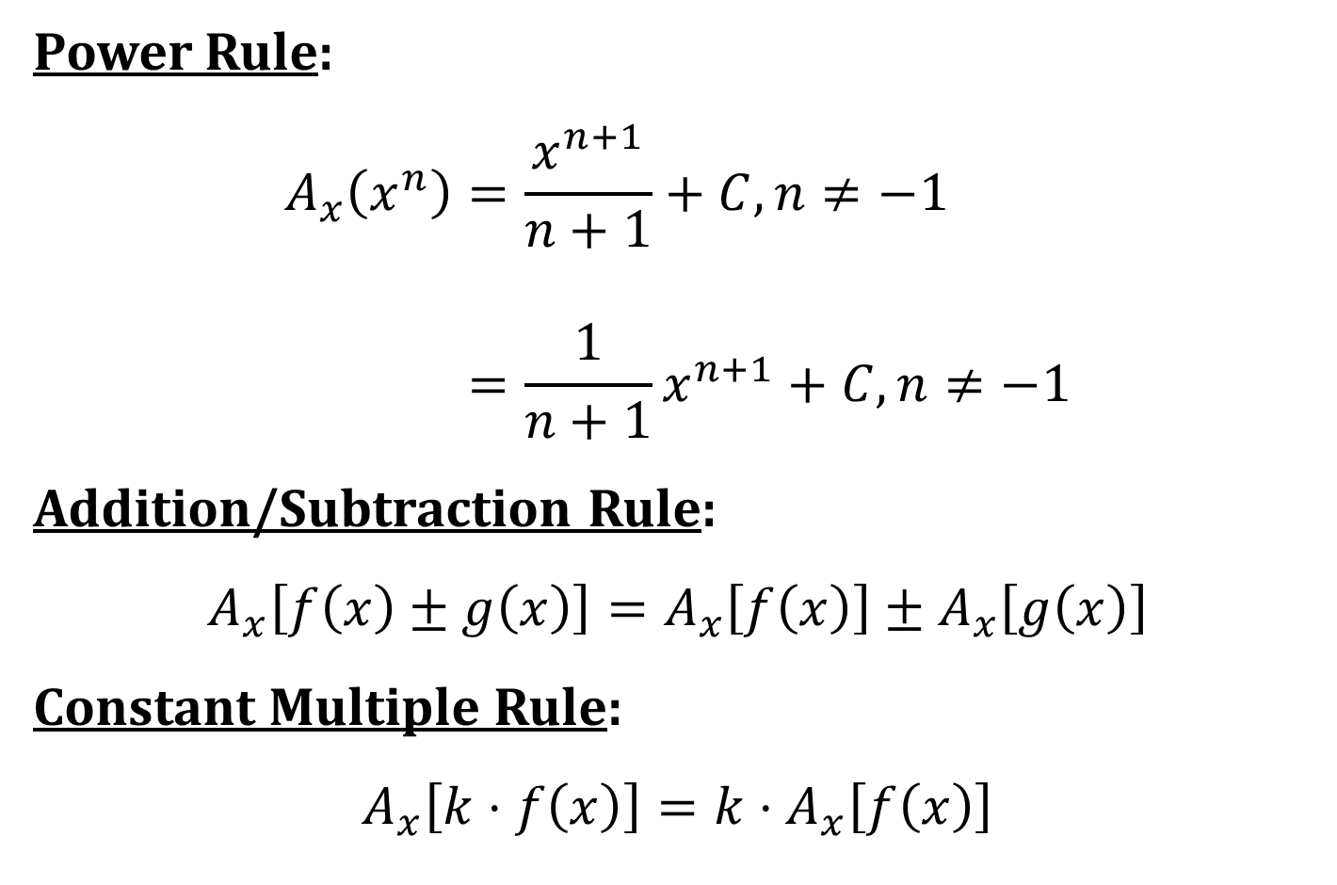
SOME ANTIDERIVATIVE FORMULAS
Power Rule:
$$A_{x}\left(x^{n}\right)=\frac{x^{n+1}}{n+1}+C, n≠−1 \\ =\frac{1}{n+1}x^{n+1}+C, n≠−1$$
Addition/Subtraction Rule:
$$A_{x}\left[f\left(x\right)±g\left(x\right)\right]=A_{x}\left[f\left(x\right)\right]±A_{x}\left[g\left(x\right)\right]$$
Constant Multiple Rule:
$$A_{x}\left[k⋅f\left(x\right)\right]=k⋅A_{x}\left[f\left(x\right)\right]$$

Slide 7
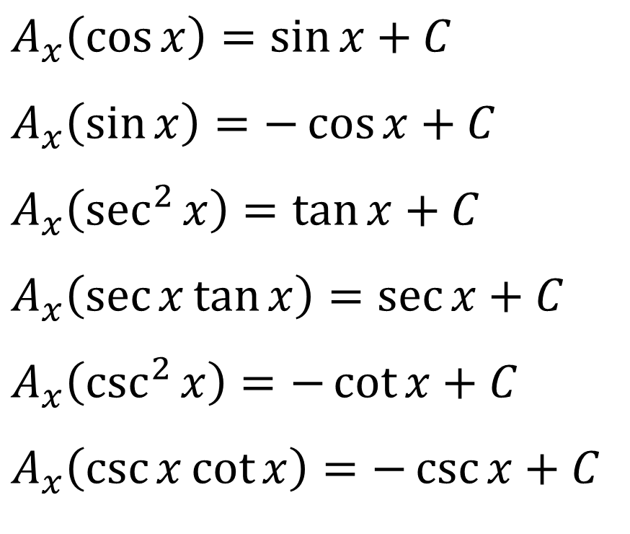
SOME TRIGONOMETRIC ANTIDERIVATIVES
$$A_{x}\left(\cos{x}\right)=\sin{x}+C$$
$$A_{x}\left(\sin{x}\right)=−\cos{x}+C$$
$$A_{x}\left(\sec^{2}{x}\right)=\tan{x}+C$$
$$A_{x}\left(\sec{x}\tan{x}\right)=\sec{x}+C$$
$$A_{x}\left(\csc^{2}{x}\right)=−\cot{x}+C$$
$$A_{x}\left(\csc{x}\cot{x}\right)=−\csc{x}+C$$

Slide 8
DIFFERENTIAL EQUATION
Definition: An equation that involves the derivatives of a function is called a differential equation.

