Slide 1
Section 3.8
Newton’s Method

Slide 2
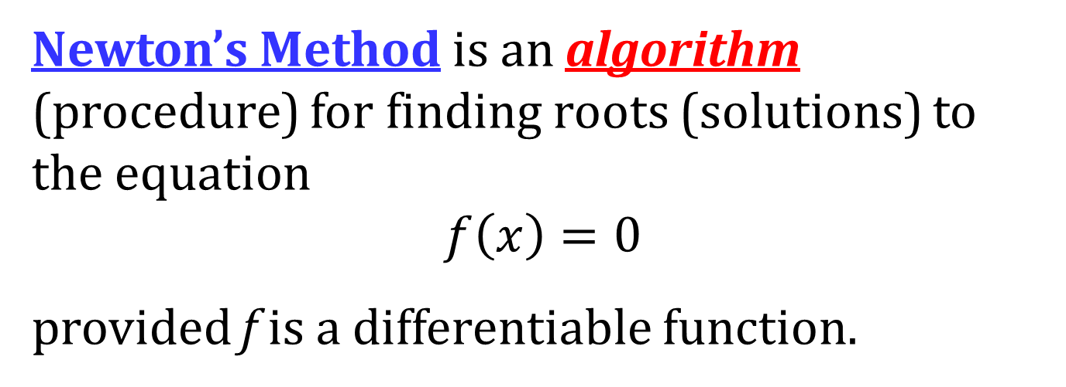
NEWTON’S METHOD
Newton’s Method is an algorithm (procedure) for finding roots (solutions) to the equation
$$f\left(x\right)=0$$
provided f is a differentiable function.

Slide 3
THE ALGORITHM
Let $f\left(x\right)$ be a differentiable function and let $x_{1}$ be an initial approximation to the root $r$ of the equation $f\left(x\right)=0$.
Compute
for $n=1, 2, 3, …$
Write , if the limit exists.
$$x_{n+1}=x_{n}−\frac{f\left(x_{n}\right)}{f^{′}\left(x_{n}\right)}$$
$$\lim_{n→∞}{x_{n}}=r$$

Slide 4
APPLYING NEWTON’S METHOD ON THE TI-83/84
Enter the original function as Y1 and its derivative as Y2.
Store the first guess as $x$ by entering the guess, pressing STO, pressing X,t,θ,n, then press ENTER.
Enter X−Y₁(X)/Y₂(X)→X. To enter Y₁, press VARS, arrow over to Y-Vars, select 1:Function, then select 1:Y₁. Use a similar process to enter Y₂.
Repeatedly press ENTER until the desired accuracy is reached.

