Slide 1
Section 3.5
Summary of Curve Sketching

Slide 2
THINGS TO CONSIDER BEFORE SKETCHING A CURVE
Domain
Intercepts
Symmetry - even, odd, periodic.
Asymptotes - vertical, horizontal, slant.
Intervals of increase or decrease.
Local maximum or minimum values.
Concavity and Points of Inflections
Not every item above is relevant to every function.

Slide 3
PROCEDURE FOR CURVE SKETCHING
Step 1: Precalculus analysis
(a) Check the domain of the function to see if any regions of the plane are excluded.
(b) Find the $x$- and $y$-intercepts.
(c) Test for symmetry with respect to the $y$-axis and the origin. (Is the function even or odd?)

Slide 4
PROCEDURE (CONTINUED)
Step 2: Calculus Analysis
(a) Find the asymptotes (vertical, horizontal, and/or slant).
(b) Use the first derivative to find the critical points and to find the intervals where the graph is increasing and decreasing.
(c) Test the critical points for local maxima and local minima.
(d) Use the second derivative to find the intervals where the graph is concave up and concave down and to locate inflection points.

Slide 5
PROCEDURE (CONCLUDED)
Step 3: Plot a few points (including all critical points, inflection points, and intercepts).
Step 4: Sketch the graph. (NOTE: On the graph, label all critical points, inflection points, intercepts and asymptotes.)

Slide 6
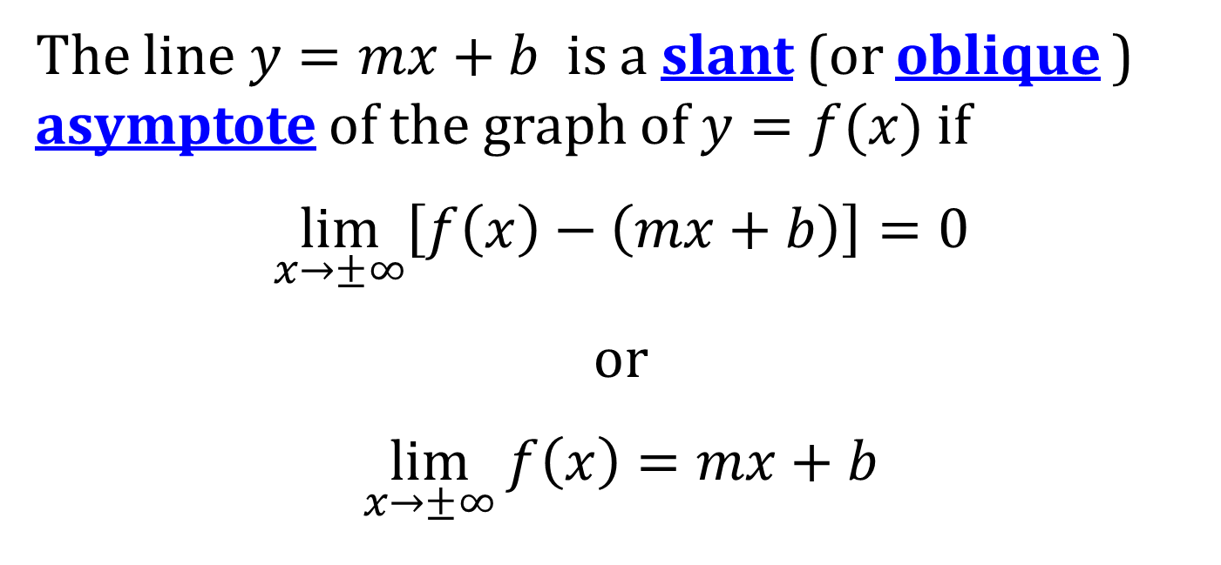
SLANT ASYMPTOTES
The line $y=mx+b$ is a slant (or oblique ) asymptote of the graph of $y=f(x)$ if
$$\lim_{x→±∞}\left[f\left(x\right)−\left(mx+b\right)\right]=0$$
or
$$\lim_{x→±∞}{f\left(x\right)}=mx+b$$

Slide 7
SLANT ASYMPTOTES AND RATIONAL FUNCTIONS
For rational functions, slant asymptotes occur when the degree of the numerator is exactly one higher than the degree of the denominator.
For rational functions, the slant asymptote can be found by using long division of polynomials.

