Slide 1
Section 3.4
Limits at Infinity; Horizontal Asymptotes

Slide 2
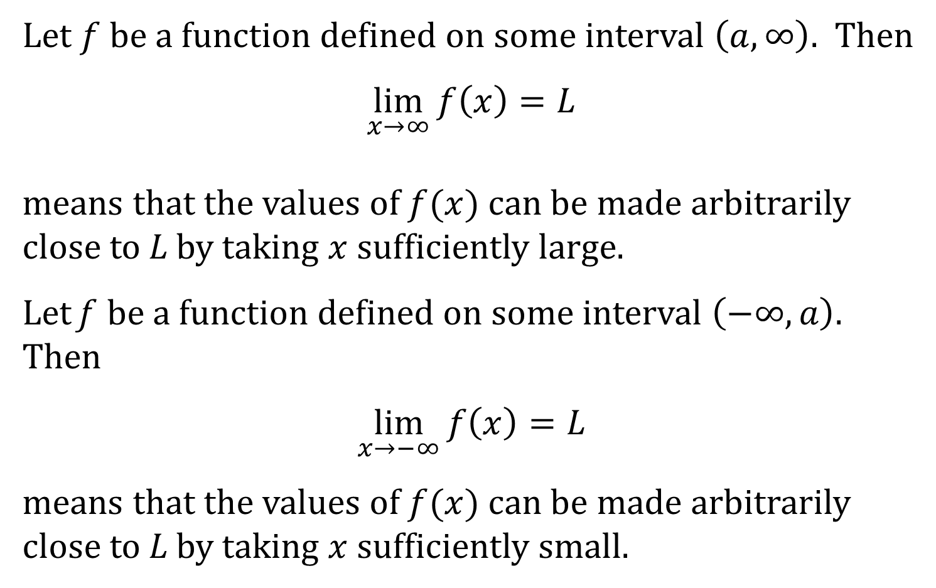
LIMIT AT INFINITY
Let $f$ be a function defined on some interval $\left(a, ∞\right)$. Then
$$\lim_{x→∞}{f\left(x\right)}=L$$
means that the values of $f(x)$ can be made arbitrarily close to L by taking $x$ sufficiently large.
Let f be a function defined on some interval $\left(−∞, a\right)$. Then
$$\lim_{x→−∞}{f\left(x\right)}=L$$
means that the values of $f(x)$ can be made arbitrarily close to L by taking $x$ sufficiently small.

Slide 3
HORIZONTAL ASYMPTOTES
The line $y=L$ is called a horizontal asymptote of the curve $y=f\left(x\right)$ if either
$$\lim_{x→∞}{f(x)}=L or \lim_{x→−∞}{f\left(x\right)}=L$$

Slide 4
THEOREM
1. If $r>0$ is a rational number, then
$$\lim_{x→∞}{\frac{1}{x^{r}}}=0$$
2. If $r>0$ is a rational number such that $x^{r}$ is defined for all $x$, then
$$\lim_{x→−∞}{\frac{1}{x^{r}}}=0$$

