Slide 1
Section 3.3
How Derivatives Affect the Shape of a Graph

Slide 2
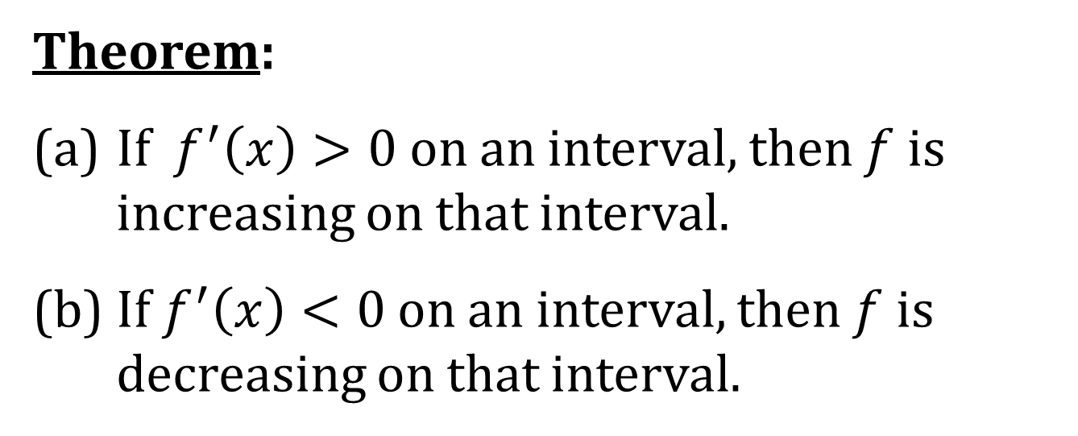
INCREASING/DECREASING TEST
Theorem:
(a) If $f^{′}\left(x\right)>0$ on an interval, then $f$ is increasing on that interval.
(b) If $f^{′}\left(x\right)<0$ on an interval, then $f$ is decreasing on that interval.

Slide 3
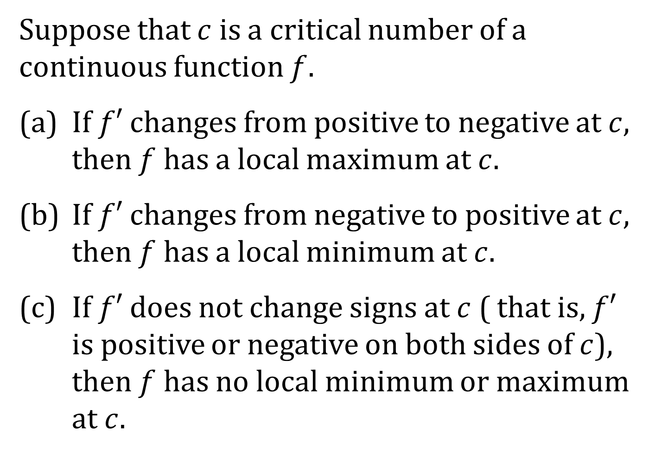
THE FIRST DERIVATIVE TEST
Suppose that $c$ is a critical number of a continuous function $f$.
(a) If $f′$ changes from positive to negative at $c$, then $f$ has a local maximum at $c$.
(b) If $f′$ changes from negative to positive at $c$, then $f$ has a local minimum at $c$.
(c) If $f′$ does not change signs at $c$ ( that is, $f′$ is positive or negative on both sides of $c$), then $f$ has no local minimum or maximum at $c$.

Slide 4
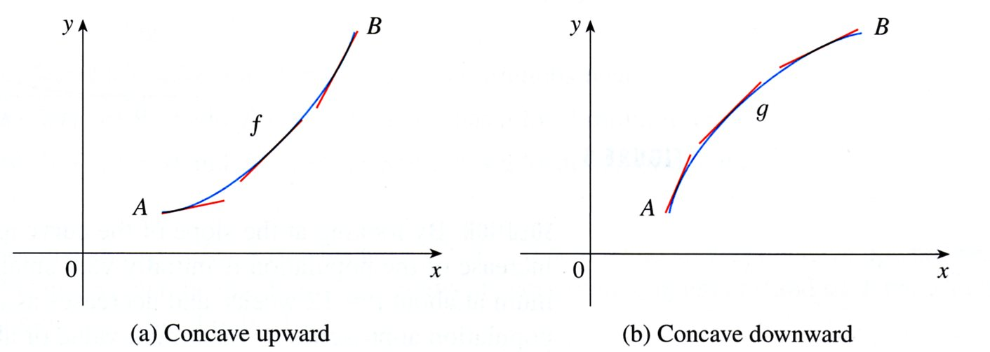
CONCAVITY
Definition: If the graph of $f$ lies above all of its tangents on an interval I, then it is called concave upward on I. If the graph of $f$ lies below all of its tangents on I, it is called concave downward.

Slide 5
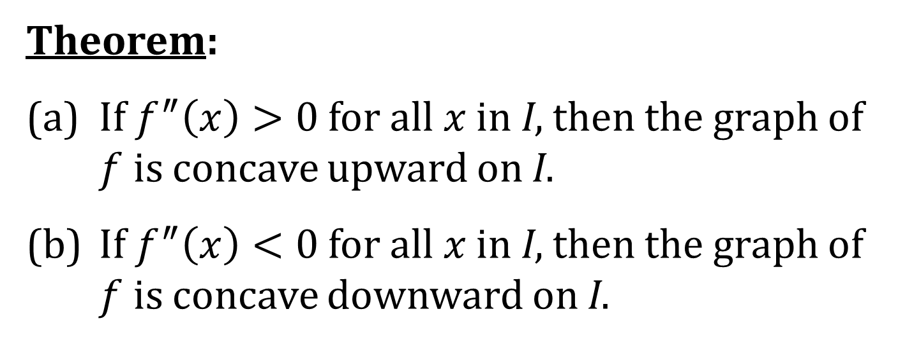
CONCAVITY TEST
Theorem:
(a) If $f^{″}\left(x\right)>0$ for all $x$ in I, then the graph of $f$ is concave upward on I.
(b) If $f^{″}\left(x\right)<0$ for all $x$ in I, then the graph of $f$ is concave downward on I.

Slide 6
INFLECTION POINT
A point P on a curve $y=f\left(x\right)$ is called an inflection point if $f$ is continuous at P and the curve changes from concave upward to concave downward or from concave downward to concave upward at P.

Slide 7
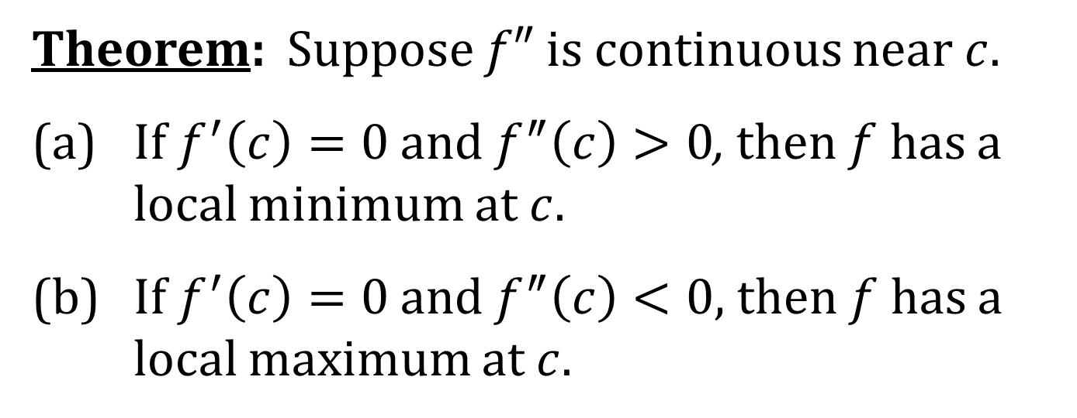
THE SECOND DERIVATIVE TEST
Theorem: Suppose $f″$ is continuous near $c$.
(a) If $f^{′}\left(c\right)=0$ and $f^{″}\left(c\right)>0$, then $f$ has a local minimum at $c$.
(b) If $f^{′}\left(c\right)=0$ and $f^{″}\left(c\right)<0$, then $f$ has a local maximum at $c$.

Slide 8
COMMENTS ON THE SECOND DERIVATIVE TEST
Suppose $c$ is a critical number of the function $y=f\left(x\right)$.
If $f^{″}\left(c\right)=0$, then the Second Derivative Test is inclusive. That is, the First Derivative Test must be used to determine local minimum or maximum. EXAMPLE: $f\left(x\right)=x4$
If $f^{′}\left(c\right)$ is undefined (does not exist), then the Second Derivative Test is inclusive. That is, the First Derivative Test must be used to determine local minimum or maximum.
EXAMPLE: $f\left(x\right)=x^{2/3}$

