Slide 1
Section 3.2
The Mean Value Theorem

Slide 2
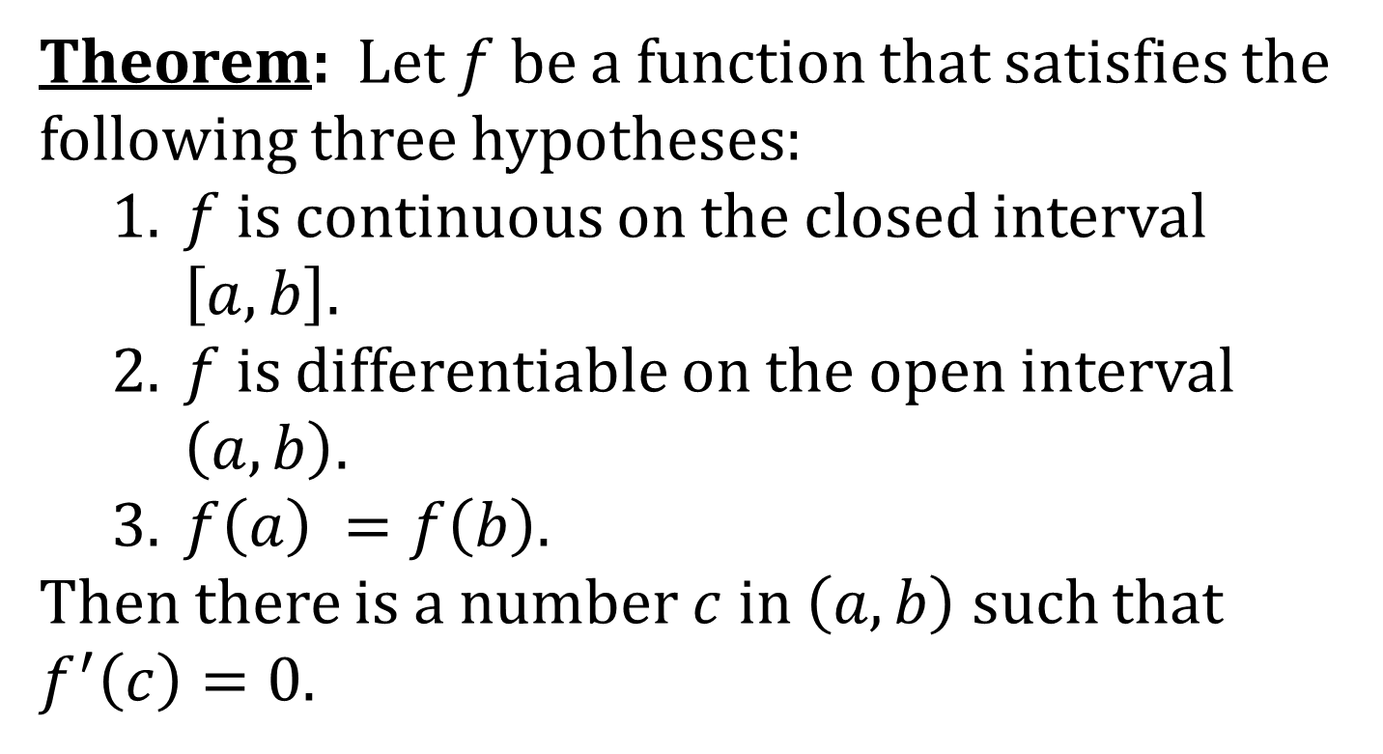
ROLLE’S THEOREM
Theorem: Let $f$ be a function that satisfies the following three hypotheses:
1. $f$ is continuous on the closed interval
$\left[a, b\right]$.
2. $f$ is differentiable on the open interval
$\left(a, b\right)$.
3. $f\left(a\right) =f\left(b\right)$.
Then there is a number $c$ in $\left(a, b\right)$ such that
$f^{′}\left(c\right)=0$.

Slide 3
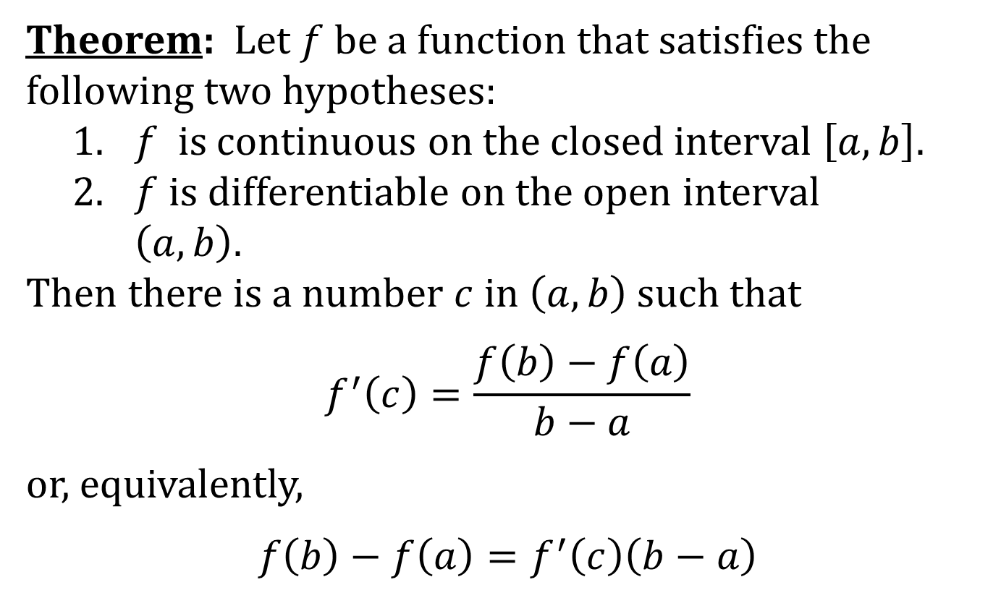
THE MEAN VALUE THEOREM (MVT)
Theorem: Let $f$ be a function that satisfies the following two hypotheses:
1. $f$ is continuous on the closed interval $\left[a, b\right]$.
2. $f$ is differentiable on the open interval
$\left(a, b\right)$.
Then there is a number $c$ in $\left(a, b\right)$ such that
$$f^{′}\left(c\right)=\frac{f\left(b\right)−f\left(a\right)}{b−a}$$
or, equivalently,
$$f\left(b\right)−f\left(a\right)=f^{′}\left(c\right)\left(b−a\right)$$

Slide 4
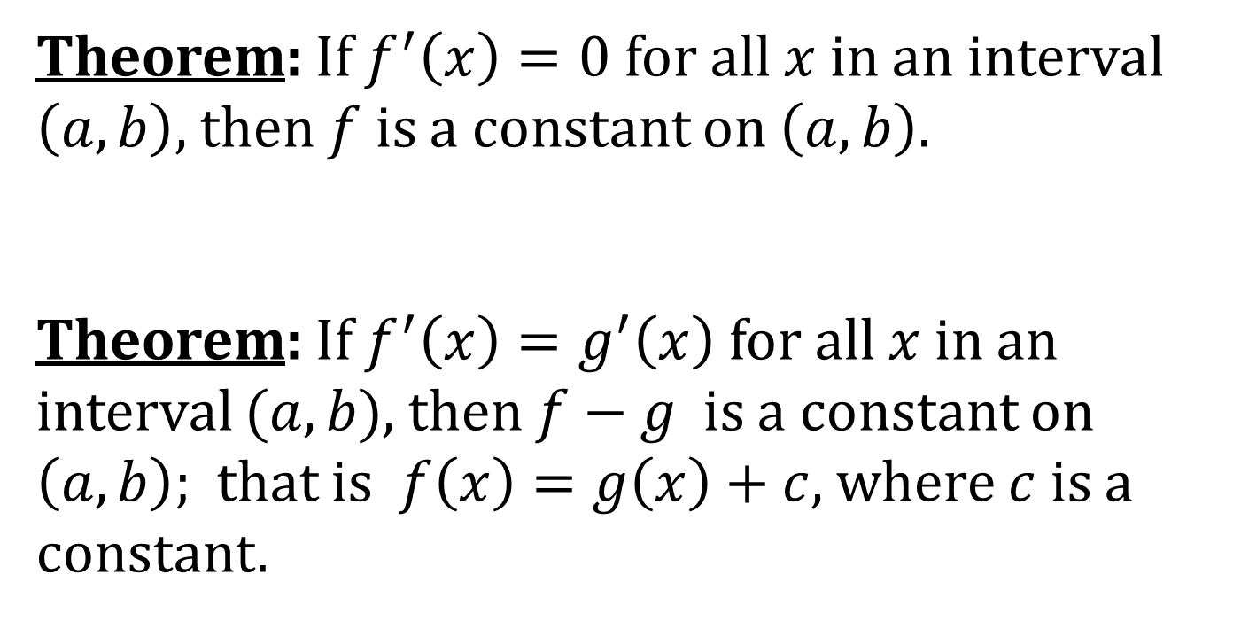
TWO THEOREMS
Theorem: If $f^{′}\left(x\right)=0$ for all $x$ in an interval $\left(a,b\right)$, then $f$ is a constant on $\left(a, b\right)$.
Theorem: If $f^{′}\left(x\right)=g^{′}\left(x\right)$ for all $x$ in an interval $(a, b)$, then $f−g$ is a constant on $\left(a, b\right)$; that is $f\left(x\right)=g\left(x\right)+c$, where $c$ is a constant.

