Slide 1
Section 3.1
Maximum and Minimum Values

Slide 2
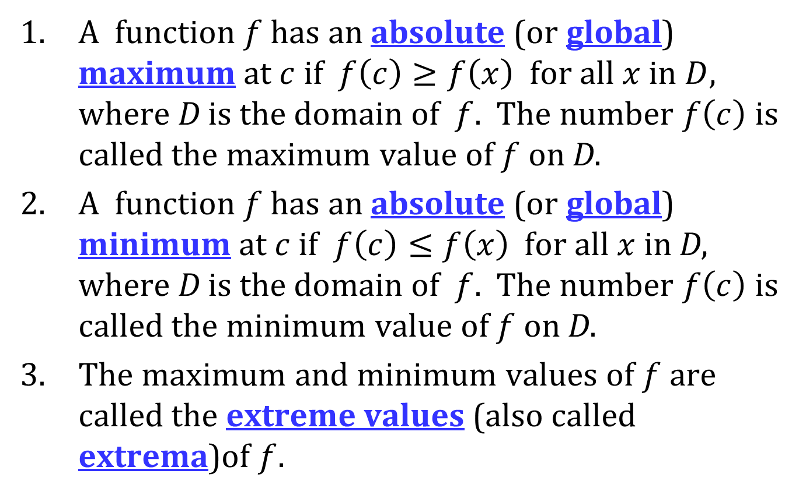
ABSOLUTE MINIMUM AND ABSOLUTE MAXIMUM
A function $f$ has an absolute (or global) maximum at $c$ if $f\left(c\right)≥f\left(x\right)$ for all $x$ in $D$, where D is the domain of $f$. The number $f\left(c\right)$ is called the maximum value of $f$ on D.
A function $f$ has an absolute (or global) minimum at $c$ if $f\left(c\right)≤f\left(x\right)$ for all $x$ in D, where D is the domain of $f$. The number $f\left(c\right)$ is called the minimum value of $f$ on D.
The maximum and minimum values of $f$ are called the extreme values (also called extrema)of $f$.

Slide 3
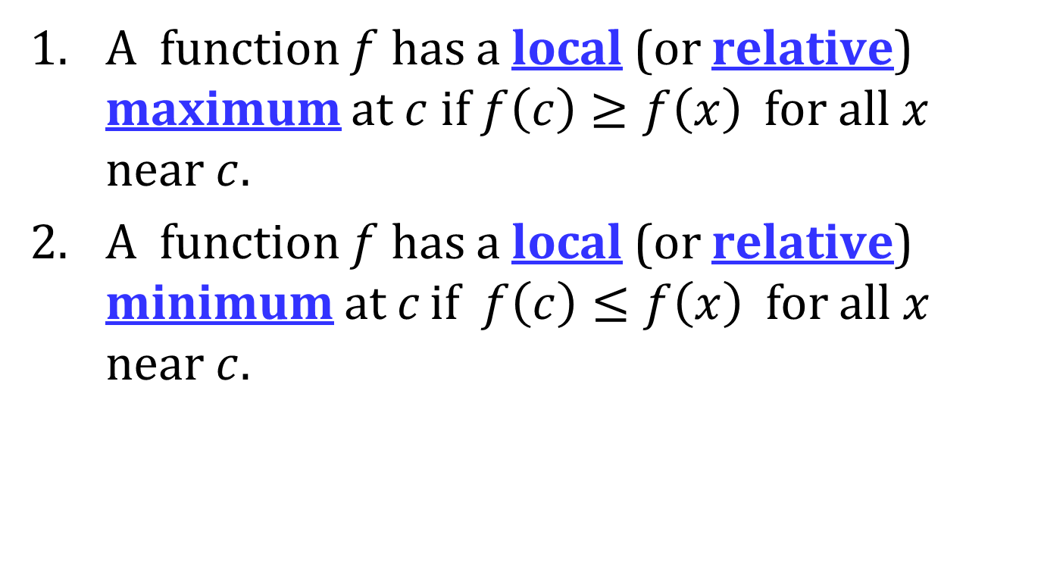
LOCAL MINIMUM AND LOCAL MAXIMUM
A function $f$ has a local (or relative) maximum at $c$ if $f\left(c\right)≥f\left(x\right)$ for all $x$ near $c$.
A function $f$ has a local (or relative) minimum at c if $f\left(c\right)≤f\left(x\right)$ for all $x$ near $c$.

Slide 4
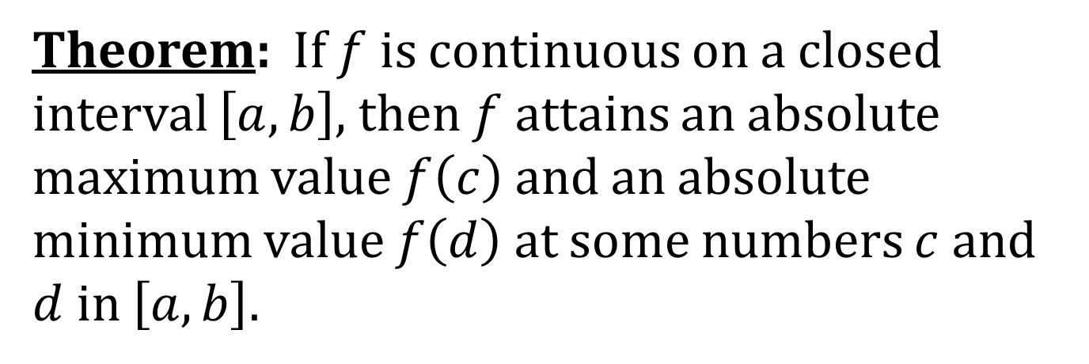
THE EXTREME VALUE THEOREM
Theorem: If $f$ is continuous on a closed interval $\left[a, b\right]$, then $f$ attains an absolute maximum value $f\left(c\right)$ and an absolute minimum value $f\left(d\right)$ at some numbers $c$ and $d$ in $\left[a, b\right]$.

Slide 5
FERMAT’S THEOREM
Theorem: If $f$ has a local maximum or minimum at $c$, and if $f^{′}\left(c\right)$ exists, then $f^{′}\left(c\right)=0$.

Slide 6
CRITICAL NUMBERS
A critical number of a function $f$ is a number $c$ in the domain of $f$ such that either $f^{′}\left(c\right)=0$ or $f^{′}\left(c\right)$ does not exist.

Slide 7
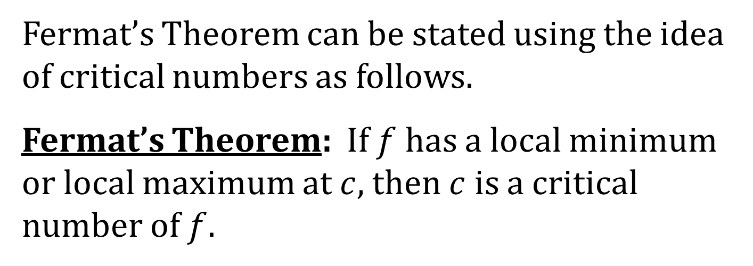
FERMAT’S THEOREM REVISITED
Fermat’s Theorem can be stated using the idea of critical numbers as follows.
Fermat’s Theorem: If $f$ has a local minimum or local maximum at $c$, then $c$ is a critical number of $f$.

Slide 8
EXTREME VALUE THEOREM RESTATED
If $f$ is continuous on a closed interval $\left[a, b\right]$, then $f$ attains both an absolute minimum and absolute maximum value on that interval.

Slide 9
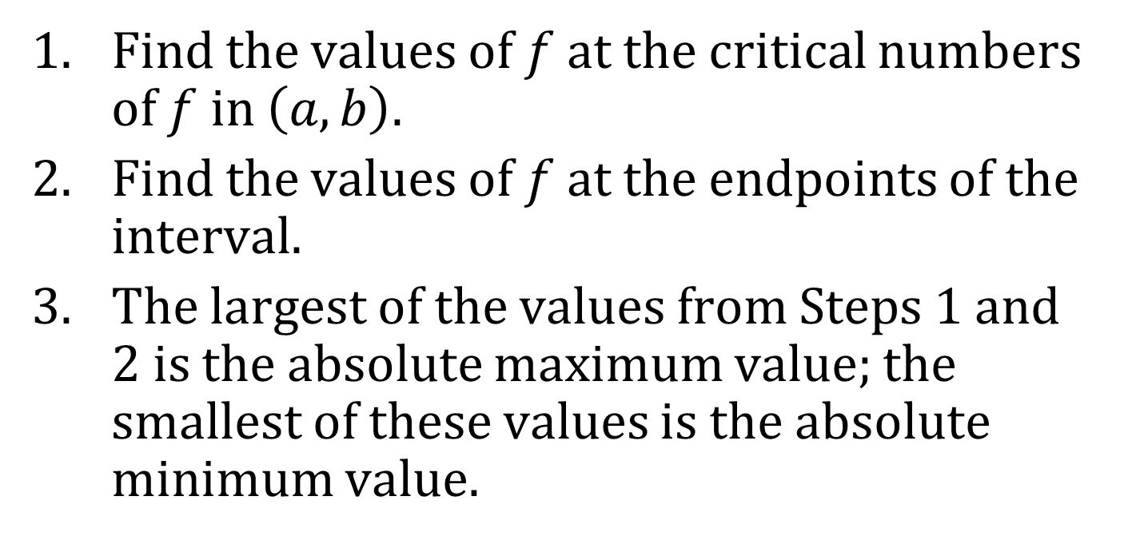
THE CLOSED INTERVAL METHOD
To find the absolute maximum and minimum values of a continuous function on a closed interval $\left[a, b\right]$:
Find the values of $f$ at the critical numbers of $f$ in $\left(a, b\right)$.
Find the values of $f$ at the endpoints of the interval.
The largest of the values from Steps 1 and 2 is the absolute maximum value; the smallest of these values is the absolute minimum value.

