Slide 1
Section 2.9
Linear Approximations and Differentials

Slide 2
EQUATION OF THE TANGENT LINE
Recall that the slope of the tangent line to the curve $y=f\left(x\right)$ at the point $\left(a, f\left(a\right)\right)$ is given by the value of the derivative at $a$; that is,
$$m=f^{′}\left(a\right)$$
Therefore, the point-slope form of the tangent line to the curve of $y=f\left(x\right)$ at the point $\left(a, f\left(a\right)\right)$ can be written as
$$L\left(x\right)=f\left(a\right)+f^{′}\left(a\right)\left(x−a\right)$$

Slide 3
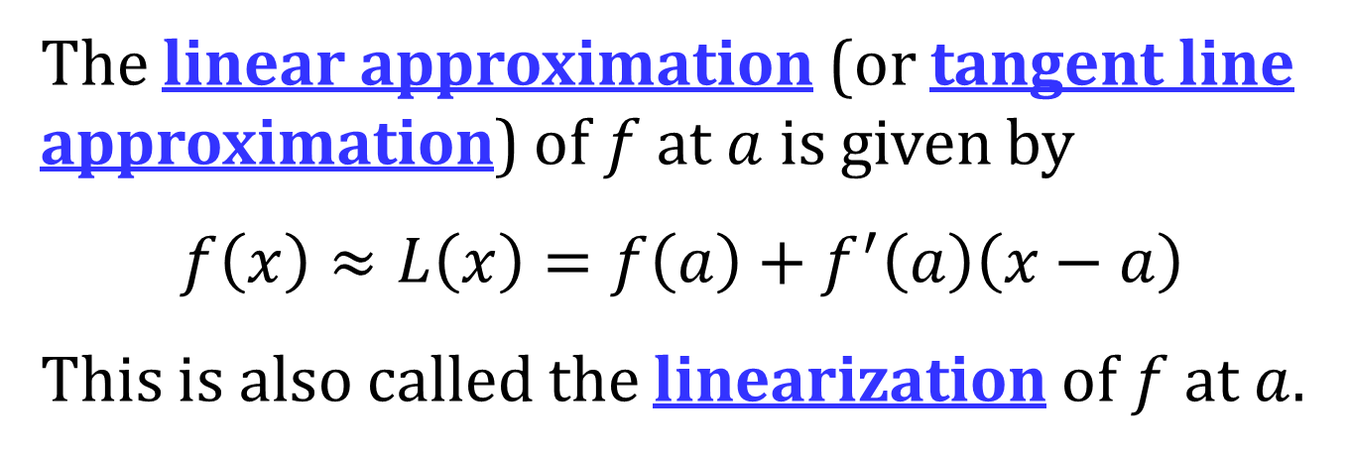
LINEAR APPROXIMATION OF f AT A POINT
The linear approximation (or tangent line approximation) of $f$ at $a$ is given by
$$f\left(x\right)≈L\left(x\right)=f\left(a\right)+f^{′}\left(a\right)\left(x−a\right)$$
This is also called the linearization of $f$ at $a$.

Slide 4
DIFFERENTIALS
Let $y=f\left(x\right)$ be a differentiable function.
The differential of x, $dx$, is an independent variable and can be any real number. Frequently, $dx$ is set equal to $Δx$.
The differential of y, $dy$, is defined by
$$dy=f^{′}\left(x\right)dx.$$
Recall, $Δy=f\left(x+Δx\right)−f\left(x\right)$.
NOTE: $dy≈Δy$

Slide 5
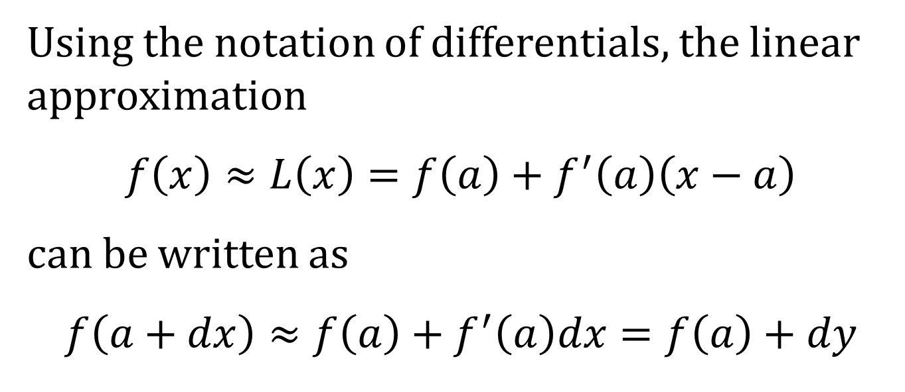
DIFFERENTIALS AND THE LINEAR APPROXIMATION
Using the notation of differentials, the linear approximation
$$f\left(x\right)≈L\left(x\right)=f\left(a\right)+f^{′}\left(a\right)\left(x−a\right)$$
can be written as
$$f\left(a+dx\right)≈f\left(a\right)+f^{′}\left(a\right)dx=f\left(a\right)+dy$$

Slide 6
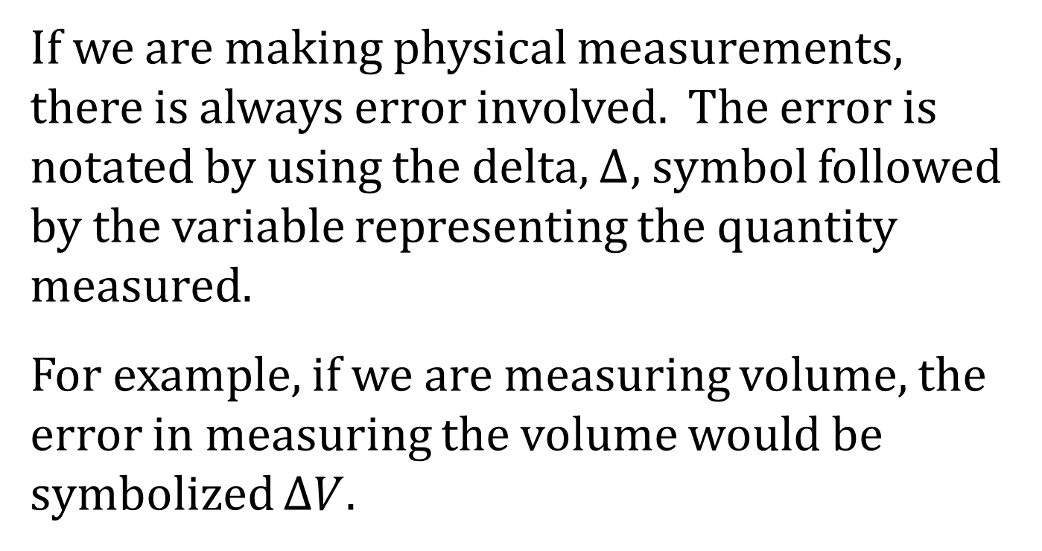
ERRORS
If we are making physical measurements, there is always error involved. The error is notated by using the delta, Δ, symbol followed by the variable representing the quantity measured.
For example, if we are measuring volume, the error in measuring the volume would be symbolized $ΔV$.

Slide 7
ABSOLUTE, RELATIVE, AND PERCENT ERROR
The actual error from the true value is called the absolute error.
The relative error is the absolute error divided by total quantity. In the case of volume, $\frac{ΔV}{V}$.
The percentage error is the relative error multiplied by 100.

