Slide 1
Section 2.8
Related Rates

Slide 2
RELATED RATE PROBLEMS
Related rate problems deal with quantities that are changing over time and that are related to each other.
For example, the radius of an oil slick and the volume of oil leaking from a tanker.
We assume all quantities are implicit functions of time.

Slide 3
PROCEDURE
1. Draw a diagram.
2. State information given about the variables and their rates of change.
3. Find and write an equation relating the variables.
3½. If necessary, eliminate one of the variables.
4. Differentiate the equation implicitly with respect to time.
5. Substitute in data given about the variables.

Slide 4
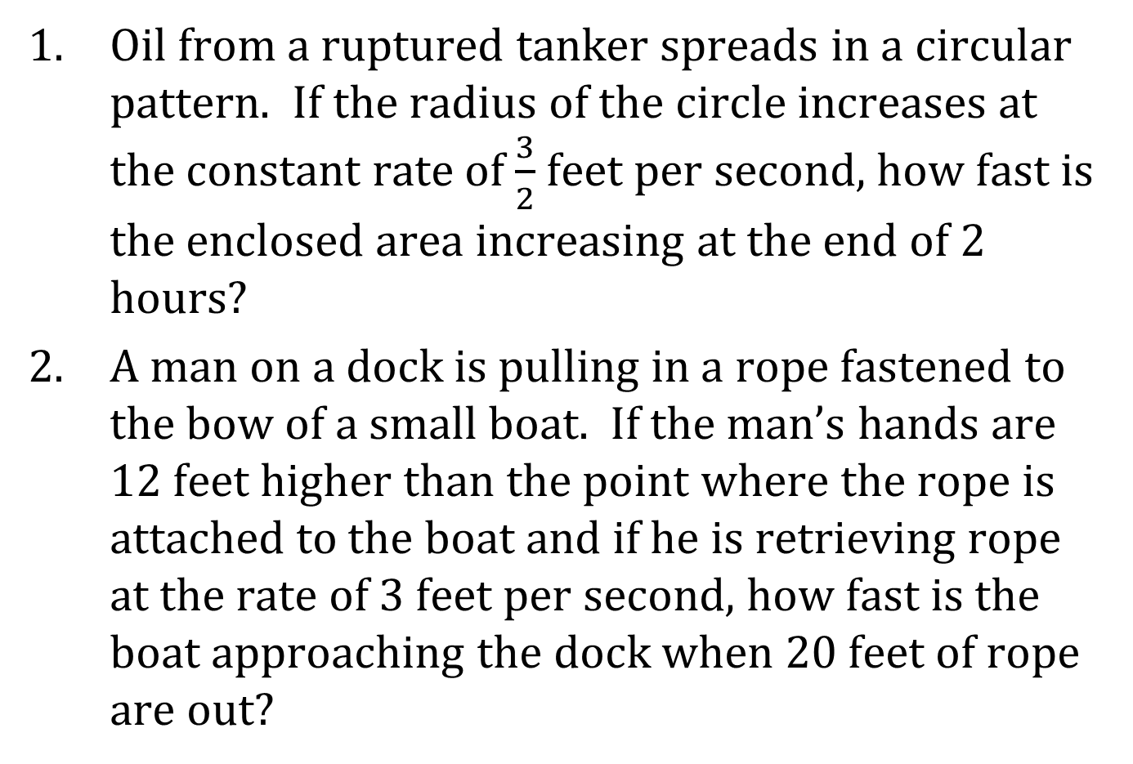
EXAMPLES
Oil from a ruptured tanker spreads in a circular pattern. If the radius of the circle increases at the constant rate of $\frac{3}{2}$ feet per second, how fast is the enclosed area increasing at the end of 2 hours?
A man on a dock is pulling in a rope fastened to the bow of a small boat. If the man’s hands are 12 feet higher than the point where the rope is attached to the boat and if he is retrieving rope at the rate of 3 feet per second, how fast is the boat approaching the dock when 20 feet of rope are out?

Slide 5
EXAMPLES (CONTINUED)
If gas is pumped into a spherical balloon at the rate of 5 ft³/min, at what rate is the radius increasing when r = 3 ft?
Suppose that you are the supervisor of a water reservoir for DeKalb County. Further suppose that this reservoir is in the shape of a cone that is 50 feet deep and 200 feet across. There is a drought in Georgia, and the water level is falling at the rate of 0.002 feet per hour. The water level has dropped to 30 feet; it is your job to know at any particular time how fast, by volume, the reservoir is losing water. So, how fast, by volume, is the reservoir losing water when the water level is 30 feet?

Slide 6
EXAMPLES (CONCLUDED)
A man 6 feet tall is walking away from a street light 20 feet high at a rate of 7/2 feet per second. What is the rate of change in the length of the man’s shadow when he is
(a) 10 feet from the street light and
(b) 50 feet from the street light?
6. The radius of a right circular cylinder is increasing at a rate of 3 cm/sec. If the volume of the cylinder remains constant, find the rate at which the height of the cylinder is changing when the radius is 5 cm an the height is 4 cm.

