Slide 1
Section 2.6
Implicit Differentiation

Slide 2
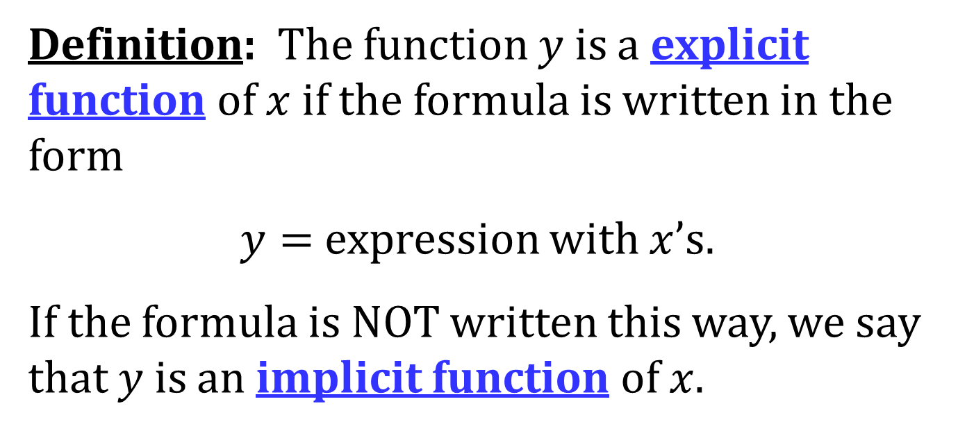
EXPLICIT AND IMPLICIT FUNCTIONS
Definition: The function $y$ is a explicit function of $x$ if the formula is written in the form
$y=$ expression with $x$’s.
If the formula is NOT written this way, we say that $y$ is an implicit function of $x$.

Slide 3
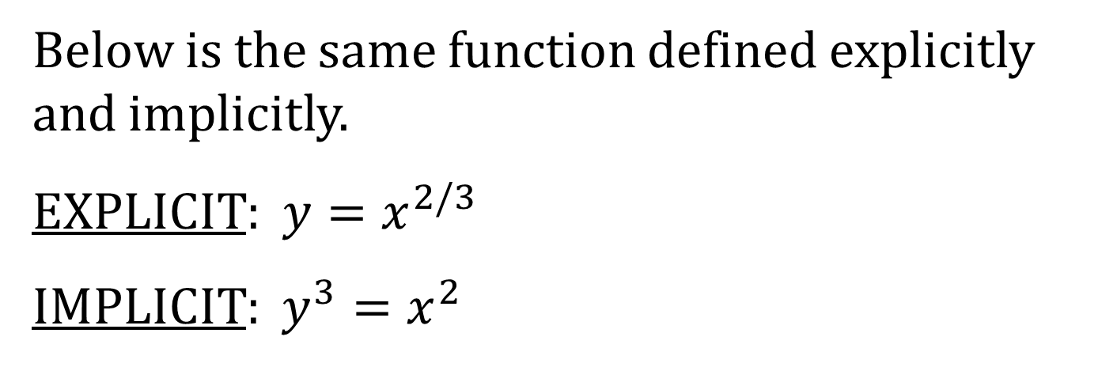
EXAMPLE
Below is the same function defined explicitly and implicitly.
EXPLICIT: $y=x^{2/3}$
IMPLICIT: $y^{3}=x^{2}$

Slide 4
IMPLICIT DIFFERENTIATION
Many times if a function is defined implicitly, it is difficult (or impossible) to write it explicitly. To take the derivative of an implicitly defined function, we use implicit differentiation.

Slide 5
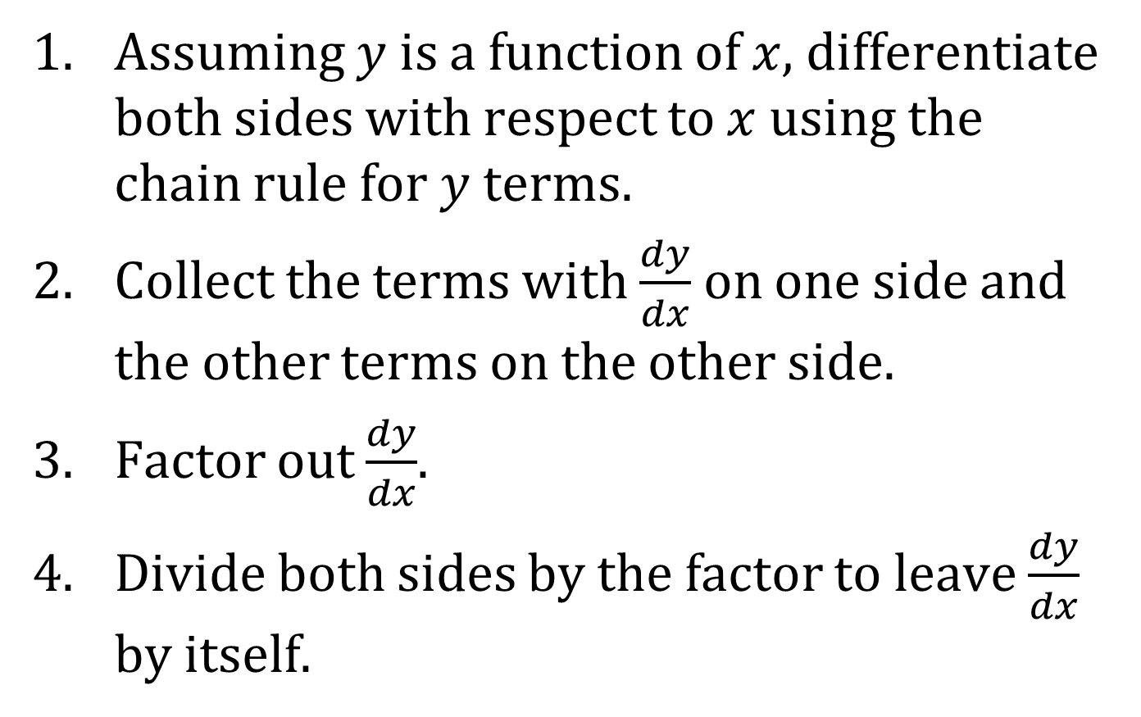
PROCEDURE FOR IMPLICIT DIFFERENTIATION
Assuming $y$ is a function of $x$, differentiate both sides with respect to $x$ using the chain rule for $y$ terms.
Collect the terms with $\frac{dy}{dx}$ on one side and the other terms on the other side.
Factor out $\frac{dy}{dx}$.
Divide both sides by the factor to leave $\frac{dy}{dx}$ by itself.

