Slide 1
Section 2.5
The Chain Rule

Slide 2
THE CHAIN RULE
Theorem: If $f$ and $g$ are differentiable and $F\left(x\right)=\left(f∘g\right)\left(x\right)=f\left(g\left(x\right)\right)$, then
$$F^{′}\left(x\right)=f^{′}\left(g\left(x\right)\right)⋅g^{′}\left(x\right).$$
Alternatively, in Leibniz notation, if $y=f\left(u\right)$ and $u=g\left(x\right)$ are both differentiable functions, then
$$\frac{dy}{dx}=\frac{dy}{du}⋅\frac{du}{dx}$$

Slide 3
“INTUITIVE” CHAIN RULE
In using the Chain Rule, we work from the outside to the inside. The formula says that we differentiate the outer function f [at the inner function g(x)] and then we multiply by the derivative of the inner function.

Slide 4
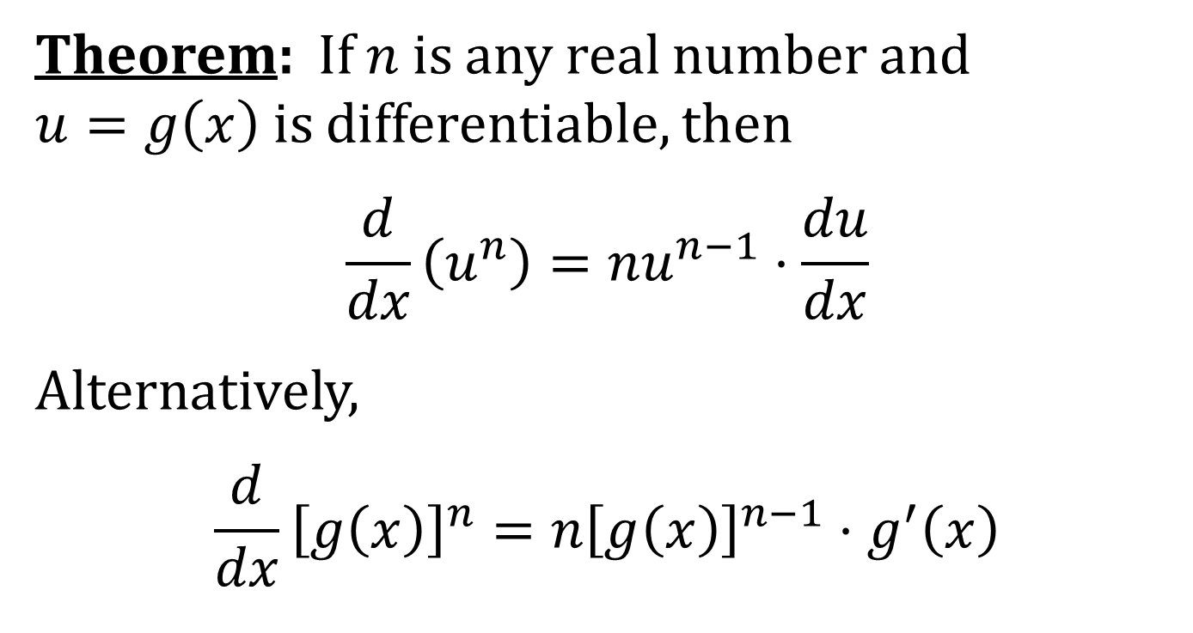
THE POWER RULE COMBINED WITH THE CHAIN RULE
Theorem: If $n$ is any real number and $u=g\left(x\right)$ is differentiable, then
$$\frac{d}{dx}\left(u^{n}\right)=nu^{n−1}⋅\frac{du}{dx}$$
Alternatively,
$$\frac{d}{dx}{\left[g\left(x\right)\right]}^{n}=n{\left[g\left(x\right)\right]}^{n−1}⋅g^{′}\left(x\right)$$

