Slide 1
Section 2.4
Derivatives of Trigonometric Functions

Slide 2
TWO SPECIAL TRIGONOMETRIC LIMITS
$$1. \lim_{θ→0}{\frac{\sin{θ}}{θ}}=1$$
$$2. \lim_{θ→0}{\frac{\cos{θ}−1}{θ}}=0$$

Slide 3
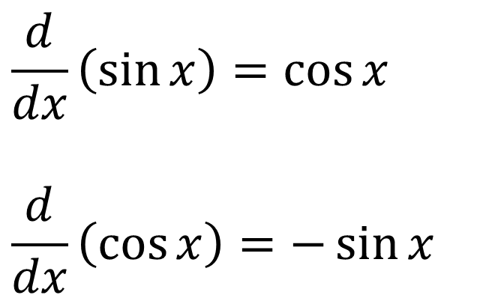
DERIVATIVES OF SINE AND COSINE
$$\frac{d}{dx}\left(\sin{x}\right)=\cos{x}$$
$$\frac{d}{dx}\left(\cos{x}\right)=−\sin{x}$$

Slide 4
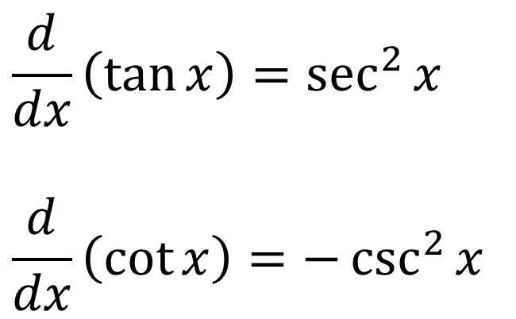
DERIVATIVES OF TANGENT AND COTANGENT
$$\frac{d}{dx}\left(\tan{x}\right)=\sec^{2}{x}$$
$$\frac{d}{dx}\left(\cot{x}\right)=−\csc^{2}{x}$$

Slide 5
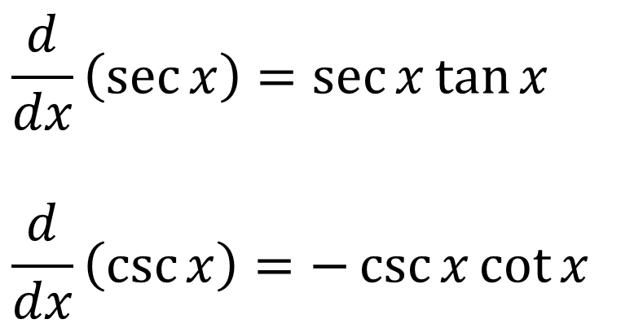
DERIVATIVES OF SECANT AND COSECANT
$$\frac{d}{dx}\left(\sec{x}\right)=\sec{x}\tan{x}$$
$$\frac{d}{dx}\left(\csc{x}\right)=−\csc{x}\cot{x}$$

