Slide 1
Section 2.3
Differentiation Formulas

Slide 2
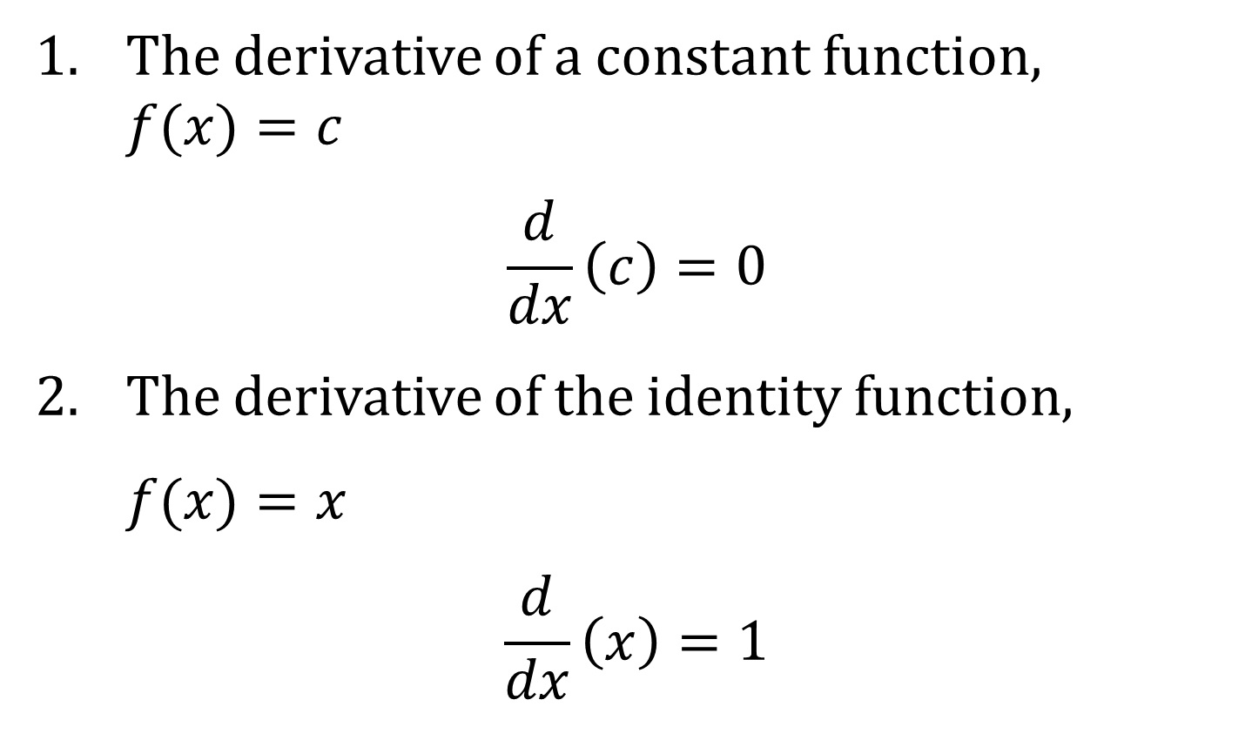
DIFFERENTIATION FORMULAS FOR BASIC FUNCTIONS
1. The derivative of a constant function, $f(x)=c$
$$\frac{d}{dx}\left(c\right)=0$$
2. The derivative of the identity function,
$f(x)=x$
$$\frac{d}{dx}\left(x\right)=1$$

Slide 3
THE POWER RULE
Let $n$ be any integer other than zero. Then the derivative of the function $f\left(x\right)=x^{n}$ is
$$\frac{d}{dx}\left(x^{n}\right)=nx^{n−1}$$

Slide 4
THE CONSTANT MULTIPLE RULE
If $c$ is a constant and $f$ is a differentiable function, then
$$\frac{d}{dx}\left[c⋅f\left(x\right)\right]=c⋅\frac{d}{dx}f\left(x\right)$$

Slide 5
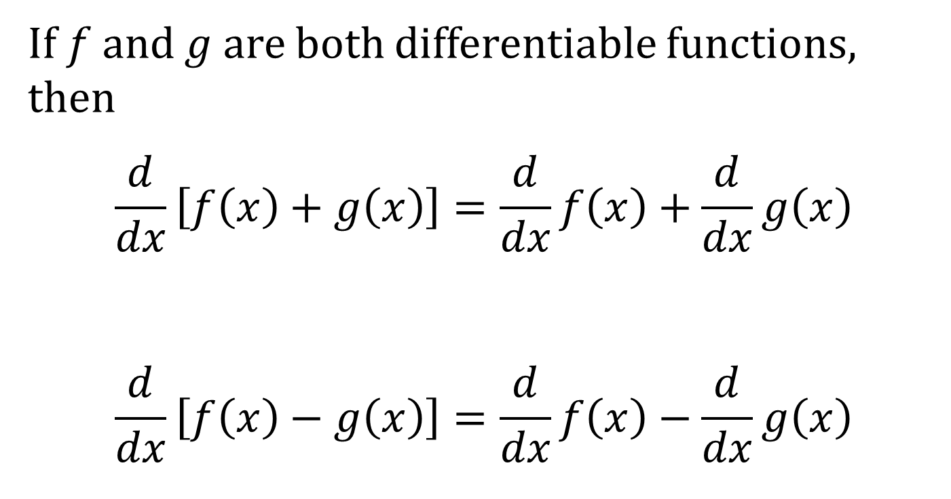
THE ADDITION AND SUBTRACTION RULES
If $f$ and $g$ are both differentiable functions, then
$$\frac{d}{dx}\left[f\left(x\right)+g\left(x\right)\right]=\frac{d}{dx}f\left(x\right)+\frac{d}{dx}g\left(x\right)$$
$$\frac{d}{dx}\left[f\left(x\right)−g\left(x\right)\right]=\frac{d}{dx}f\left(x\right)−\frac{d}{dx}g\left(x\right)$$

Slide 6
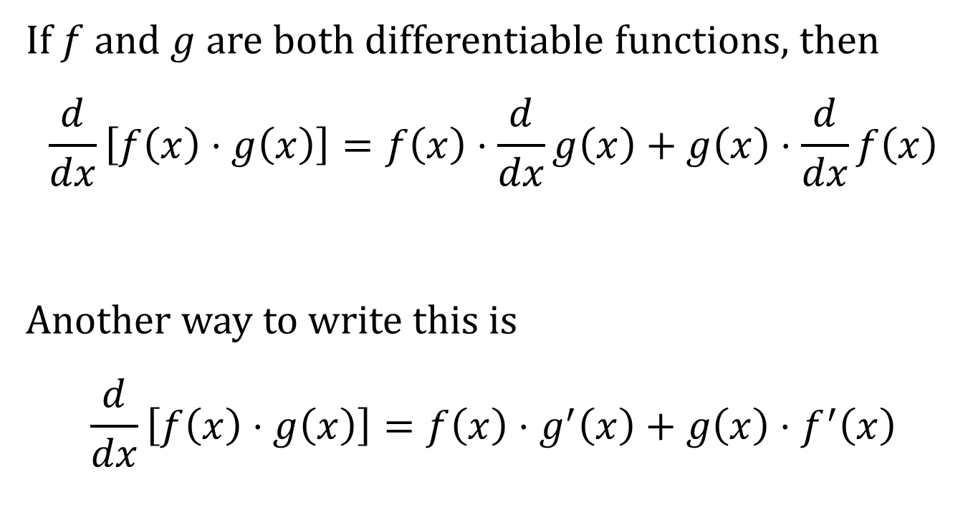
THE MULTIPLICATION RULE
If $f$ and $g$ are both differentiable functions, then
$$\frac{d}{dx}\left[f\left(x\right)⋅g\left(x\right)\right]=f\left(x\right)⋅\frac{d}{dx}g\left(x\right)+g\left(x\right)⋅\frac{d}{dx}f\left(x\right)$$
Another way to write this is
$$\frac{d}{dx}\left[f\left(x\right)⋅g\left(x\right)\right]=f\left(x\right)⋅g^{′}\left(x\right)+g\left(x\right)⋅f^{′}\left(x\right)$$

Slide 7
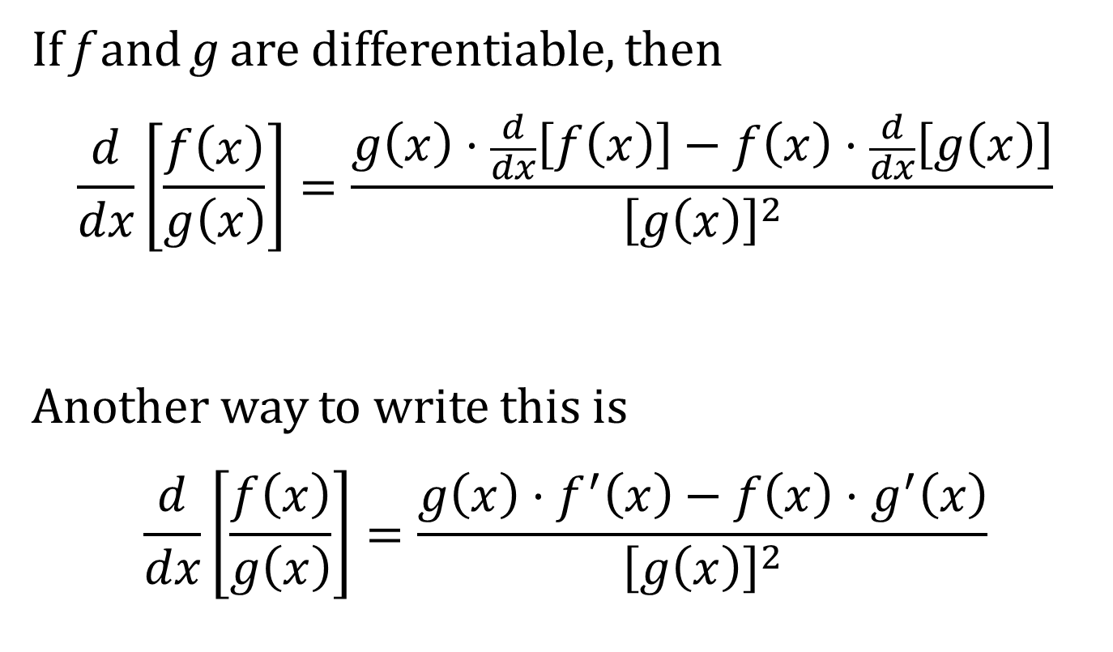
THE QUOTIENT RULE
If f and g are differentiable, then
$$\frac{d}{dx}\left[\frac{f\left(x\right)}{g\left(x\right)}\right]=\frac{g\left(x\right)⋅\frac{d}{dx}\left[f\left(x\right)\right]−f\left(x\right)⋅\frac{d}{dx}\left[g\left(x\right)\right]}{{\left[g\left(x\right)\right]}^{2}}$$
Another way to write this is
$$\frac{d}{dx}\left[\frac{f\left(x\right)}{g\left(x\right)}\right]=\frac{g\left(x\right)⋅f^{′}\left(x\right)−f\left(x\right)⋅g^{′}\left(x\right)}{{\left[g\left(x\right)\right]}^{2}}$$

Slide 8
A MNEMONIC DEVICE FOR THE QUOTIENT RULE
If the function in the numerator is called “hi” and the function in the denominator is called “ho,” the quotient rule can be remembered with the following mnemonic phrase.
ho D hi minus hi D ho over ho ho
In mathematical notation, this would be
$$\frac{ho D hi −hi D ho}{ho ho}$$
Recall that “D” means “derivative of.”

Slide 9
All the derivative rules are summarized in the box on page 136 of the text.

