Slide 1
Section 2.2
The Derivative as a Function

Slide 2
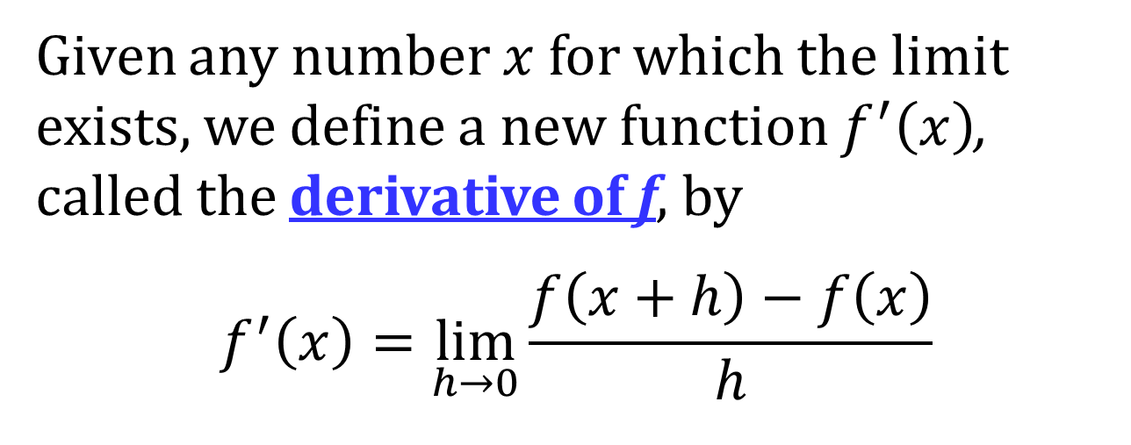
THE DERIVATIVE AS A FUNCTION
Given any number $x$ for which the limit exists, we define a new function $f^{′}\left(x\right)$, called the derivative of f, by
$$f^{′}\left(x\right)=\lim_{h→0}{\frac{f\left(x+h\right)−f\left(x\right)}{h}}$$
NOTE: The function $f′$ can be graphed and studied just like any other function.

Slide 3
OTHER NOTATIONS FOR THE DERIVATIVE
Below are other notations for the derivative function, $f^{′}\left(x\right)$. All of the these notation are used interchangeably.
$$f^{′}\left(x\right)=y^{′}=\frac{dy}{dx}=\frac{df}{dx}=\frac{d}{dx}f\left(x\right) \\ =D f\left(x\right)=D_{x}f\left(x\right)$$
The symbols D and $\frac{dy}{dx}$ are called differential operators because they indicate the operation of differentiation, which is the process of calculating a derivative.

Slide 4
LEIBNIZ NOTATION
The $\frac{dy}{dx}$ notation is called Leibniz notation. This notation comes from the increment notation; that is,
$$\frac{dy}{dx}=\lim_{Δx→0}{\frac{Δy}{Δx}}$$
If we want to indicate the value of $\frac{dy}{dx}$ at the value $a$ using Leibniz notation, we write
$${\left.\frac{dy}{dx}\right|}_{x=a}$$

Slide 5
DIFFERENTIABILITY
Definition: A function $f$ is differentiable at a if $f^{′}\left(a\right)$ exists. The function $f$ is differentiable on an open interval $\left(a, b\right)$ [or $\left(a, ∞\right)$ or $\left(−∞, b\right)$ or $\left(−∞, ∞\right)$ ] if it is differentiable at every number in the interval.

Slide 6
DIFFERENTIABILITY AND CONTINUITY
Theorem: If $f$ is differentiable at $a$, then $f$ is continuous at $a$.
NOTE: The converse of this theorem is false; that is, there are functions that are continuous at a point but not differentiable at that point.

Slide 7
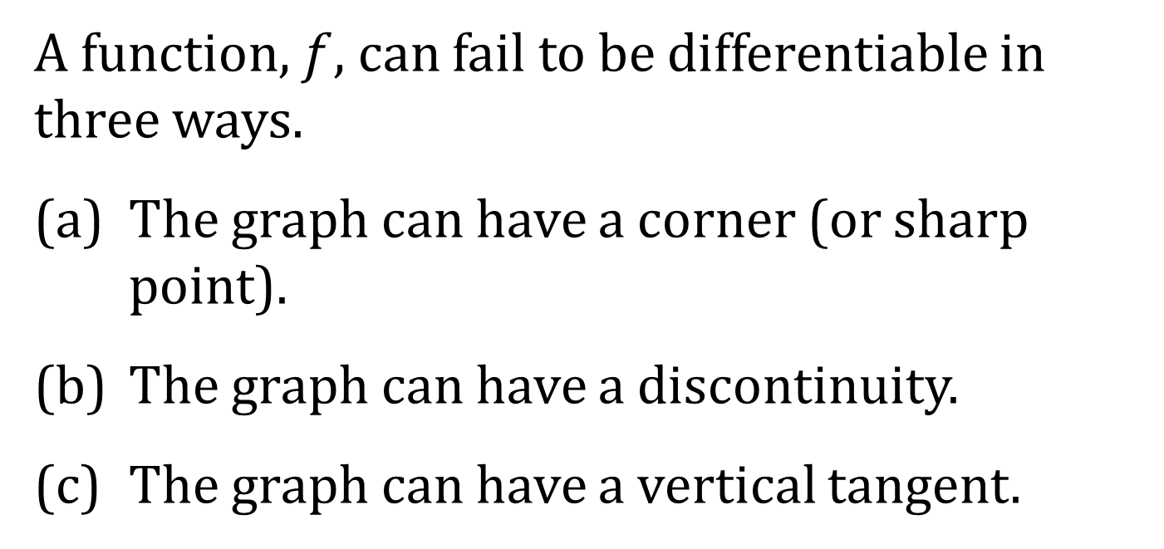
HOW CAN A FUNCTION FAIL TO BE DIFFERENTIABLE?
A function, $f$, can fail to be differentiable in three ways.
(a) The graph can have a corner (or sharp point).
(b) The graph can have a discontinuity.
(c) The graph can have a vertical tangent.

Slide 8
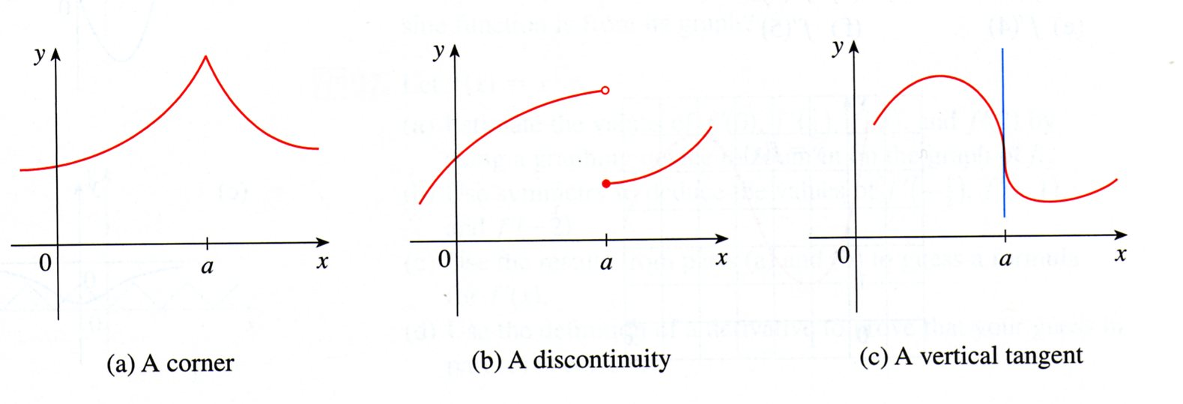

Slide 9
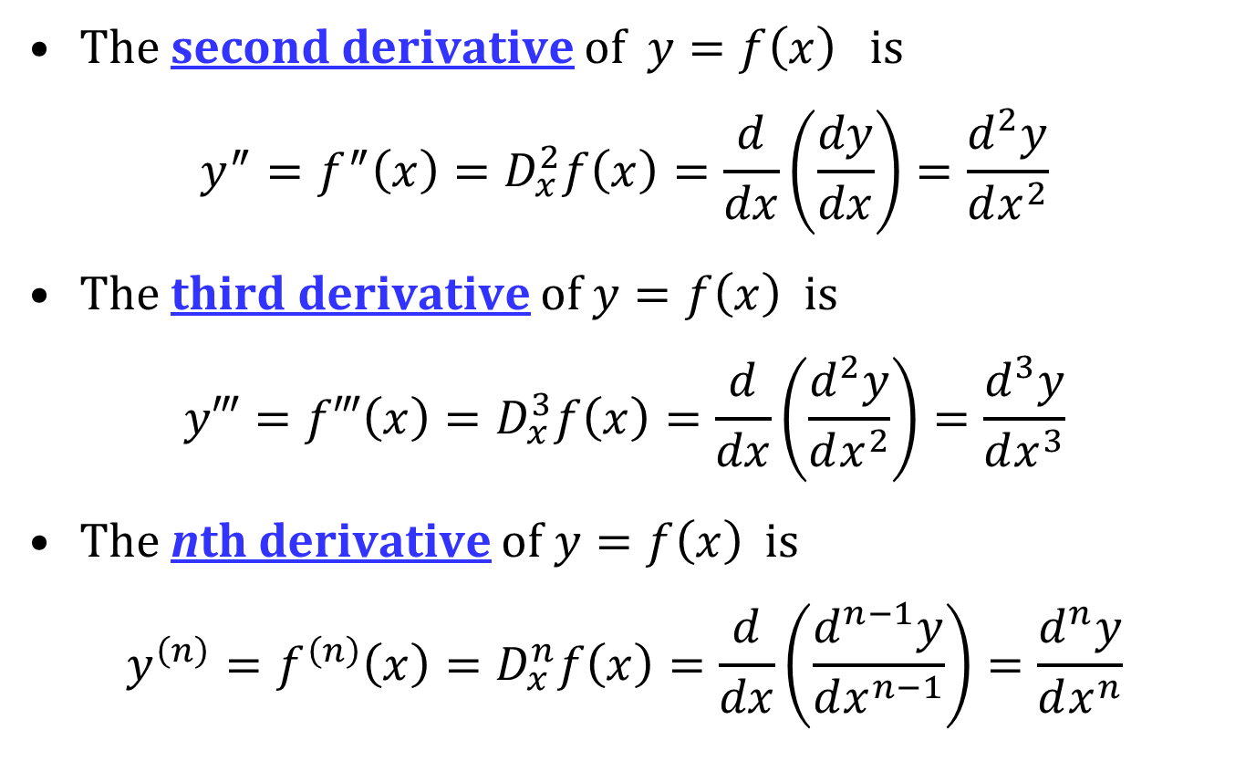
HIGHER ORDER DERIVATIVES
The second derivative of $y=f\left(x\right)$ is
$$y^{″}=f^{″}\left(x\right)=D_{x}^{2}f\left(x\right)=\frac{d}{dx}\left(\frac{dy}{dx}\right)=\frac{d^{2}y}{dx^{2}}$$
The third derivative of $y=f\left(x\right)$ is
$$y‴=f‴\left(x\right)=D_{x}^{3}f\left(x\right)=\frac{d}{dx}\left(\frac{d^{2}y}{dx^{2}}\right)=\frac{d^{3}y}{dx^{3}}$$
The nth derivative of $y=f\left(x\right)$ is
$$y^{\left(n\right)}=f^{\left(n\right)}\left(x\right)=D_{x}^{n}f\left(x\right)=\frac{d}{dx}\left(\frac{d^{n−1}y}{dx^{n−1}}\right)=\frac{d^{n}y}{dx^{n}}$$

