Slide 1
Section 2.1
Derivatives and Rates of Change

Slide 2
THE TANGENT LINE TO A CURVE AT A POINT
Definition: The tangent line to the curve $y=f\left(x\right)$ at the point $P\left(a, f\left(a\right)\right)$ is the line through P with slope $m$ where
$$m=\lim_{x→a}{\frac{f\left(x\right)−f\left(a\right)}{x−a}} \\ =\lim_{h→0}{\frac{f\left(a+h\right)−f\left(a\right)}{h}}$$
provided the limit exists.
We sometimes refer to the slope of the tangent line at a point as the slope of the curve at that point.

Slide 3
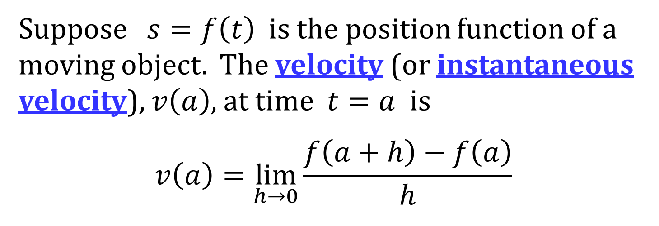
INSTANTANEOUS VELOCITY
Suppose $s=f\left(t\right)$ is the position function of a moving object. The velocity (or instantaneous velocity), $v\left(a\right)$, at time $t=a$ is
$$v\left(a\right)=\lim_{h→0}{\frac{f\left(a+h\right)−f\left(a\right)}{h}}$$

Slide 4
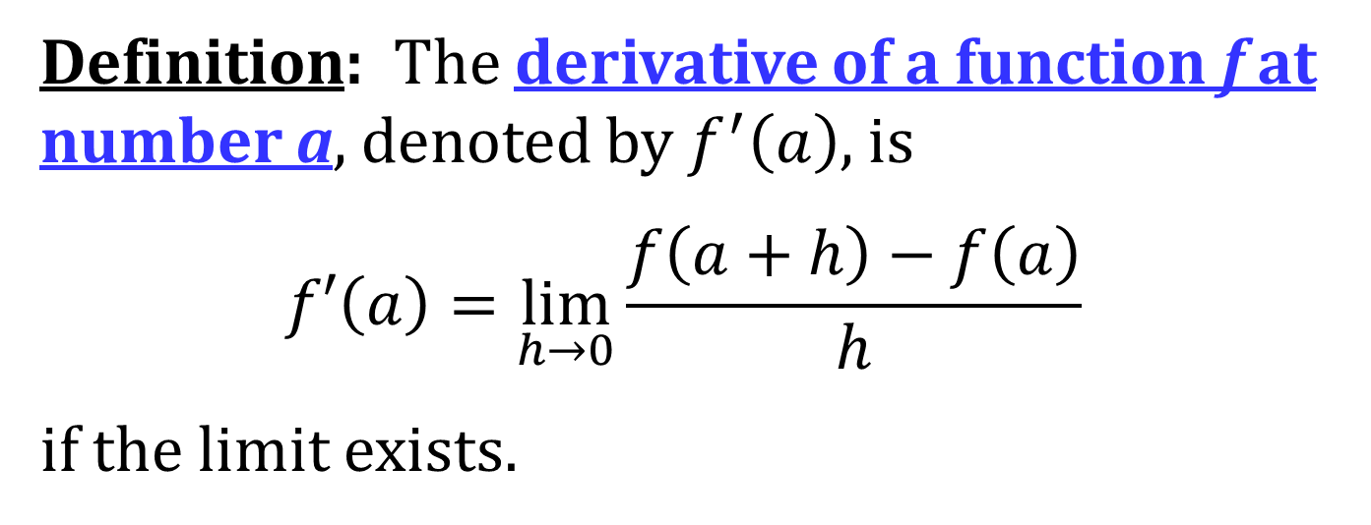
THE DERIVATIVE AT A POINT
Definition: The derivative of a function f at number a, denoted by $f^{′}\left(a\right)$, is
$$f′\left(a\right)=\lim_{h→0}{\frac{f\left(a+h\right)−f\left(a\right)}{h}}$$
if the limit exists.

Slide 5
AN ALTERNATIVE FORM OF THE DERIVATIVE
$$f^{′}\left(a\right)=\lim_{x→a}{\frac{f\left(x\right)−f\left(a\right)}{x−a}}$$

Slide 6
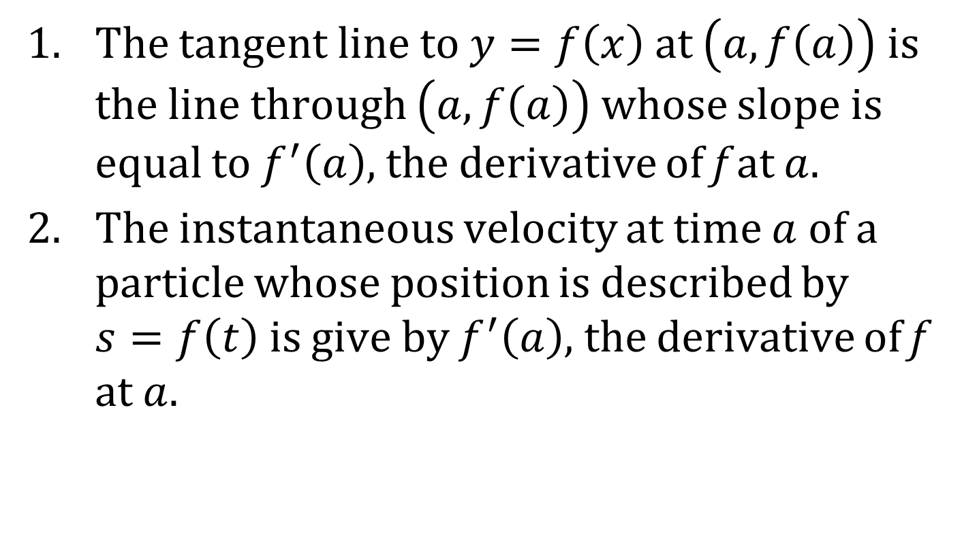
INTERPRETATIONS OF THE DERIVATIVE
The tangent line to $y=f\left(x\right)$ at $\left(a, f\left(a\right)\right)$ is the line through $\left(a, f\left(a\right)\right)$ whose slope is equal to $f^{′}\left(a\right)$, the derivative of f at $a$.
The instantaneous velocity at time $a$ of a particle whose position is described by $s=f\left(t\right)$ is give by $f^{′}\left(a\right)$, the derivative of f at $a$.

Slide 7
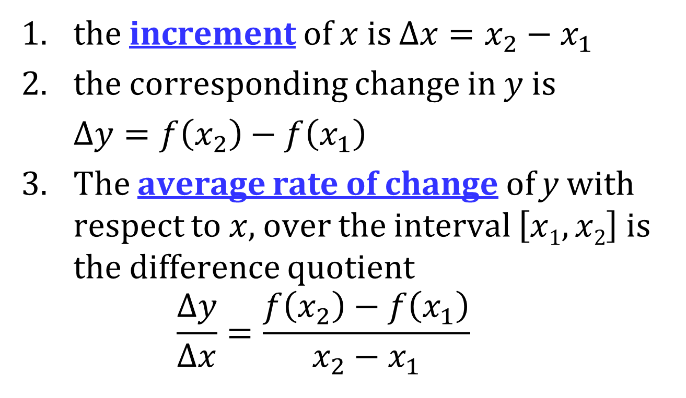
RATE OF CHANGE
Let $y=f\left(x\right)$. If $x$ changes from $x_{1}$ to $x_{2}$, then
1. the increment of $x$ is $Δx=x_{2}−x_{1}$
2. the corresponding change in $y$ is
$Δy=f\left(x_{2}\right)−f\left(x_{1}\right)$
3. The average rate of change of y with respect to $x$, over the interval $\left[x1, x2\right]$ is the difference quotient
$$\frac{Δy}{Δx}=\frac{f\left(x_{2}\right)−f\left(x_{1}\right)}{x_{2}−x_{1}}$$

Slide 8
RATE OF CHANGE (CONCLUDED)
4. The instantaneous rate of change is
$$\lim_{Δx→0}{\frac{Δy}{Δx}}=\lim_{x_{2}→x_{1}}\frac{f\left(x_{2}\right)−f\left(x_{1}\right)}{x_{2}−x_{1}}$$

Slide 9
ANOTHER INTERPRETATION OF THE DERIVATIVE
The derivative $f^{′}\left(a\right)$ is the instantaneous rate of change of $y=f\left(x\right)$ with respect to $x$ when $x=a$.

