Slide 1
Section 1.8
Continuity

Slide 2
CONTINUITY AT A NUMBER a
Definition: A function f is continuous at a number $a$ if
$$\lim_{x→a}{f(x)}=f\left(a\right).$$

Slide 3
INTERPRETATION OF THE DEFINITION
Notice that the definition on the previous slide implicitly requires three things if f is continuous at $a$.
1. $f\left(a\right)$ is defined (that is, $a$ is in the domain of f )
$$2. \lim_{x→a}{f(x)} exists$$
$$3. \lim_{x→a}{f(x)}=f\left(a\right)$$

Slide 4
DISCONTINUITIES
Definition: If f is defined near $a$, we say that f has a discontinuity at $a$, or f is discontinuous at a, if f is not continuous at $a$.

Slide 5
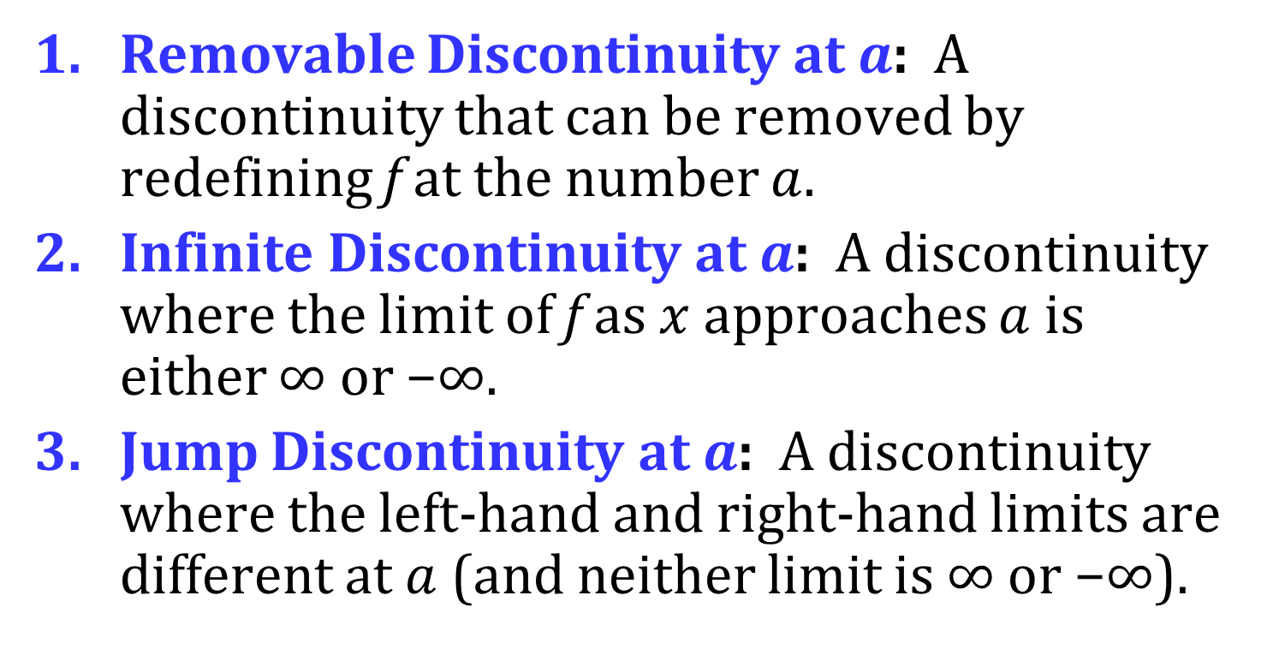
TYPES OF DISCONTINUITIES
There are three types of discontinuities.
Removable Discontinuity at $a$: A discontinuity that can be removed by redefining f at the number $a$.
Infinite Discontinuity at $a$: A discontinuity where the limit of f as $x$ approaches $a$ is either ∞ or −∞.
Jump Discontinuity at $a$: A discontinuity where the left-hand and right-hand limits are different at $a$ (and neither limit is ∞ or −∞).

Slide 6
LEFT CONTINUOUS AND RIGHT CONTINUOUS
Definition: A function f is continuous from the left at a number $a$ if
$$\lim_{x→a^{−}}{f\left(x\right)}=f\left(a\right)$$
Definition: A function f is continuous from the right at a number $a$ if
$$\lim_{x→a^{+}}{f\left(x\right)}=f\left(a\right)$$

Slide 7
CONTINUITY ON AN INTERVAL
Definition: A function f is continuous on an interval if it is continuous at every number in the interval.

Slide 8
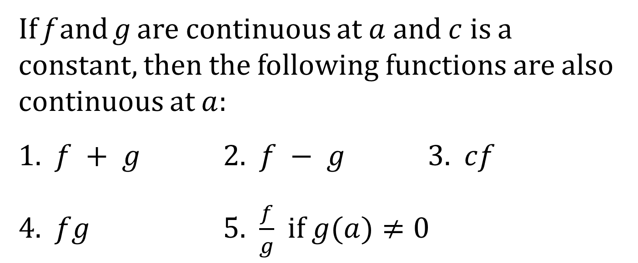
THEOREM
If f and g are continuous at $a$ and $c$ is a constant, then the following functions are also continuous at $a$:
1. $f + g$ 2. $f − g$ 3. $cf$
4. $fg$ 5. $\frac{f}{g}$ if $g(a)≠0$

Slide 9
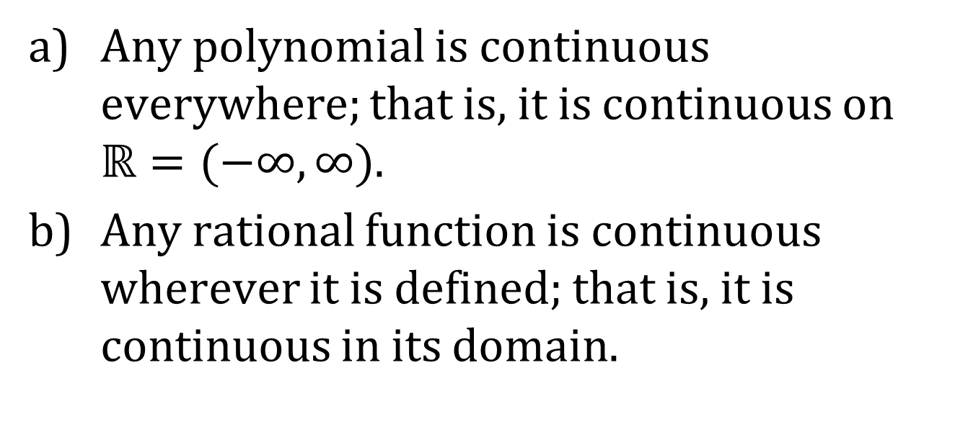
CONTINUITY OF POLYNOMIALS AND RATIONAL FUNCTIONS
Theorem:
Any polynomial is continuous everywhere; that is, it is continuous on $ℝ=(−∞, ∞)$.
Any rational function is continuous wherever it is defined; that is, it is continuous in its domain.

Slide 10
The following types of functions are continuous at every number in their domains:
polynomials rational functions
root functions trigonometric functions

Slide 11
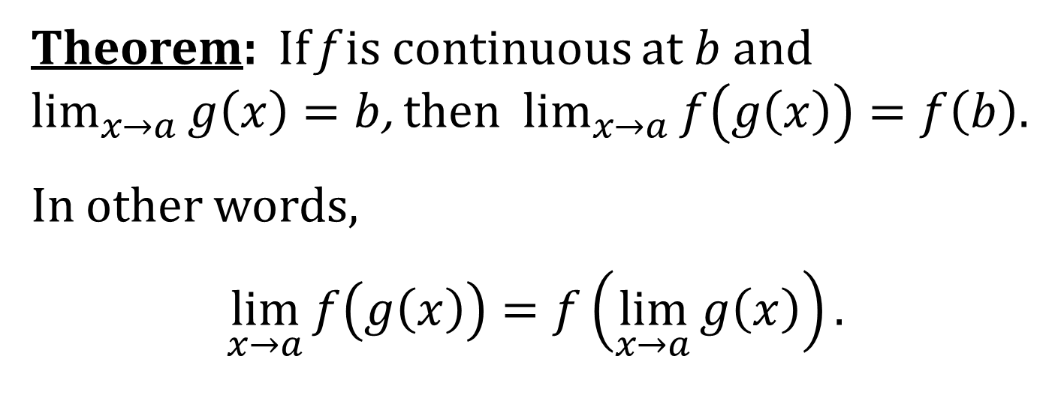
THE COMPOSITE LIMIT THEOREM
Theorem: If f is continuous at $b$ and $\lim_{x→a}{g\left(x\right)=b}$, then $\lim_{x→a}{f\left(g\left(x\right)\right)}=f\left(b\right).$
In other words,
$$\lim_{x→a}{f\left(g\left(x\right)\right)}=f\left(\lim_{x→a}{g\left(x\right)}\right).$$
This theorem says that a limit symbol can be moved through a function symbol if the function is continuous and the limit exists. In other words, the order of these two symbols can be reversed.

Slide 12
A COROLLARY OF THE COMPOSITE LIMIT THEOREM
If g is continuous at $a$ and f is continuous at $g\left(a\right)$, then the composite function $f∘g$ given by $\left(f ∘g\right)\left(x\right)=f\left(g\left(x\right)\right)$ is continuous at $a$.

Slide 13
THE INTERMEDIATE VALUE THEOREM
Theorem: Suppose that f is continuous on the closed interval $\left[a, b\right]$ and let N be a number between $f\left(a\right)$ and $f\left(b\right)$, where $f\left(a\right)≠f\left(b\right)$. Then there exists a number $c$ in $\left(a, b\right)$ such that $f\left(c\right)=N$.

