Slide 1
Section 1.7
The Precise Definition of a Limit

Slide 2
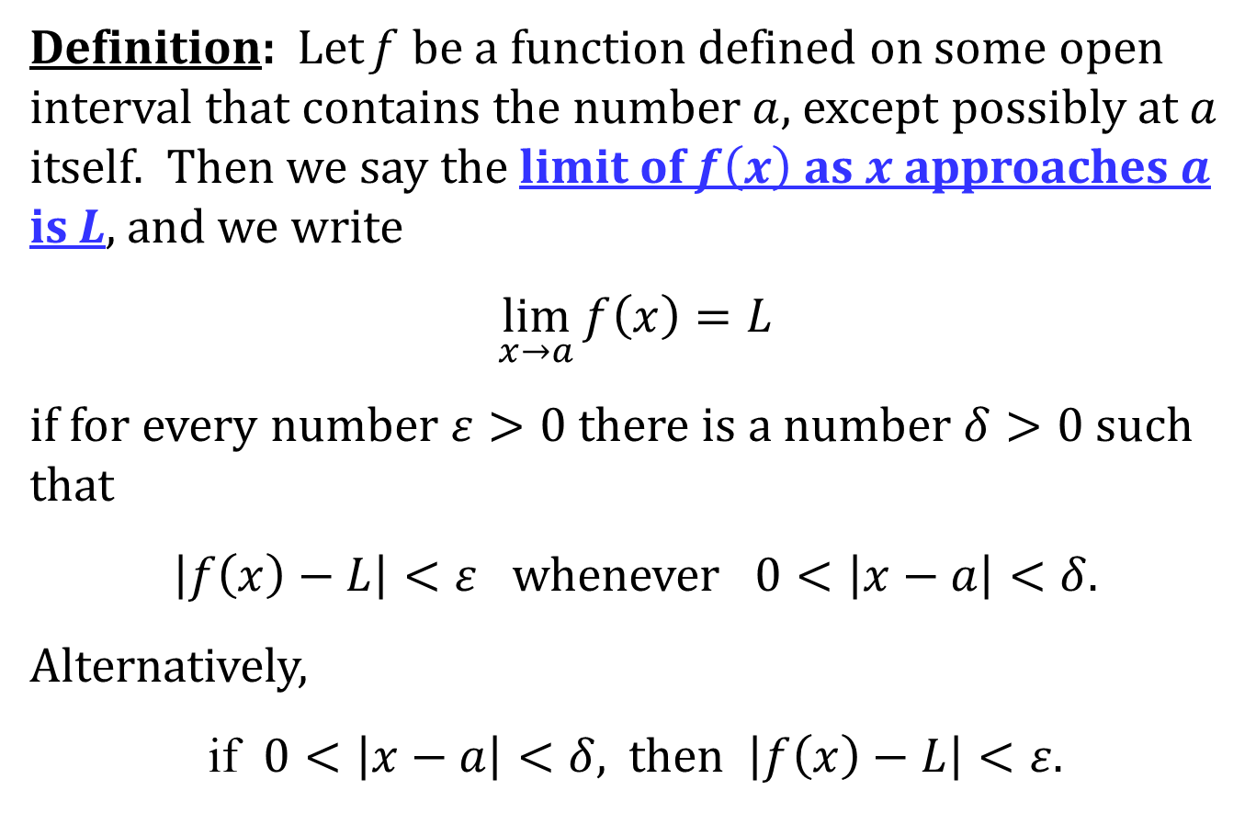
THE PRECISE DEFINITION OF A LIMIT
Definition: Let f be a function defined on some open interval that contains the number $a$, except possibly at $a$ itself. Then we say the limit of $f\left(x\right)$ as $x$ approaches $a$ is L, and we write
$$\lim_{x→a}{f\left(x\right)}=L$$
if for every number $ε>0$ there is a number $δ>0$ such that
$\left|f\left(x\right)−L\right|<ε$ whenever $0<\left|x−a\right|<δ$.
Alternatively,
if $0<\left|x−a\right|<δ$, then $\left|f\left(x\right)−L\right|<ε$.

Slide 3
LEFT-HAND AND RIGHT-HAND LIMITS
See page 77 of the text for the precise definition of left-hand and right-hand limits.

Slide 4
INFINITE LIMITS
Definition: Let f be a function defined on some open interval that contains the number $a$, except possibly at $a$. Then
$$\lim_{x→a}{f(x)}=∞$$
means that for every positive number $M$ there is a positive number $δ$ such that
$f\left(x\right)>M$ whenever $0<\left|x−a\right|<δ.$

Slide 5
There is a similar definition for
$$\lim_{x→a}{f(x)}=−∞$$
on page 80 of the text.

