Slide 1
Section 1.6
Calculating Limits Using the Limit Laws

Slide 2
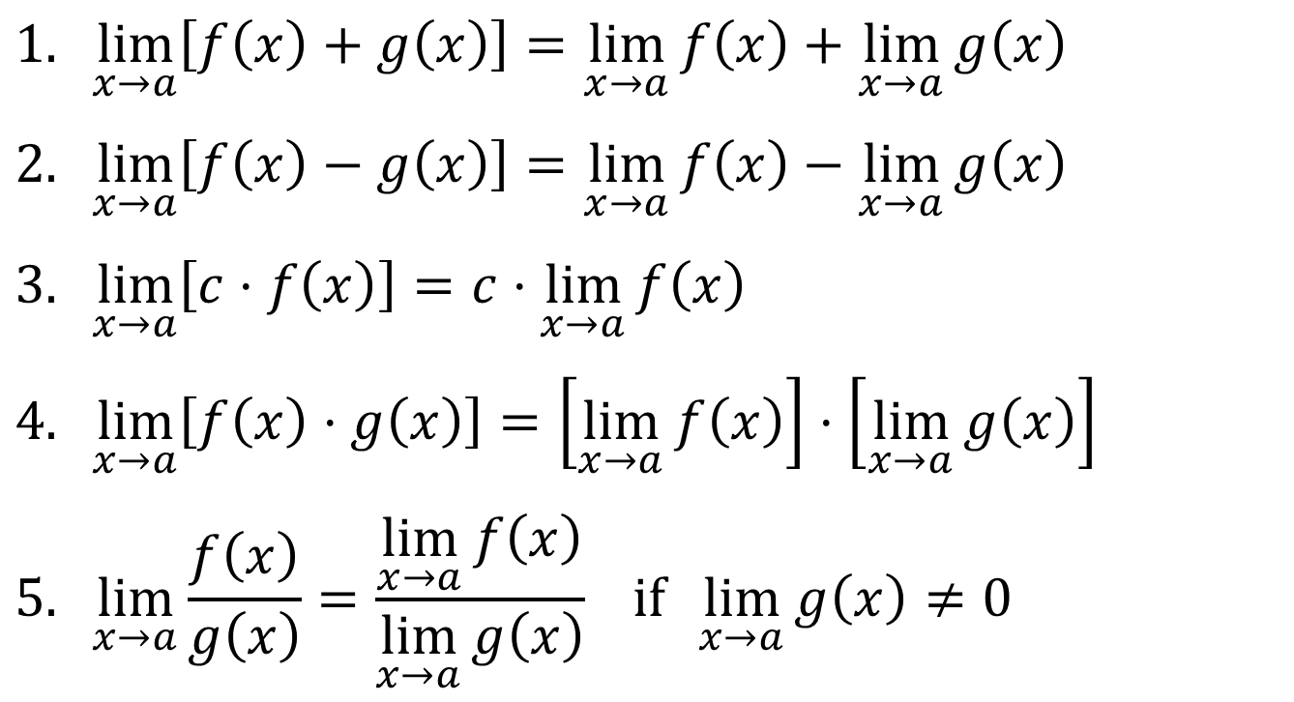
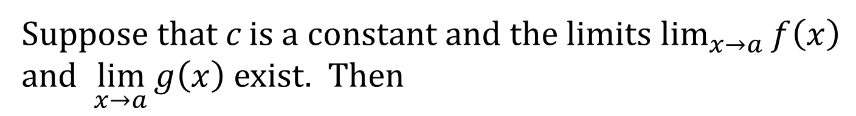
LIMIT LAWS THEOREM
Suppose that c is a constant and the limits $\lim_{x→a}{f\left(x\right)}$ and $\lim_{x→a}{g\left(x\right)}$ exist. Then
$$1. \lim_{x→a}\left[f\left(x\right)+g\left(x\right)\right]=\lim_{x→a}{f\left(x\right)}+\lim_{x→a}{g\left(x\right)}$$
$$2. \lim_{x→a}\left[f\left(x\right)−g\left(x\right)\right]=\lim_{x→a}{f\left(x\right)}−\lim_{x→a}{g\left(x\right)}$$
$$3. \lim_{x→a}\left[c⋅f\left(x\right)\right]=c⋅\lim_{x→a}{f\left(x\right)}$$
$$4. \lim_{x→a}\left[f\left(x\right)⋅g\left(x\right)\right]=\left[\lim_{x→a}{f\left(x\right)}\right]⋅\left[\lim_{x→a}{g\left(x\right)}\right]$$
$$5. \lim_{x→a}{\frac{f\left(x\right)}{g\left(x\right)}}=\frac{\lim_{x→a}{f\left(x\right)}}{\lim_{x→a}{g\left(x\right)}} if \lim_{x→a}{g\left(x\right)}≠0$$

Slide 3
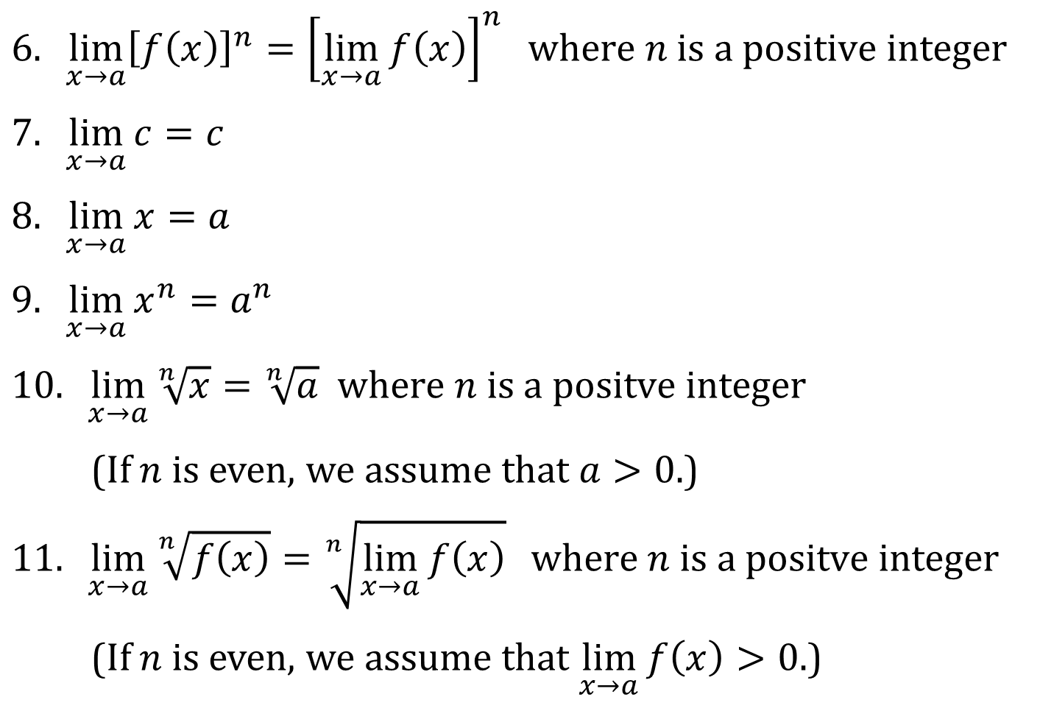
LIMIT LAWS (CONTINUED)
$$6. \lim_{x→a}{{\left[f\left(x\right)\right]}^{n}}={\left[\lim_{x→a}{f\left(x\right)}\right]}^{n} where n is a positive integer$$
$$7. \lim_{x→a}{c}=c$$
$$8. \lim_{x→a}{x}=a$$
$$9. \lim_{x→a}{x^{n}}=a^{n}$$
$$10. \lim_{x→a}{\sqrt[n]{x}}=\sqrt[n]{a} where n is a positve integer$$
(If $n$ is even, we assume that $a>0$.)
$$11. \lim_{x→a}{\sqrt[n]{f\left(x\right)}}=\sqrt[n]{\lim_{x→a}{f\left(x\right)}} where n is a positve integer$$
(If $n$ is even, we assume that $\lim_{x→a}{f\left(x\right)}>0$.)

Slide 4
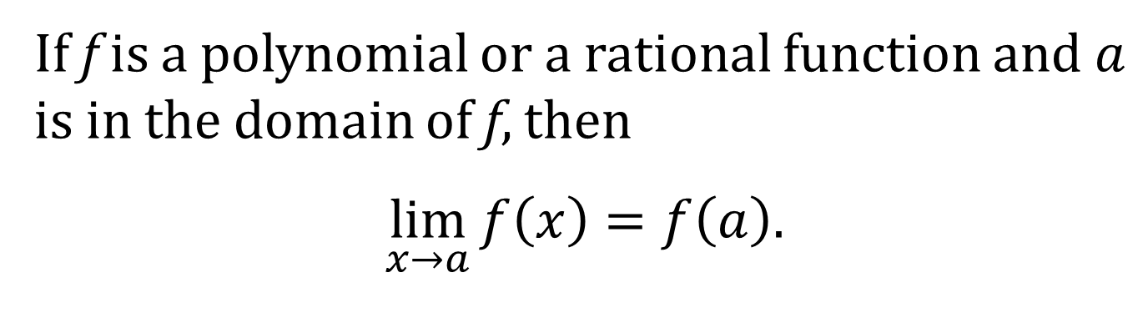
DIRECT SUBSTITUTION PROPERTY
If f is a polynomial or a rational function and $a$ is in the domain of f, then
$$\lim_{x→a}{f\left(x\right)}=f\left(a\right).$$

Slide 5
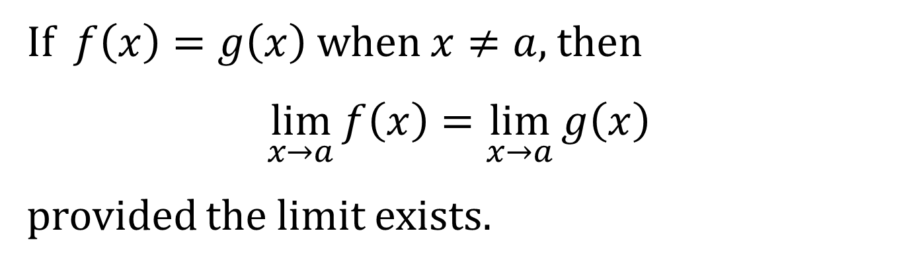
ANOTHER LIMIT PROPERTY
If $f\left(x\right)=g\left(x\right)$ when $x≠a$, then
$$\lim_{x→a}{f\left(x\right)}=\lim_{x→a}{g\left(x\right)}$$
provided the limit exists.

Slide 6
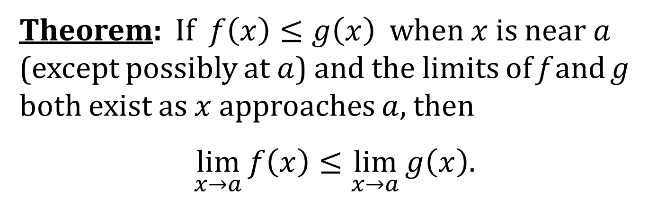
A LIMIT THEOREM
Theorem: If $f\left(x\right)≤g\left(x\right)$ when $x$ is near $a$ (except possibly at $a$) and the limits of f and g both exist as $x$ approaches $a$, then
$$\lim_{x→a}{f\left(x\right)}≤\lim_{x→a}{g\left(x\right).}$$

Slide 7
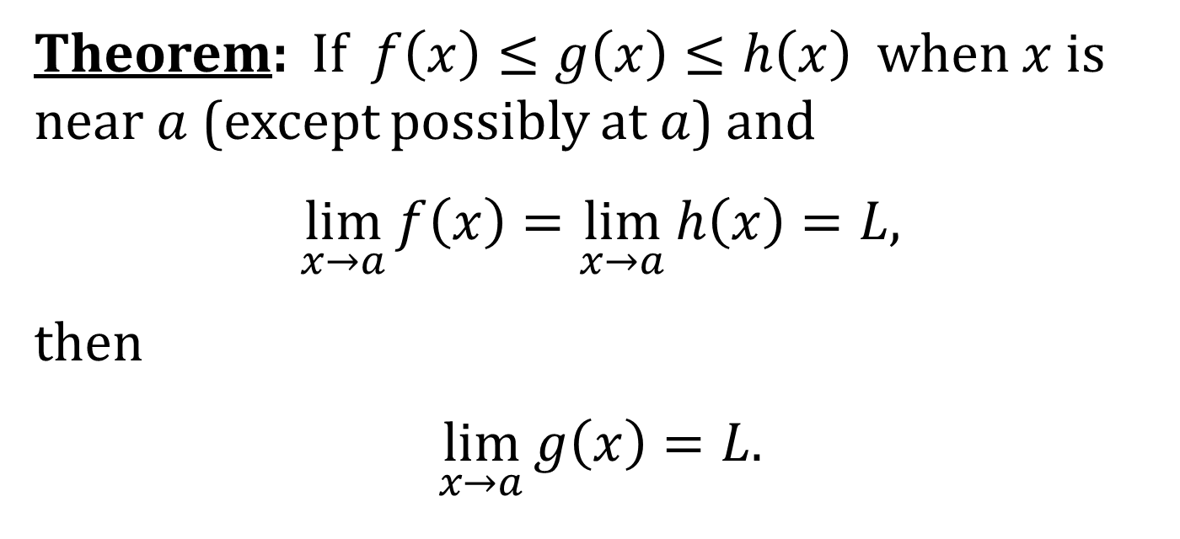
THE SQUEEZE THEOREM
Theorem: If $f\left(x\right)≤g\left(x\right)≤h\left(x\right)$ when $x$ is near $a$ (except possibly at $a$) and
$$\lim_{x→a}{f\left(x\right)}=\lim_{x→a}{h\left(x\right)}=L,$$
then
$$\lim_{x→a}{g\left(x\right)}=L.$$
NOTE: This theorem is also sometimes called the Sandwich Theorem.

