Slide 1
Section 1.5
The Limit of a Function

Slide 2
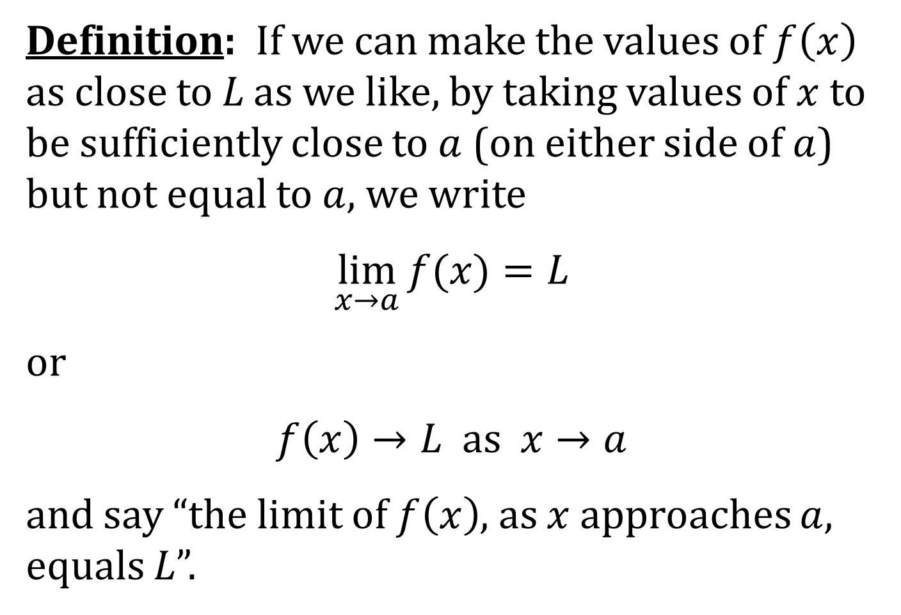
THE LIMIT OF A FUNCTION
Definition: If we can make the values of $f\left(x\right)$ as close to L as we like, by taking values of $x$ to be sufficiently close to $a$ (on either side of $a$) but not equal to $a$, we write
$$\lim_{x→a}{f(x)}=L$$
or
$$f\left(x\right)→L as x→a$$
and say “the limit of $f\left(x\right)$, as $x$ approaches $a$, equals L”.

Slide 3
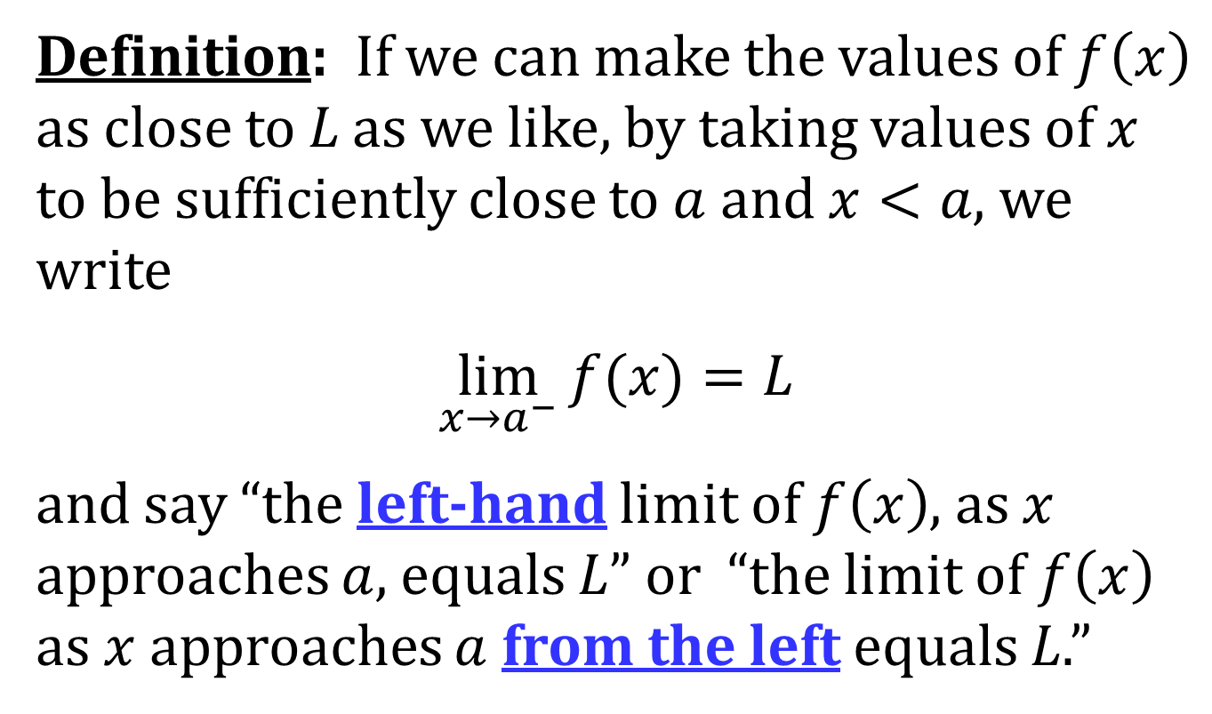
LEFT-HAND LIMITS
Definition: If we can make the values of $f\left(x\right)$ as close to L as we like, by taking values of $x$ to be sufficiently close to $a$ and $x<a$, we write
$$\lim_{x→a^{−}}{f(x)}=L$$
and say “the left-hand limit of $f\left(x\right)$, as $x$ approaches $a$, equals L” or “the limit of $f\left(x\right)$ as $x$ approaches $a$ from the left equals L.”

Slide 4
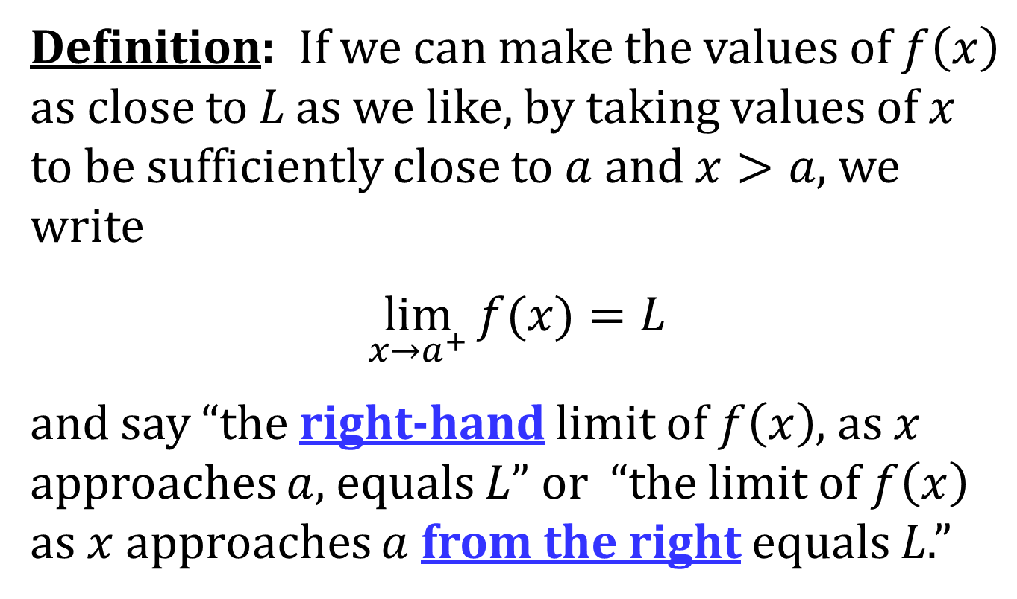
RIGHT-HAND LIMITS
Definition: If we can make the values of $f\left(x\right)$ as close to L as we like, by taking values of $x$ to be sufficiently close to $a$ and $x>a$, we write
$$\lim_{x→a^{+}}{f(x)}=L$$
and say “the right-hand limit of $f\left(x\right)$, as $x$ approaches $a$, equals L” or “the limit of $f\left(x\right)$ as $x$ approaches $a$ from the right equals L.”

Slide 5
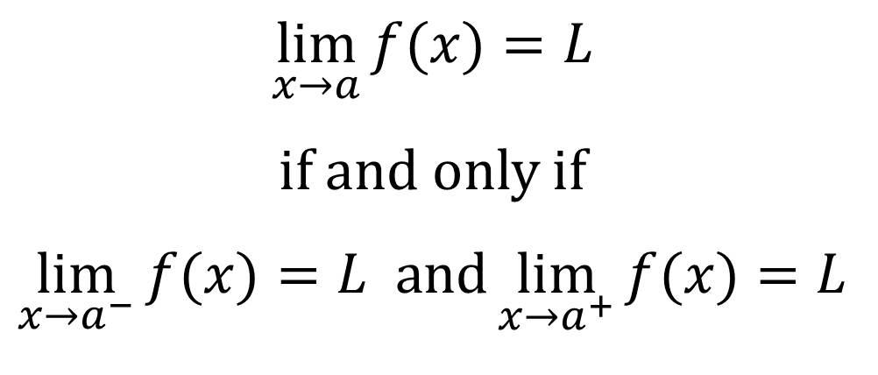
A LEFT-HAND RIGHT-HAND LIMIT THEOREM
Theorem:
$$\lim_{x→a}{f(x)}=L$$
if and only if
$$\lim_{x→a^{−}}{f(x)}=L and\lim_{x→a^{+}}{f(x)}=L$$

Slide 6
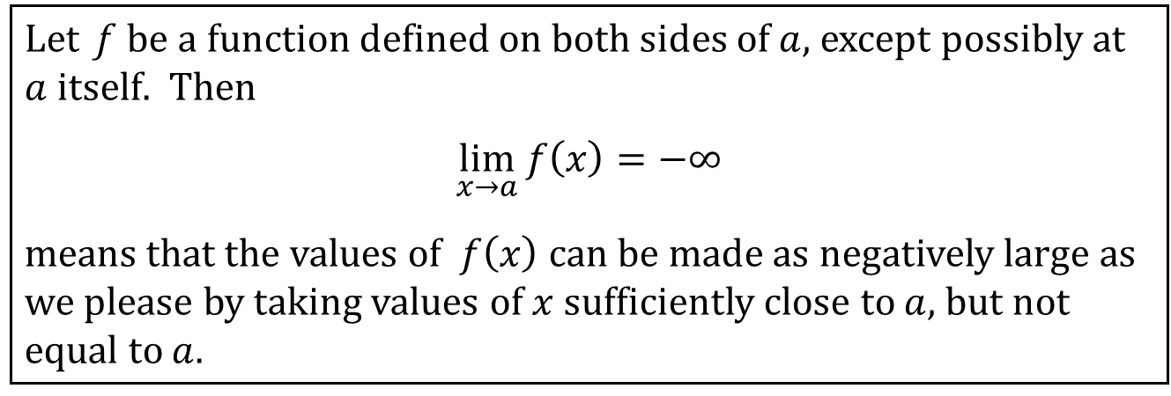
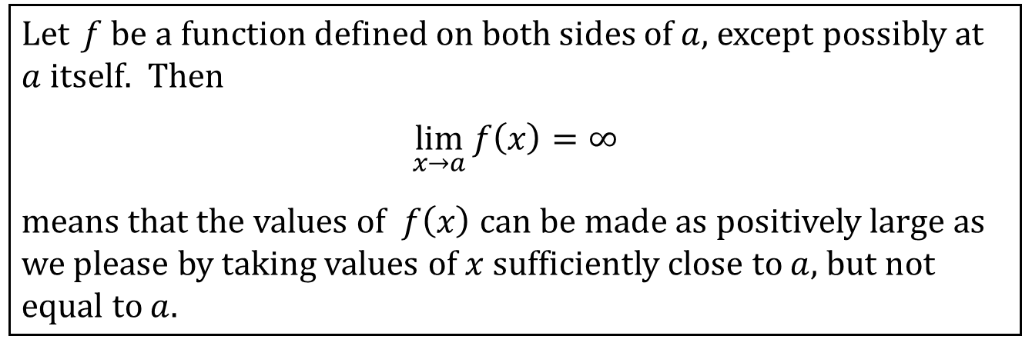
INFINITE LIMITS
Let f be a function defined on both sides of $a$, except possibly at $a$ itself. Then
$$\lim_{x→a}{f\left(x\right)}=∞$$
means that the values of $f\left(x\right)$ can be made as positively large as we please by taking values of $x$ sufficiently close to $a$, but not equal to $a$.
Let f be a function defined on both sides of $a$, except possibly at $a$ itself. Then
$$\lim_{x→a}{f\left(x\right)}=−∞$$
means that the values of $f\left(x\right)$ can be made as negatively large as we please by taking values of $x$ sufficiently close to $a$, but not equal to $a$.

Slide 7
VERTICAL ASYMPTOTES
Definition: The line $x=a$ is called a vertical asymptote of the curve $y=f\left(x\right)$ if at least one of the following statements is true:
$$\lim_{x→a}{f\left(x\right)}=∞$$ | $$\lim_{x→a^{−}}{f\left(x\right)}=∞$$ | $$\lim_{x→a^{+}}{f\left(x\right)}=∞$$
$$\lim_{x→a}{f\left(x\right)}=−∞$$ | $$\lim_{x→a^{−}}{f\left(x\right)}=−∞$$ | $$\lim_{x→a^{+}}{f\left(x\right)}=−∞$$
It is NOT the vertical asymptotes that cause the limits to be ∞ or −∞, but rather the limits being ∞ or −∞ that create the vertical asymptotes.

