Slide 1
Section 1.4
The Tangent and Velocity Problems

Slide 2
WHAT IS A TANGENT LINE TO THE GRAPH OF A FUNCTION?
A line l is said to be a tangent to a curve at a point P if the line l touches, but does not intersect, the curve at P.

Slide 3
SECANT LINES
A secant line to a curve is a line that goes through two points, P and Q, on the curve. We will denote the slope of the secant line through PQ by $m_{PQ}$.
In particular, if $y=f\left(x\right)$ is our function and P is the point $\left(a, f\left(a\right)\right)$ and Q is the point $\left(x, f\left(x\right)\right)$, then the slope of the secant line is given by
$$m_{PQ}=\frac{f\left(x\right)−f\left(a\right)}{x−a}$$

Slide 4
THE SLOPE OF THE TANGENT LINE
The slope (m) of the tangent line at P is the limit of the slopes of the secant lines PQ as Q approaches P. That is,
$$m=\lim_{Q→P}{m_{PQ}}$$
In particular, if $y=f\left(x\right)$ is our function and P is the point $\left(a, f\left(a\right)\right)$ and Q is the point $\left(x, f\left(x\right)\right)$, then the slope of the tangent line at $\left(a, f\left(a\right)\right)$ is given by
$$m=\lim_{x→a}{\frac{f\left(x\right)−f\left(a\right)}{x−a}}$$

Slide 5
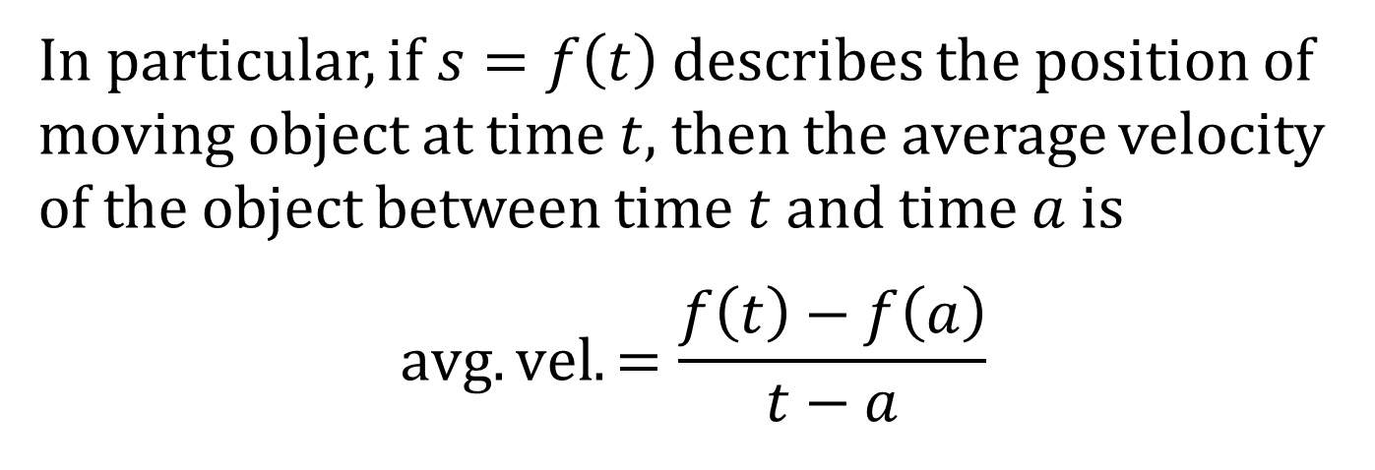
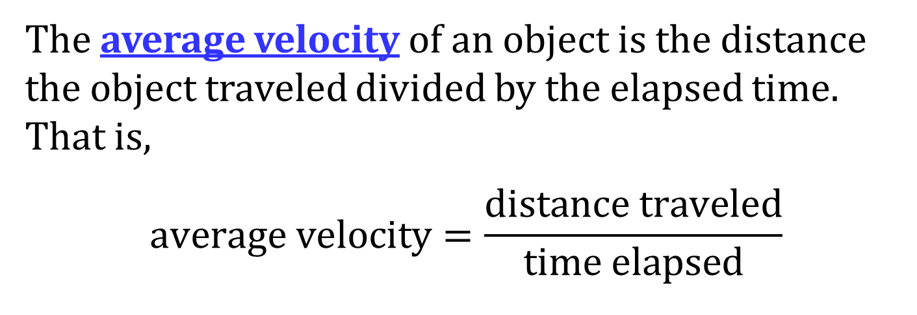
AVERAGE VELOCITY
The average velocity of an object is the distance the object traveled divided by the elapsed time. That is,
$$average velocity=\frac{distance traveled}{time elapsed}$$
In particular, if $s=f\left(t\right)$ describes the position of moving object at time $t$, then the average velocity of the object between time $t$ and time $a$ is
$$avg. vel.=\frac{f\left(t\right)−f\left(a\right)}{t−a}$$

Slide 6
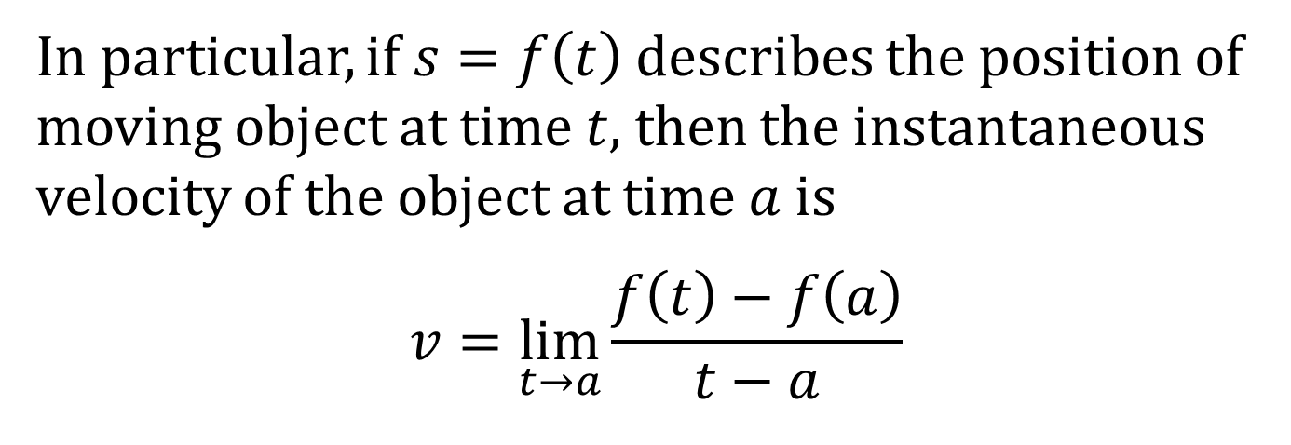
INSTANTANEOUS VELOCITY
The instantaneous velocity is the limiting value of the average velocities over shorter and shorter time periods.
In particular, if $s=f\left(t\right)$ describes the position of moving object at time $t$, then the instantaneous velocity of the object at time $a$ is
$$v=\lim_{t→a}{\frac{f\left(t\right)−f\left(a\right)}{t−a}}$$

