Slide 1
SECTION 6.6
Logarithmic and
Exponential Equations

Slide 2
EXPONENTIAL EQUATION
An exponential equation is an equation in which the variable is located in the exponent.
For example: $3^{x−2}=81$

Slide 3
EQUALITY-OF-EXPONENTS THEOREM
Theorem: If $a^{u}=a^{v}$, then $u=v$, provided that $a>0$ and $a≠1$.
NOTE: This theorem can be used to solve some exponential equations. In particular, it can be used to solve equations in which both sides can be expressed as the same base raised to different powers.
Example: Solve $3^{x−2}=81$

Slide 4
SOLVING EXPONENTIAL EQUATIONS
To solve an exponential equation, you can take the log or ln of both sides. This will allow the exponent to be moved in front of the logarithm.

Slide 5
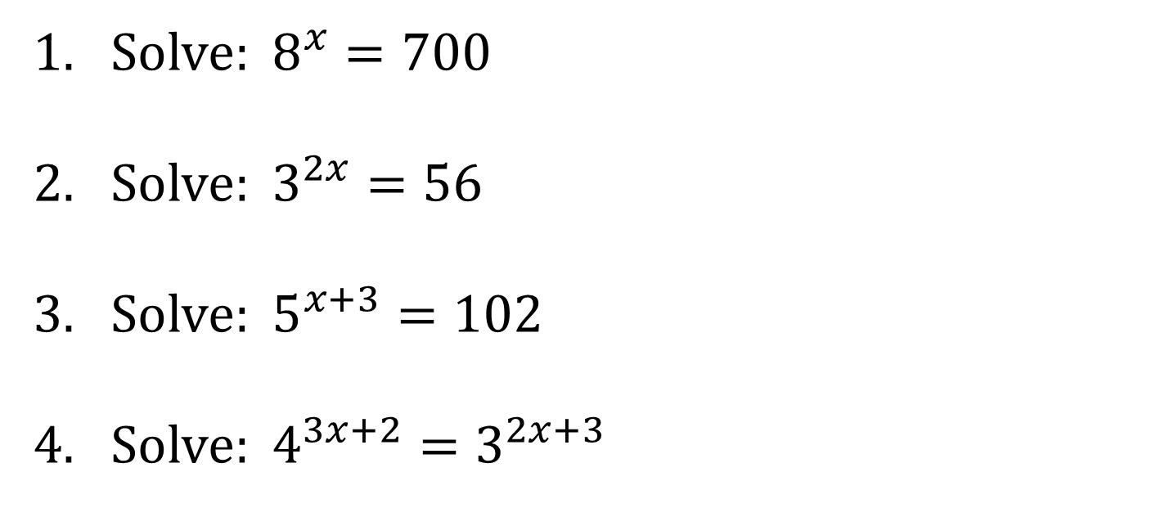
EXAMPLES
1. Solve: $8^{x}=700$
2. Solve: $3^{2x}=56$
3. Solve: $5^{x+3}=102$
4. Solve: $4^{3x+2}=3^{2x+3}$

Slide 6
LOGARITHMIC EQUATIONS
A logarithmic equation is an equation in which the variable is located inside a logarithm.
For example: $\log\left(9x+1\right)=3$

Slide 7
SOLVING LOGARITHMIC EQUATIONS
Some logarithmic equations can be solved by converting the logarithmic form into the exponential form. Sometimes you may first need to use properties of logarithms to write one side as a single logarithm.
When solving logarithmic equations, you MUST ALWAYS check your solutions because some of them may not work.

Slide 8
EXAMPLES
1. Solve: $\log\left(9x+1\right)=3$
2. Solve: $\log_{4}{x}+\log_{4}{(x−30)}=3$
3. Solve: $\log_{3}{(x+4)}=2+\log_{3}{(2x−1)}$

Slide 9
SOLVING LOGARITHMIC EQUATIONS THAT ARE NOT EQUAL TO A CONSTANT
If a logarithmic equation is not equal to (or cannot be made to be equal to) a constant, then use equality property of logarithms which says
$\log_{a}{M}=\log_{a}{N}$ if, and only if, $M=N$.
Example:
Solve: $\ln\left(2x+3\right)=\ln\left(4x+6\right)−\ln\left(1−x\right)$

