Slide 1
Section 6.5
Properties of Logarithms

Slide 2
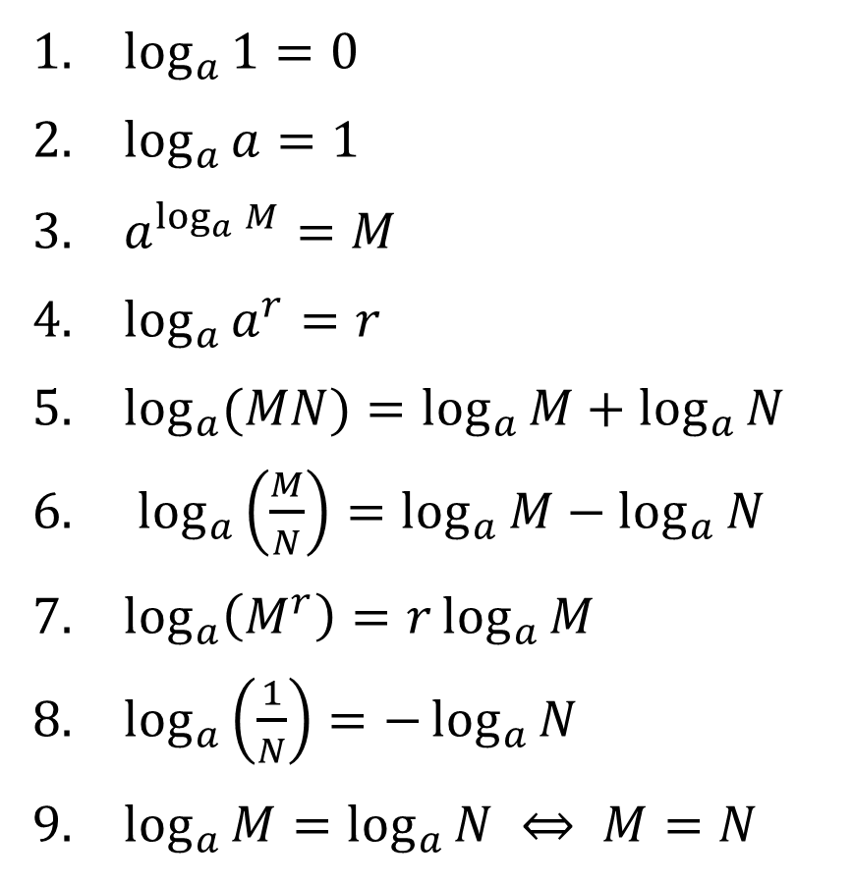
LOGARITHIMIC PROPERTIES
1. $\log_{a}{1}=0$
2. $\log_{a}{a}=1$
3. $a^{\log_{a}{M}}=M$
4. $\log_{a}{a^{r}}=r$
5. $\log_{a}{(MN)}=\log_{a}{M}+\log_{a}{N}$
6. $\log_{a}\left(\frac{M}{N}\right)=\log_{a}{M}−\log_{a}{N}$
7. $\log_{a}\left(M^{r}\right)=r\log_{a}{M}$
8. $\log_{a}\left(\frac{1}{N}\right)=−\log_{a}{N}$
9. $\log_{a}{M}=\log_{a}{N} ⇔ M=N$

Slide 3
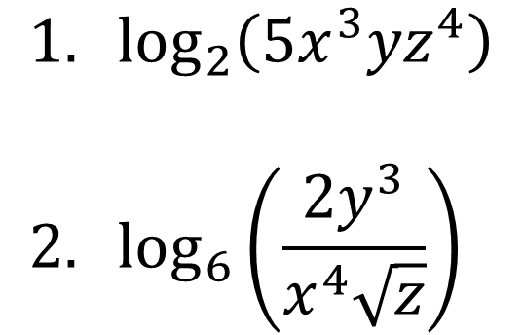
EXAMPLES
Use the properties of logarithms to write each expression as a sum and/or difference of logarithms. Express powers as factors.
$$1. \log_{2}\left(5x^{3}yz^{4}\right) \\ 2. \log_{6}\left(\frac{2y^{3}}{x^{4}\sqrt{z}}\right)$$

Slide 4
EXAMPLES
Use the properties of logarithms to rewrite each expression as a single logarithm.
$$1. \frac{1}{2}\log_{5}{z}−3\log_{5}{y}−2\log_{5}\left(x+5\right) \\ 2. 3\ln\left(y−2\right)−2\ln\left(y−3\right)+4\ln{y}$$

Slide 5
CHANGE OF BASE FORMULA
If M, $a$, and $b$ are positive real numbers with $a≠1$ and $b≠1$, then
$$\log_{a}{M}=\frac{\log_{b}{M}}{\log_{b}{a}}$$
In particular, if M and $a$ are positive real numbers and $a≠1$, then
$$\log_{a}{M}=\frac{\log{M}}{\log{a}}=\frac{\ln{M}}{\ln{a}}$$

Slide 6
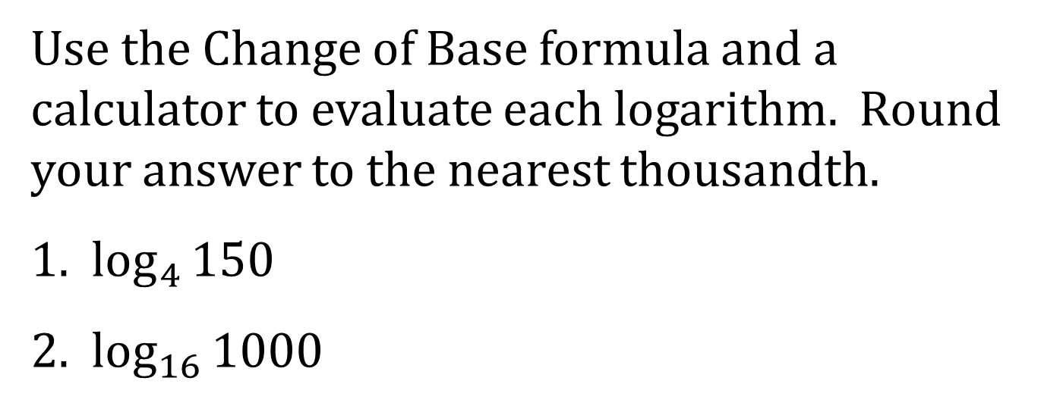
EXAMPLES
Use the Change of Base formula and a calculator to evaluate each logarithm. Round your answer to the nearest thousandth.
1. $\log_{4}{150}$
2. $\log_{16}{1000}$

