Slide 1
Section 6.4
Logarithmic Functions

Slide 2
LOGARITHIMS
Since exponential functions are one-to-one, each has an inverse. These inverse exponential functions are called logarithms.

Slide 3
LOGARITHMIC FUNCTIONS
The logarithmic function with base a, where $a>0$ and $a≠1$, is denoted by $y=\log_{a}{x}$ (read as “$y$ is the logarithm to the base a of $x$”) and is defined by
$y=\log_{a}{x}$ if and only if $x=a y$
The domain of the logarithmic function $y=\log_{a}{x}$ is $x>0$.
NOTE: Logarithms are just another way to express exponents.

Slide 4

EXPONENTIAL AND LOGARITHMIC FORMS
The exponential form of $y=\log_{a}{x}$ is
$ay=x$.
The logarithmic form of $ay=x$ is
$y=\log_{a}{x}$.

Slide 5
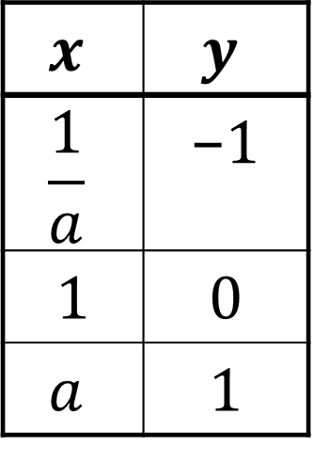
GRAPHING LOGARITHMIC FUNCTIONS
To quickly graph the logarithmic function
$$y=\log_{a}{x}$$
plot points for $x=\frac{1}{a}, 1$, and $a$.
$$x$$ | $$y$$
$$\frac{1}{a}$$ | −1
1 | 0
$$a$$ | 1

Slide 6
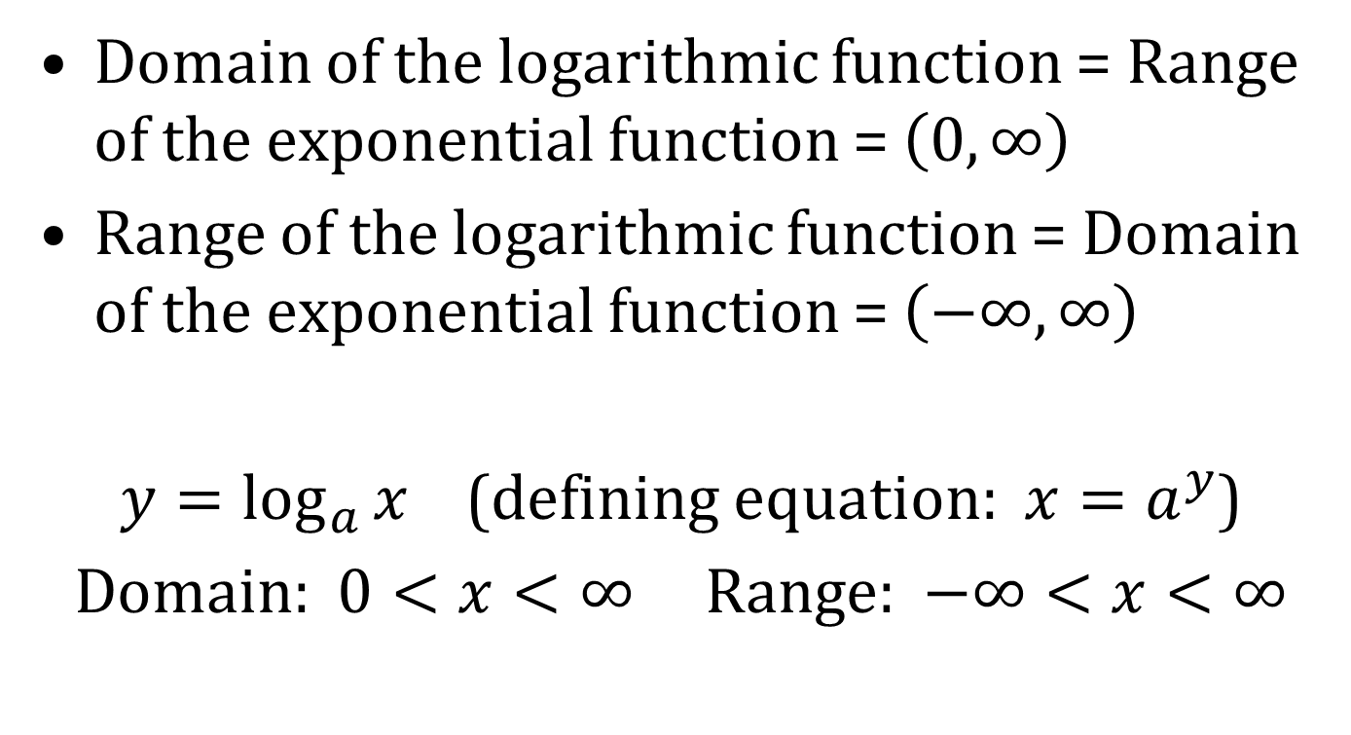
DOMAIN AND RANGE OF LOGARITHMIC FUNCTION
Domain of the logarithmic function = Range of the exponential function = $\left(0, ∞\right)$
Range of the logarithmic function = Domain of the exponential function = $\left(−∞, ∞\right)$
$y=\log_{a}{x}$ (defining equation: $x=a^{y}$)
Domain: $0<x<∞$ Range: $−∞<x<∞$

Slide 7
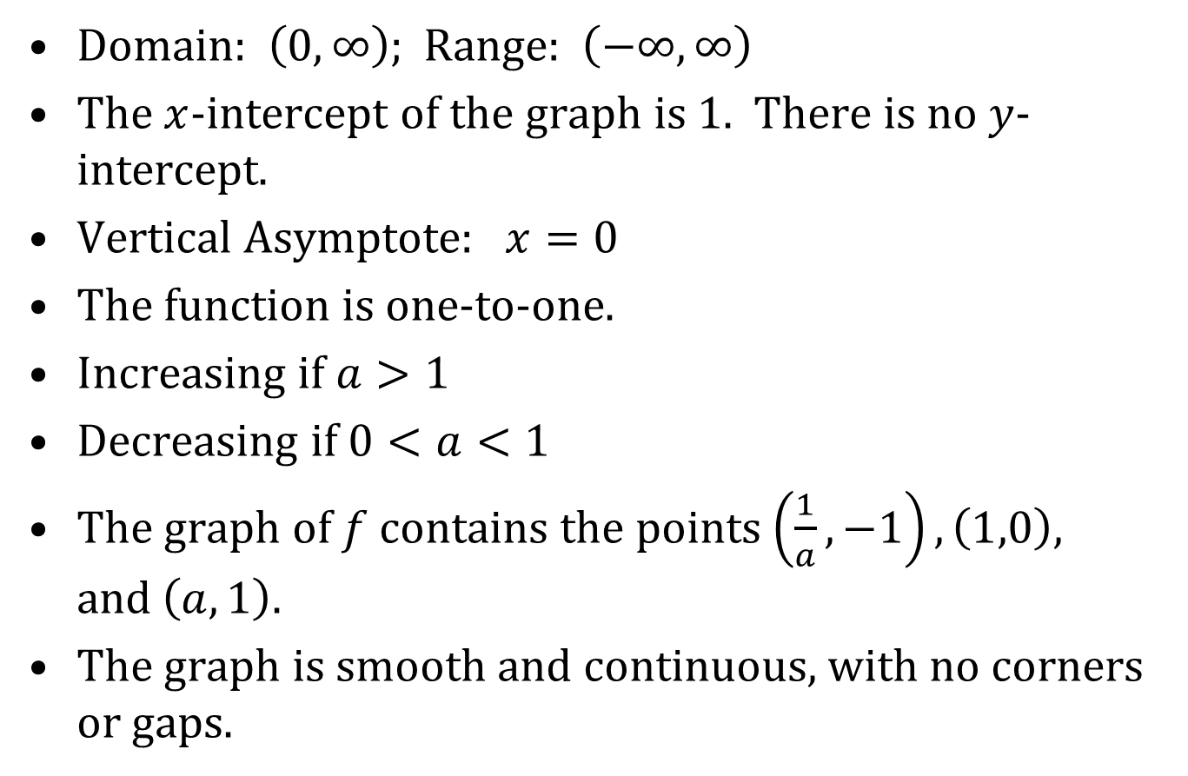
PROPERTIES OF $f\left(x\right)=\log_{a}{x}$
Domain: $\left(0, ∞\right)$; Range: $\left(−∞, ∞\right)$
The $x$-intercept of the graph is 1. There is no $y$-intercept.
Vertical Asymptote: $x=0$
The function is one-to-one.
Increasing if $a>1$
Decreasing if $0<a<1$
The graph of $f$ contains the points $\left(\frac{1}{a},−1\right), \left(1,0\right)$, and$\left(a, 1\right)$.
The graph is smooth and continuous, with no corners or gaps.

Slide 8
DOMAIN OF A GENERAL LOGARITHMIC FUNCTIONS
Since the logarithm of a negative number and the logarithm of zero cannot be taken, the argument of a logarithmic function must always be positive. That is, if $Z$ is an algebraic expression in x, the domain of
$$f\left(x\right)=\log_{a}{Z}$$
is the set of numbers such that $Z>0$.

Slide 9
COMMON AND NATURAL LOGARITHMS
Logarithms with a base of 10 are called common logarithms. We denote this by $\log{x}$. That is,
$$\log{x=\log_{10}{x}}$$
Logarithms with a base of $e$ are called natural logarithms. We denote this by $\ln{x}$. That is,
$$\ln{x}=\log_{e}{x}$$

Slide 10
LOGARITHMIC EQUATIONS
Equations that contain logarithms are called logarithmic equation. Some logarithmic equations can be solved by converting them to exponential form. However, when solving logarithmic equations, you must always check your solutions.

