Slide 1
Sections 6.3
Exponential Functions

Slide 2
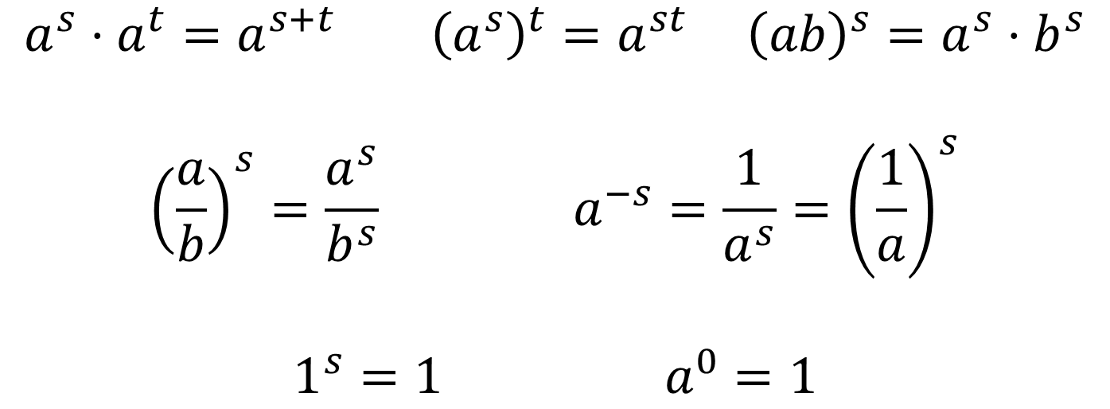
LAWS OF EXPONENTS
If $s, t, a$, and $b$ are real numbers with $a$ positive and $b$ positive, then
$$a^{s}⋅a^{t}=a^{s+t} {\left(a^{s}\right)}^{t}=a^{st} {\left(ab\right)}^{s}=a^{s}⋅b^{s}$$
$${\left(\frac{a}{b}\right)}^{s}=\frac{a^{s}}{b^{s}} a^{−s}=\frac{1}{a^{s}}={\left(\frac{1}{a}\right)}^{s}$$
$$1^{s}=1 a^{0}=1$$

Slide 3
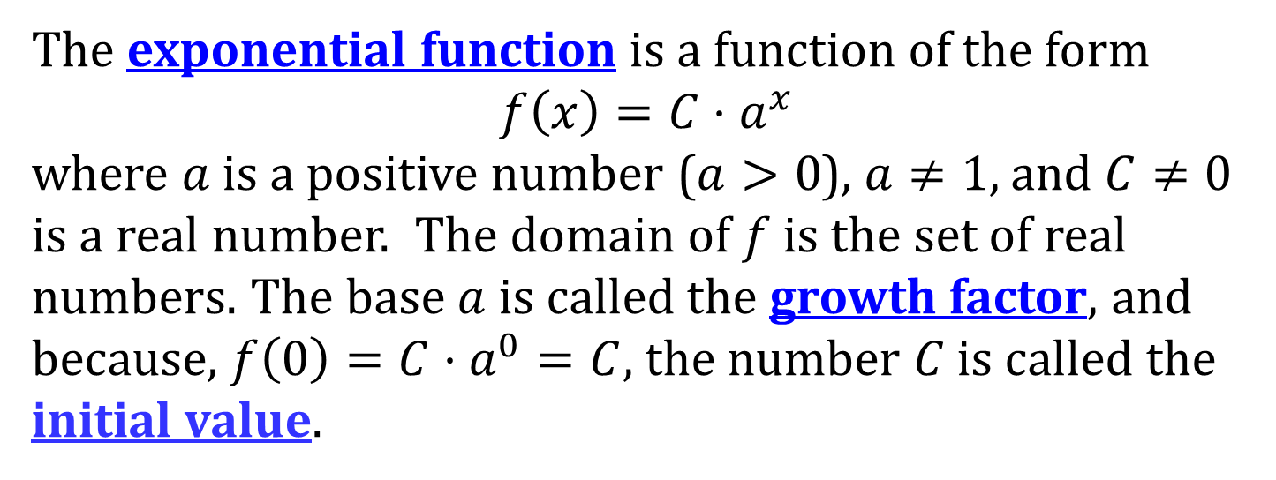
EXPONENTIAL FUNCTION
The exponential function is a function of the form
$$f\left(x\right)={C⋅a}^{x}$$
where $a$ is a positive number ($a>0$), $a≠1$, and $C≠0$ is a real number. The domain of $f$ is the set of real numbers. The base $a$ is called the growth factor, and because, $f\left(0\right)=C⋅a^{0}=C$, the number $C$ is called the initial value.
NOTE: Do not confuse exponential and power functions
$f\left(x\right) = x^{2}$ (power function)
$f\left(x\right)=2^{x}$ (exponential function)

Slide 4
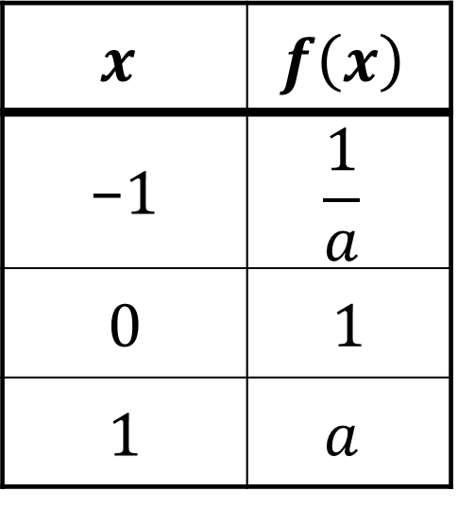
GRAPHING EXPONENTIAL FUNCTIONS
To graph the exponential function
$$f\left(x\right)=a^{x}$$
plot points for $x= –1, 0,$ and 1.
$$x$$ | $$f\left(x\right)$$
−1 | $$\frac{1}{a}$$
0 | 1
1 | $$a$$

Slide 5
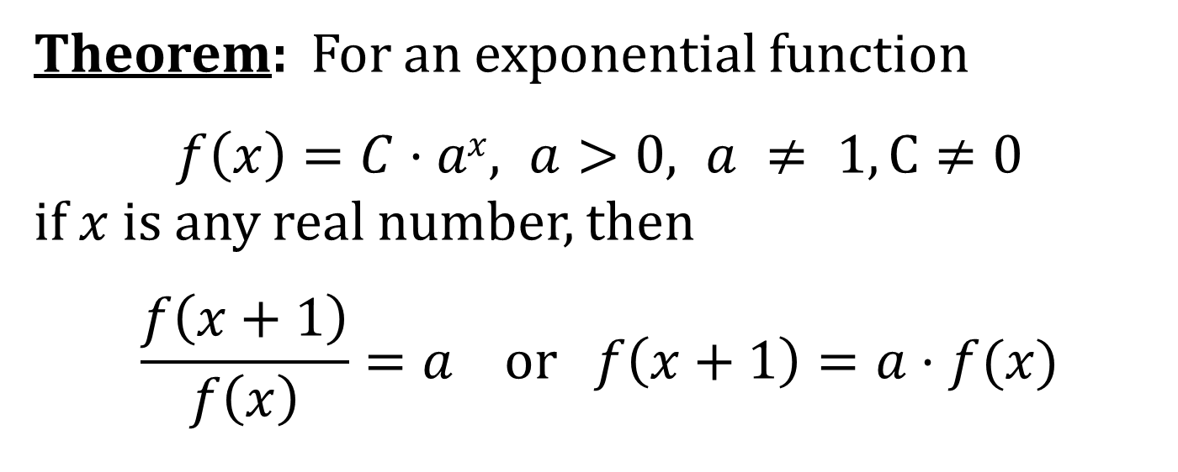
A THEOREM
Theorem: For an exponential function
$f\left(x\right)=C⋅ax, a>0, a ≠ 1, C≠0$
if $x$ is any real number, then
$$\frac{f\left(x+1\right)}{f\left(x\right)}=a or f\left(x+1\right)=a⋅f(x)$$

Slide 6
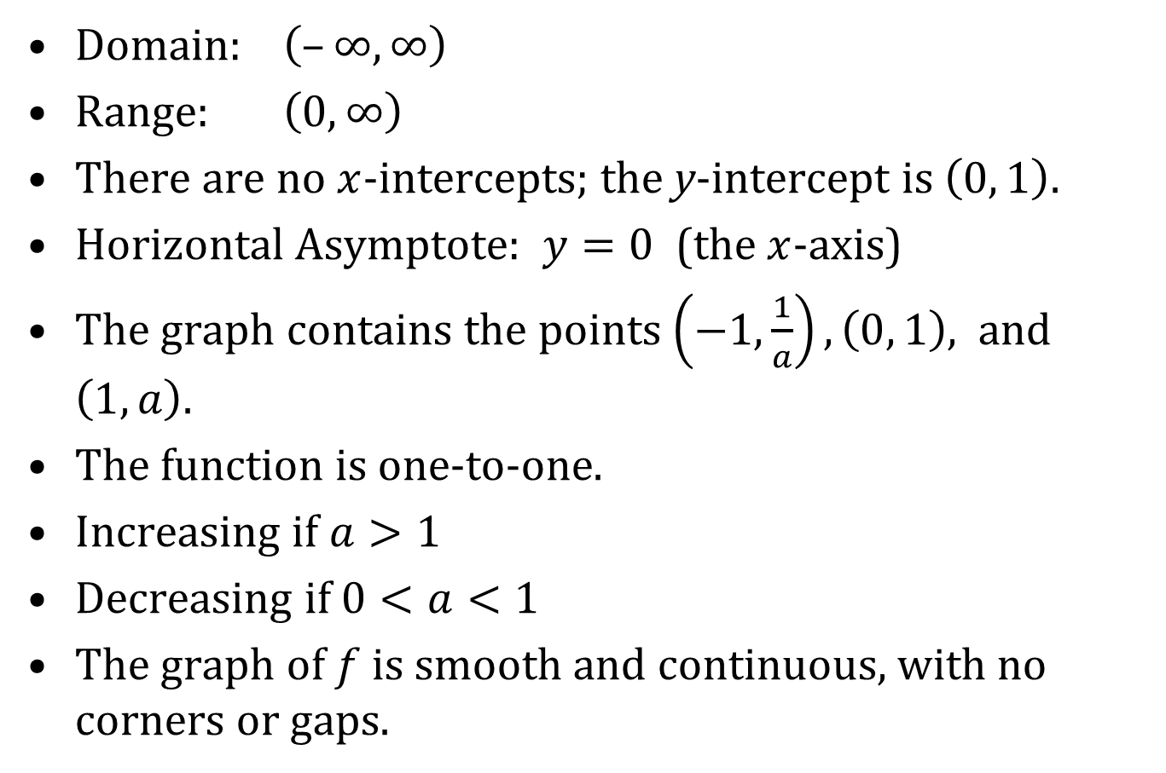
PROPERTIES OF $f\left(x\right)=a^{x}$
Domain: $\left(–∞, ∞\right)$
Range: $\left(0, ∞\right)$
There are no $x$-intercepts; the y-intercept is $\left(0, 1\right)$.
Horizontal Asymptote: $y=0$ (the $x$-axis)
The graph contains the points $\left(−1,\frac{1}{a}\right), \left(0, 1\right),$and $\left(1, a\right)$.
The function is one-to-one.
Increasing if $a>1$
Decreasing if $0<a<1$
The graph of $f$ is smooth and continuous, with no corners or gaps.

Slide 7
GROWTH AND DECAY FUNCTIONS
If an exponential function is increasing, it is called an exponential growth function.
If an exponential function is decreasing, it is called an exponential decay function.

Slide 8
THE NUMBER e
The number e is called the natural number and is often the base of an exponential function. It is defined as the number that the expression
$${\left(1+\frac{1}{n}\right)}^{n}$$
approaches as $n→∞$.
The decimal approximation of $e$ is
$$e≈ 2.718281828459045$$
$$e≈2.7 1828 1828 45 90 45$$

Slide 9
THE NATURAL EXPONENTIAL FUNCTION
The exponential function defined by
$$f\left(x\right)=e^{x}$$
is called the natural exponential function.

Slide 10
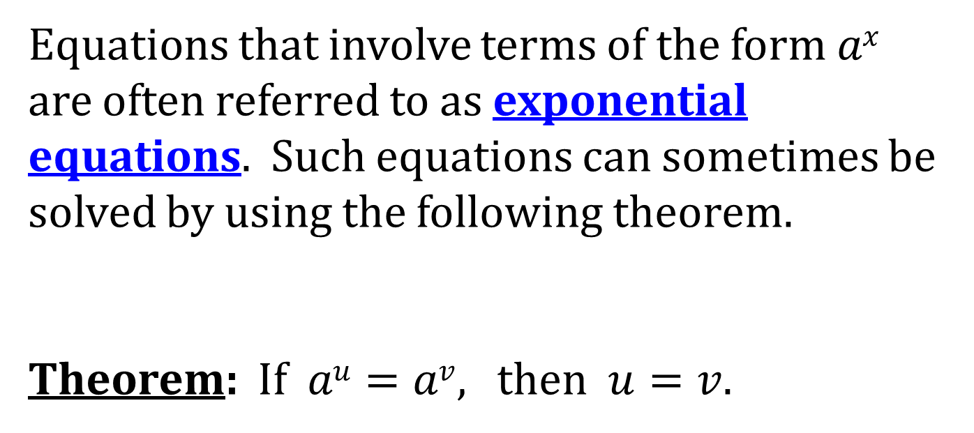
EXPONENTIAL EQUATIONS
Equations that involve terms of the form $ax$ are often referred to as exponential equations. Such equations can sometimes be solved by using the following theorem.
Theorem: If $au=av$, then $u=v$.

