Slide 1
Section 6.1 Section 6.2
Composite Functions
One-to-One Functions; Inverse Functions

Slide 2
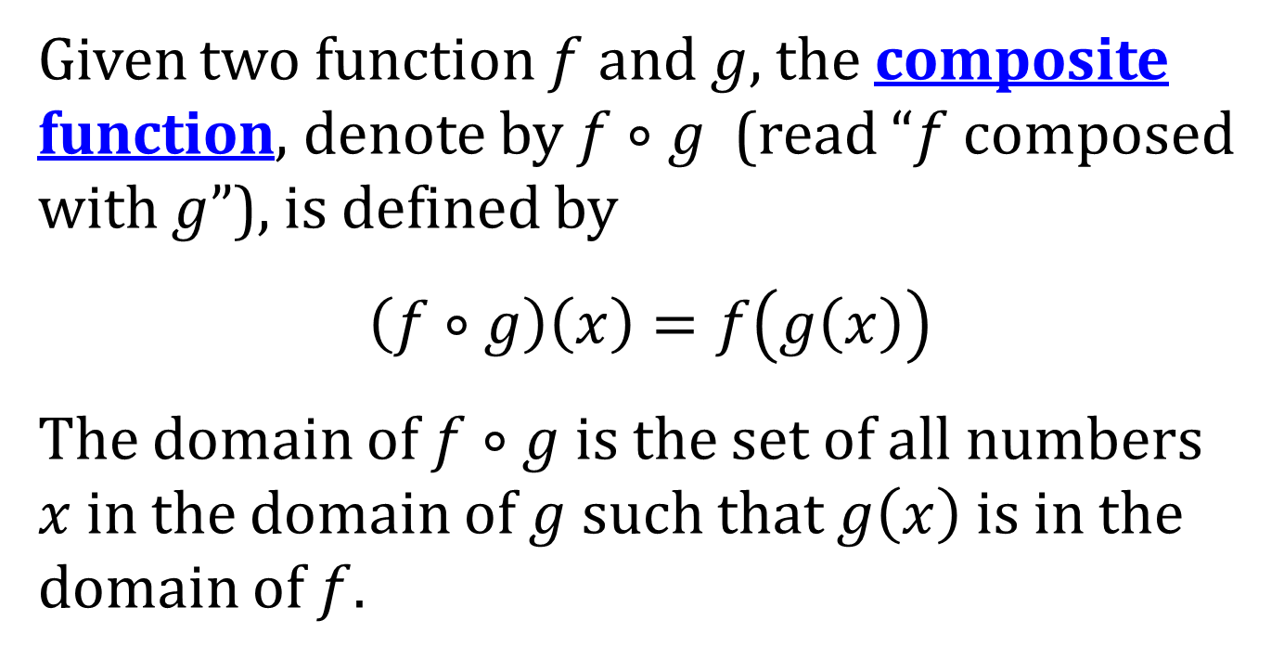
THE COMPOSITE FUNCTION
Given two function $f$ and $g$, the composite function, denote by $f∘g$ (read “$f$ composed with $g$”), is defined by
$$\left(f∘g\right)\left(x\right)=f\left(g\left(x\right)\right)$$
The domain of $f∘g$ is the set of all numbers $x$ in the domain of $g$ such that $g\left(x\right)$ is in the domain of $f$.

Slide 3
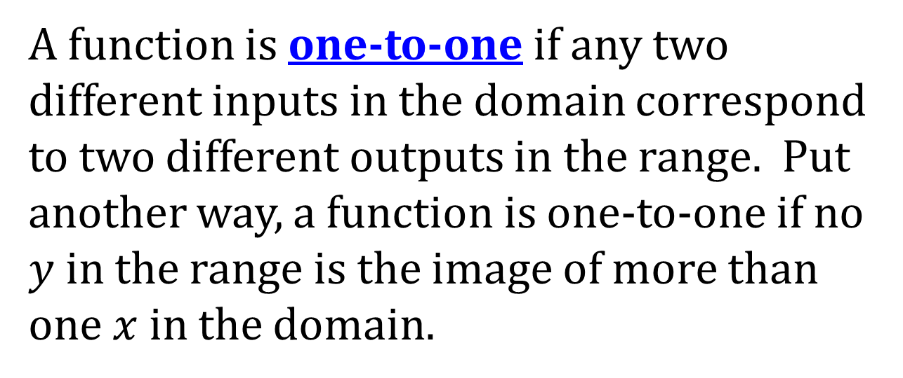
ONE-TO-ONE FUNCTIONS
A function is one-to-one if any two different inputs in the domain correspond to two different outputs in the range. Put another way, a function is one-to-one if no $y$ in the range is the image of more than one $x$ in the domain.

Slide 4
TESTING FOR A ONE-TO-ONE FUNCTION
Horizontal Line Test: A function $f$ is one-to-one if and only if every horizontal line intersects the graph of $f$ in at most one point.

Slide 5
A THEOREM ON ONE-TO-ONE FUNCTIONS
A function that is increasing on an interval $I$ is a one-to-one function on $I$.
A function that is decreasing on an interval $I$ is a one-to-one function on $I$.

Slide 6
DEFINITION OF AN INVERSE FUNCTION
Suppose that 𝑓 is a one-to-one function. Then, corresponding to each 𝑥 in the domain of 𝑓, there is exactly one 𝑦 in the range (because 𝑓 is a function); and corresponding to each 𝑦 in the range of 𝑓, there is exactly one 𝑥 in the domain (because 𝑓 is one-to-one). The correspondence from the range of 𝑓 back to the domain of 𝑓 is called the inverse function of f. The symbol $f^{−1}$ is used to denote the inverse function of $f$.
NOTE: $f^{−1}\left(x\right)$ does NOT mean $\frac{1}{f\left(x\right)}$

Slide 7
PROPERTIES OF INVERSE FUNCTIONS
Domain of $f$ = Range of $f^{−1}$; that is, $D_{f}=R_{f^{−1}}$
Range of $f$ = Domain of $f^{−1}$; that is, $R_{f}=D_{f^{−1}}$

Slide 8
AN EQUIVALENT DEFINITION OF INVERSE FUNCTIONS
In the language of function notation, two functions $f$ and $f^{−1}$ are inverses of each other if and only if
$\left(f^{−1}∘f\right)\left(x\right)=f^{−1}\left(f\left(x\right)\right)=x$ where $x$ is in the domain of $f$
$\left(f∘f^{−1}\right)\left(x\right)=f\left(f^{−1}\left(x\right)\right)=x$ where $x$ is in the domain of $f^{−1}$

Slide 9
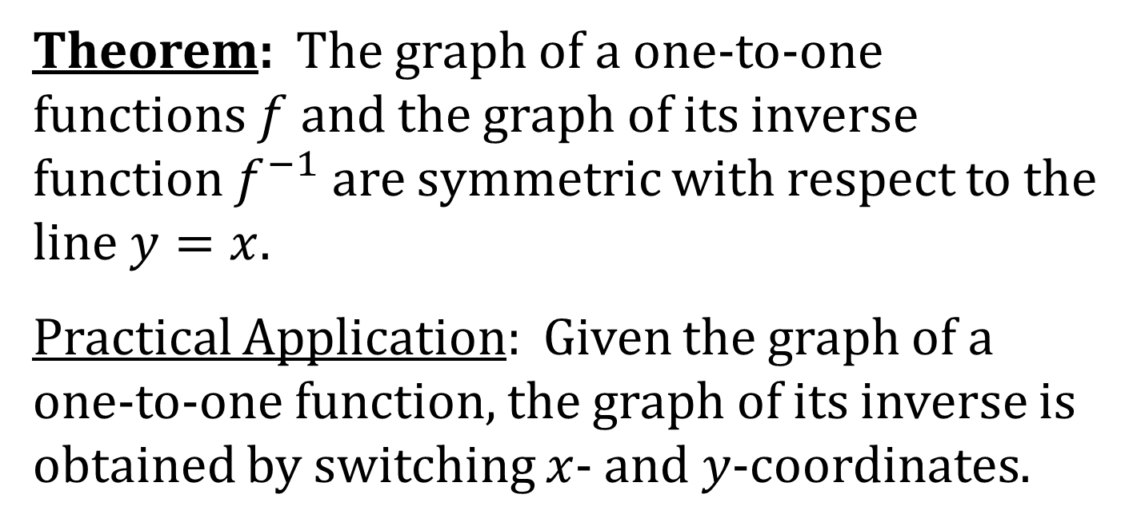
GRAPHING AN INVERSE FUNCTION
Theorem: The graph of a one-to-one functions $f$ and the graph of its inverse function $f^{−1}$ are symmetric with respect to the line $y=x$.
Practical Application: Given the graph of a one-to-one function, the graph of its inverse is obtained by switching $x$- and $y$-coordinates.

Slide 10
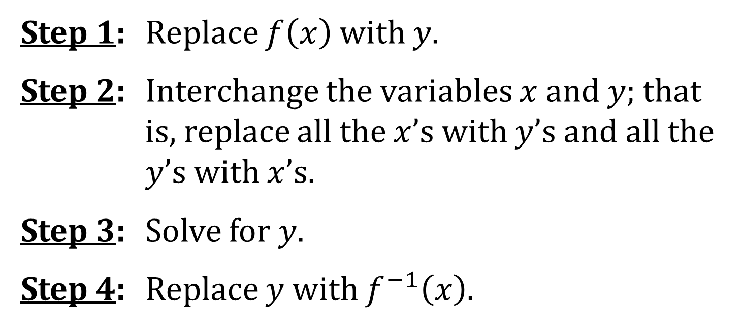
FINDING A FORMULA FOR AN INVERSE FUNCTION
Step 1: Replace $f\left(x\right)$ with $y$.
Step 2: Interchange the variables $x$ and $y$; that is, replace all the $x$’s with $y$’s and all the $y$’s with $x$’s.
Step 3: Solve for $y$.
Step 4: Replace $y$ with $f^{−1}\left(x\right)$.

