Slide 1
Section 5.5
The Real Zeros of a Polynomial Function

Slide 2
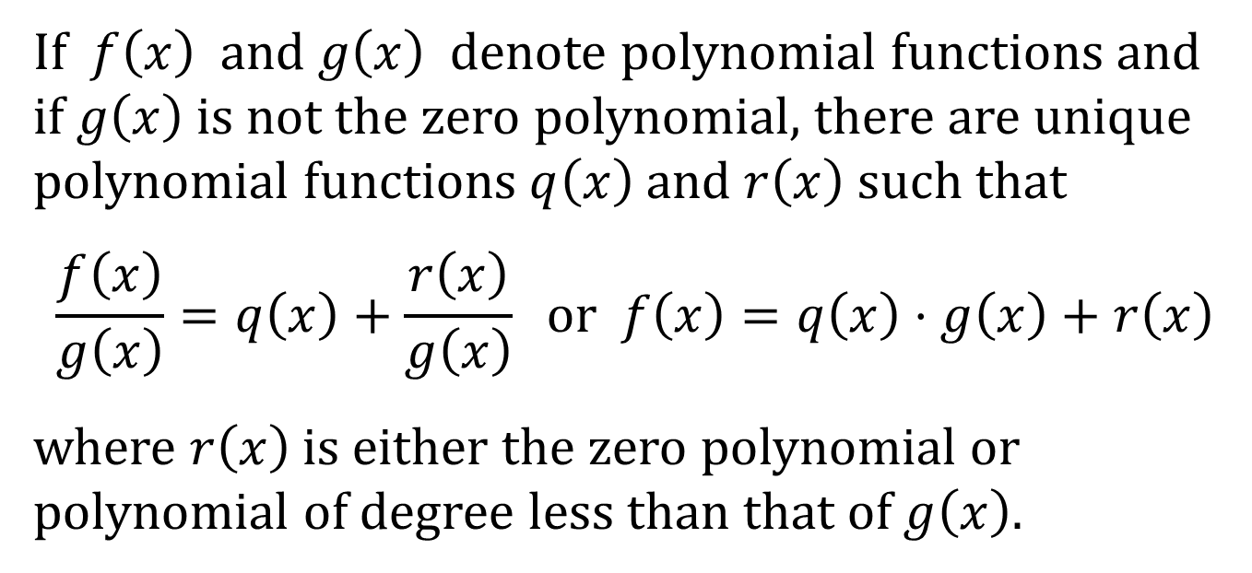
THE DIVISION ALGORITHM FOR POLYNOMIALS
If $f\left(x\right)$ and $g\left(x\right)$ denote polynomial functions and if $g\left(x\right)$ is not the zero polynomial, there are unique polynomial functions $q\left(x\right)$ and $r\left(x\right)$ such that
$$\frac{f\left(x\right)}{g\left(x\right)}=q\left(x\right)+\frac{r\left(x\right)}{g\left(x\right)} or f\left(x\right)=q\left(x\right)⋅g\left(x\right)+r\left(x\right)$$
where $r\left(x\right)$ is either the zero polynomial or polynomial of degree less than that of $g\left(x\right)$.

Slide 3
DIVIDEND, DIVISOR, QUOTIENT, AND REMAINDER
In the equation on the previous slide,
$f\left(x\right)$ is the dividend
$g\left(x\right)$ is the divisor
$q\left(x\right)$ is the quotient
$r\left(x\right)$ is the remainder

Slide 4
THE REMAINDER THEOREM
Let $f\left(x\right)$ be a polynomial function. If $f\left(x\right)$ is divided by $x−c$, then the remainder is $f\left(c\right)$.

Slide 5
THE FACTOR THEOREM
Let $f$ be a polynomial function. Then $x−c$ is a factor of $f\left(x\right)$ if and only if $f\left(c\right)=0$.
The Factor Theorem consists of two separate statements.
1. If $f\left(c\right)=0$, then $x−c$ is a factor of $f\left(x\right)$.
2. If $x−c$ is a factor of $f\left(x\right)$, then $f\left(c\right)=0$.

Slide 6
THE NUMBER OF REAL ZEROS
A polynomial function cannot have more zeros than its degree.

