Slide 1
Section 5.4
Polynomial and Rational Inequalities

Slide 2
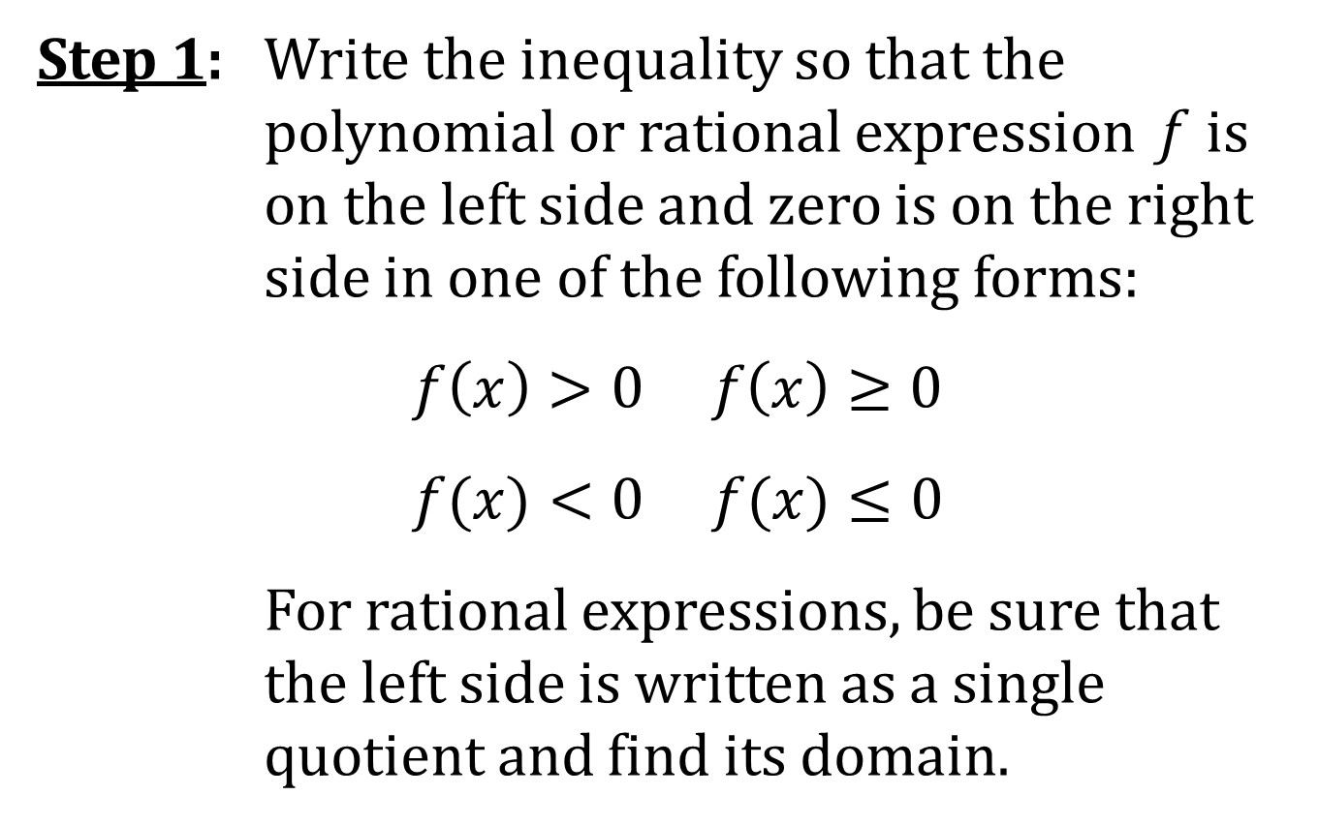
SOLVING A POLYNOMIAL OR RATIONAL INEQUALITY
Step 1: Write the inequality so that the polynomial or rational expression f is on the left side and zero is on the right side in one of the following forms:
$f\left(x\right)>0 f\left(x\right)≥0$
$f(x)<0 f(x)≤0$
For rational expressions, be sure that the left side is written as a single quotient and find its domain.

Slide 3
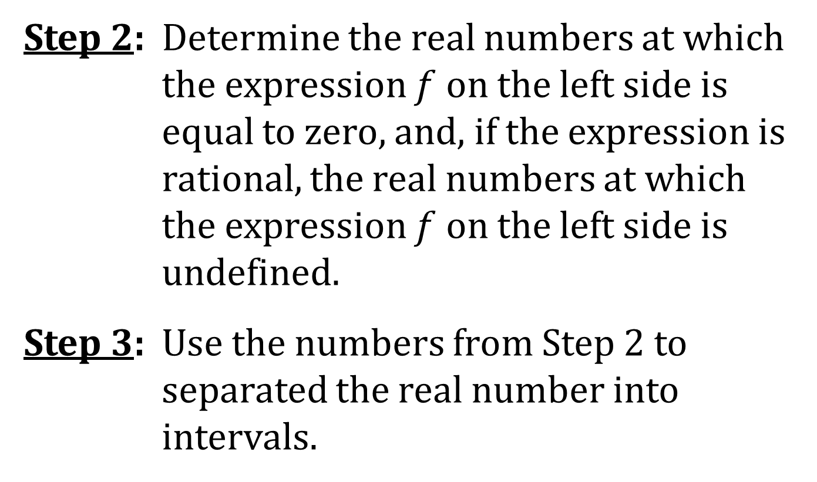
SOLVING (CONTINUED)
Step 2: Determine the real numbers at which the expression $f$ on the left side is equal to zero, and, if the expression is rational, the real numbers at which the expression $f$ on the left side is undefined.
Step 3: Use the numbers from Step 2 to separated the real number into intervals.

Slide 4
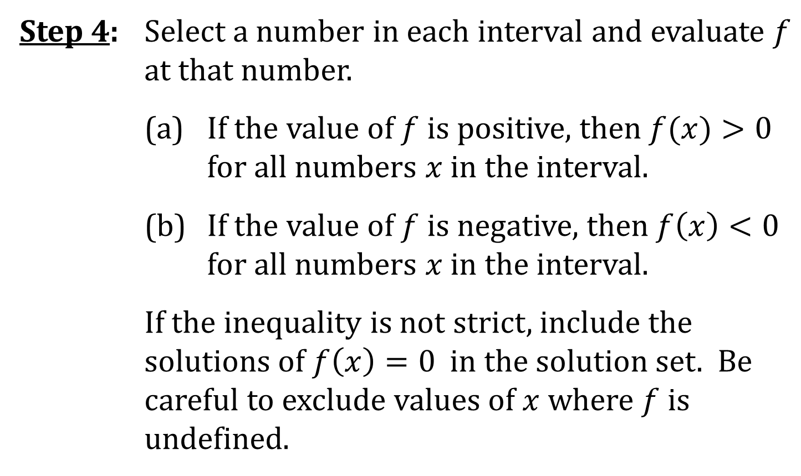
SOLVING (CONCLUDED)
Step 4: Select a number in each interval and evaluate $f$ at that number.
(a) If the value of $f$ is positive, then $f(x)>0$ for all numbers $x$ in the interval.
(b) If the value of $f$ is negative, then $f\left(x\right)<0$ for all numbers $x$ in the interval.
If the inequality is not strict, include the solutions of $f\left(x\right)=0$ in the solution set. Be careful to exclude values of $x$ where $f$ is undefined.

Slide 5
TEST VALUES
The numbers selected in Step 4 are called test values because they are used to test whether the function is positive or negative in the interval.
The preceding method is sometimes called the test-value method for solving inequalities.

