Slide 1
Section 4.3
Quadratic Functions and Their Properties

Slide 2
QUADRATIC FUNCTIONS
A quadratic function of $x$ is a function that can be represented by an equation of the form
$$f\left(x\right)=ax^{2}+bx+c$$
where $a$, $b$, and $c$ are real numbers and $a≠0$. The domain of a quadratic function is all real numbers.

Slide 3
GRAPHS OF QUADRATIC FUNCTIONS
The graph of a quadratic function is a parabola.
The parabola opens up if the coefficient of $x^{2}$ is positive.
The parabola opens down if the coefficient of $x^{2}$ is negative.
The vertex of a parabola is the lowest point on a parabola that opens up or the highest point on a parabola that opens down.
The axis of symmetry is the vertical line passing through the vertex of a parabola.

Slide 4
STANDARD FORM OF QUADRATIC FUNCTIONS
Every quadratic function given by
$f\left(x\right)=ax^{2}+bx+c$ can be written in the standard form of a quadratic function:
$$f\left(x\right)=a{\left(x − h\right)}^{2}+k, a≠0$$
The graph of $f$ is a parabola with vertex $\left(h, k\right)$. The parabola opens up if $a$ is positive, and it opens down if $a$ is negative.
To find the standard form of a quadratic function, use the technique of completing the square.

Slide 5
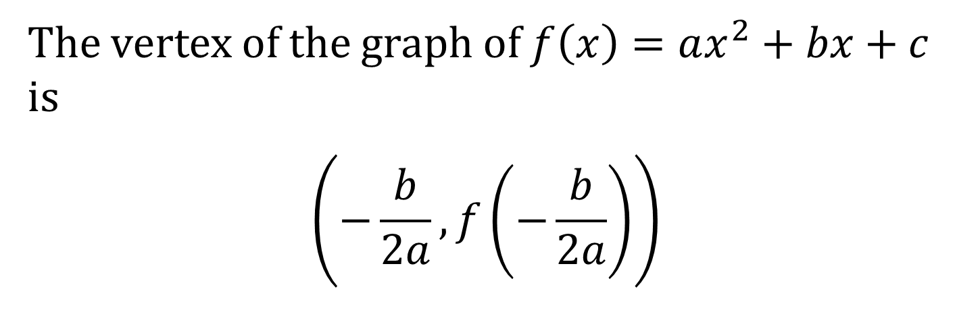
VERTEX FORMULA
The vertex of the graph of $f\left(x\right)=ax^{2}+bx+c$ is
$$\left(−\frac{b}{2a}, f\left(−\frac{b}{2a}\right)\right)$$

Slide 6
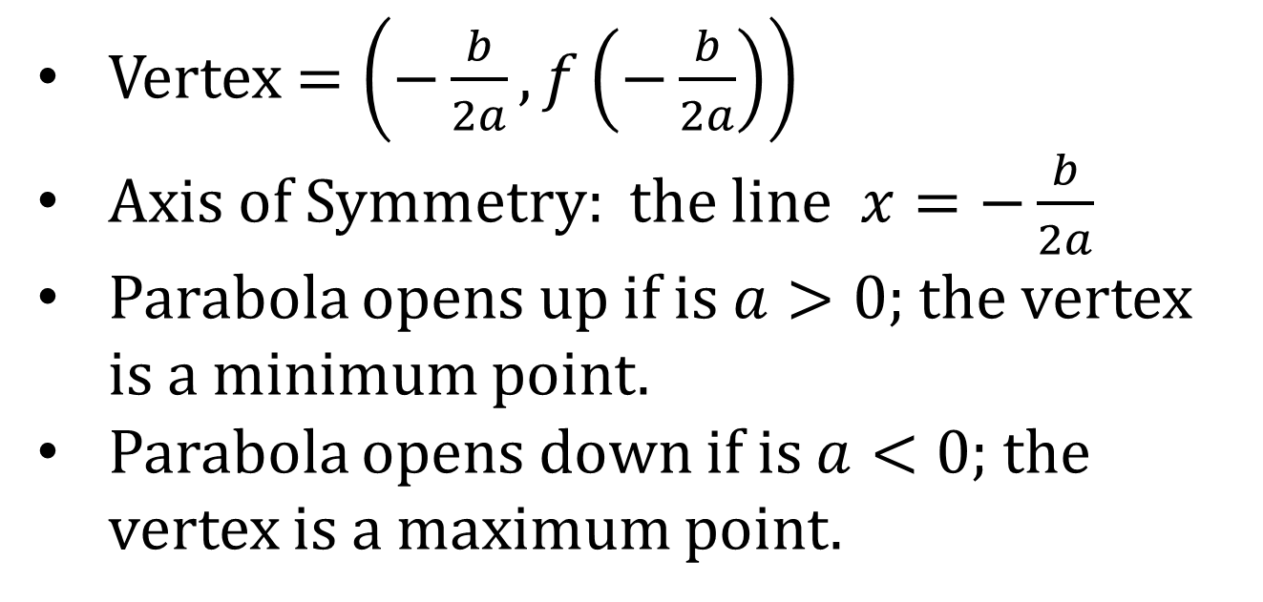
SUMMARY OF PROPERTIES OF THE GRAPH OF A QUADRATIC FUNCTION
$$f\left(x\right)=ax^{2}+bx+c, a≠0$$
Vertex $=\left(−\frac{b}{2a}, f\left(−\frac{b}{2a}\right)\right)$
Axis of Symmetry: the line $x=−\frac{b}{2a}$
Parabola opens up if is $a>0$; the vertex is a minimum point.
Parabola opens down if is $a<0$; the vertex is a maximum point.

Slide 7
x-INTERCEPTS OF A QUADRATIC FUNCTION
If the discriminant $b^{2}−4ac>0$, then graph of $f\left(x\right)=ax^{2}+bx+c$ has two distinct $x$-intercepts so it crosses the $x$-axis in two places.
If the discriminant $b^{2}−4ac=0$, then graph of $f\left(x\right)=ax^{2}+bx+c$ has one $x$-intercept so it touches the $x$-axis in at its vertex.
If the discriminant $b^{2}−4ac<0$, then graph of $f\left(x\right)=ax^{2}+bx+c$ has no $x$-intercept so it does not cross or touch the $x$-axis.

Slide 8
MAXIMUM OR MINIMUM VALUE OF A QUADRATIC FUNCTION
If $a$ is positive, then the vertex $\left(h, k\right)$ is the lowest point on the graph of $f\left(x\right)=a{\left(x − h\right)}^{2}+k$, and the $y$-coordinate $k$ of the vertex is the minimum value of the function $f$.
If $a$ is negative, then the vertex $\left(h, k\right)$ is the highest point on the graph of $f\left(x\right)=a{\left(x − h\right)}^{2}+k$, and the $y$-coordinate $k$ of the vertex is the maximum value of the function $f$.
In either case, the maximum or minimum value is achieved when $x=h$.

