Slide 1
Section 4.1
Linear Functions

Slide 2
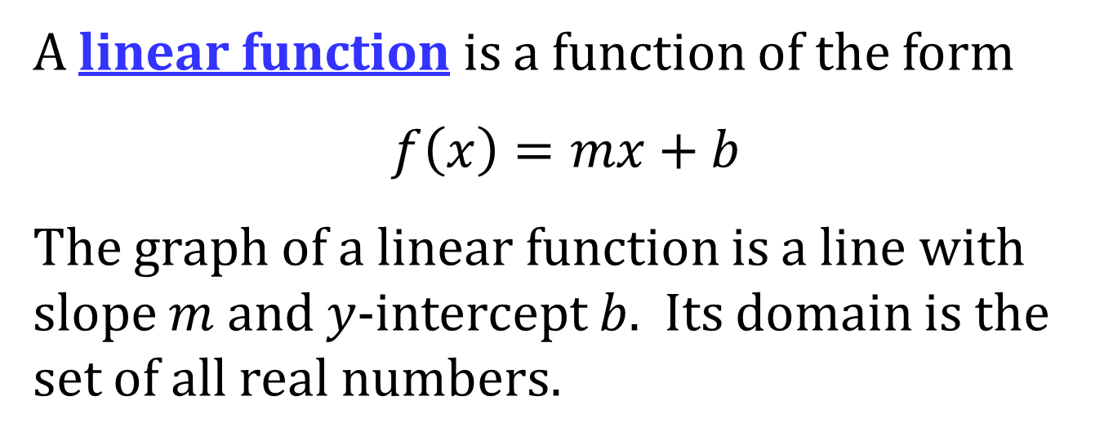
LINEAR FUNCTIONS
A linear function is a function of the form
$$f\left(x\right)=mx+b$$
The graph of a linear function is a line with slope $m$ and $y$-intercept $b$. Its domain is the set of all real numbers.

Slide 3
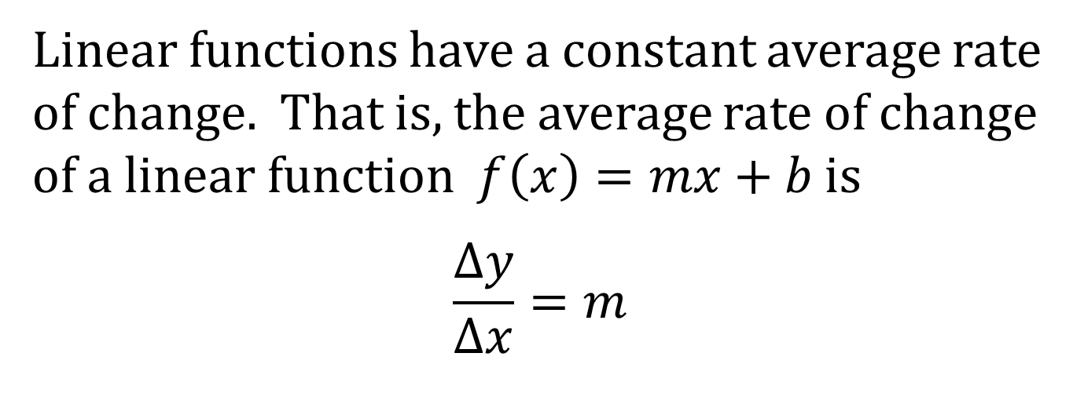
AVERAGE RATE OF CHANGE OF A LINEAR FUNCTION
Linear functions have a constant average rate of change. That is, the average rate of change of a linear function $f\left(x\right)=mx+b$ is
$$\frac{Δy}{Δx}=m$$

Slide 4
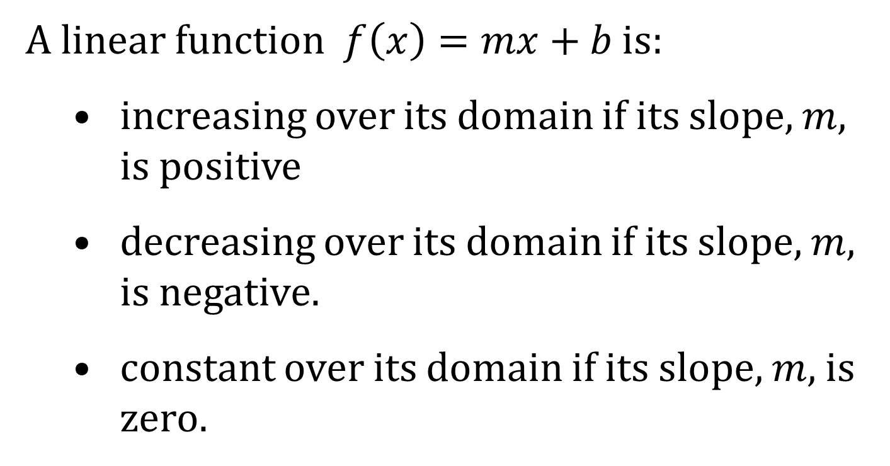
INCREASING, DECREASING, AND CONSTANT LINEAR FUNCTIONS
A linear function $f\left(x\right)=mx+b$ is:
increasing over its domain if its slope, $m$, is positive
decreasing over its domain if its slope, $m$, is negative.
constant over its domain if its slope, $m$, is zero.

