Slide 1
Section 3.1
Functions

Slide 2
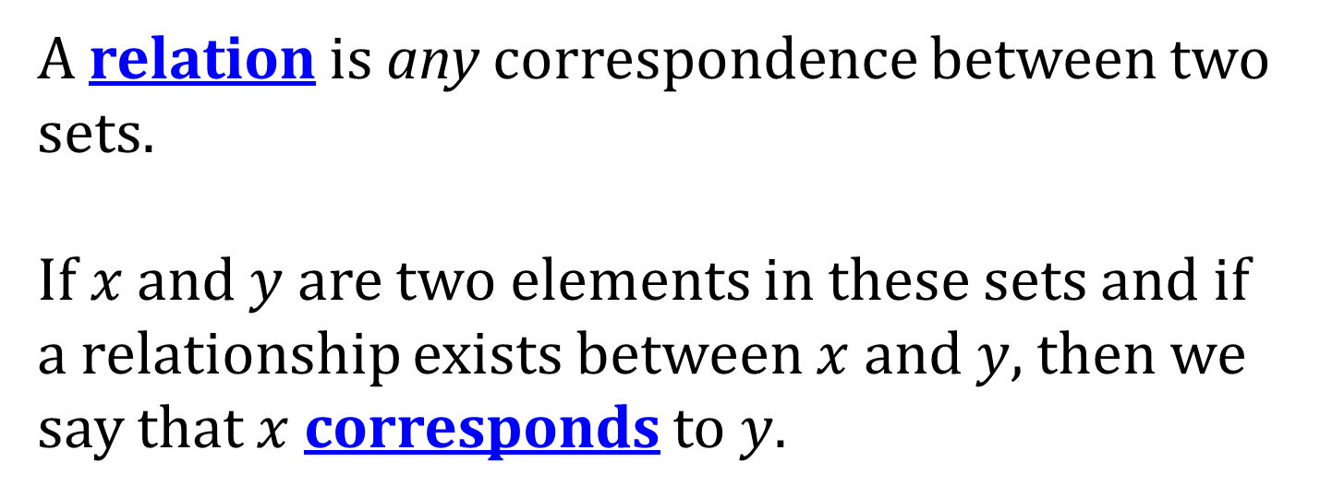
RELATIONS

Slide 3
WAYS TO REPRESENT A RELATION
A relation can be represented in four ways:
A listing of the ordered pairs, many times as a table
A graph
An equation
A mapping

Slide 4
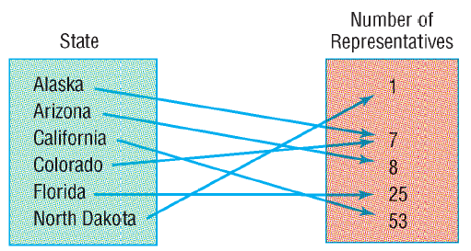
MAPPINGS
A map illustrates a relation by using two sets and drawing arrows between them to show the correspondence between $x$ and $y$.

Slide 5
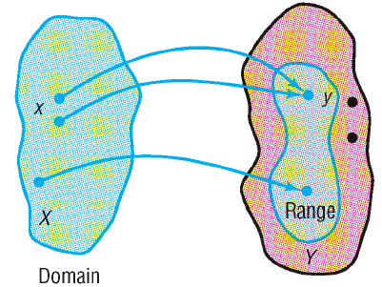
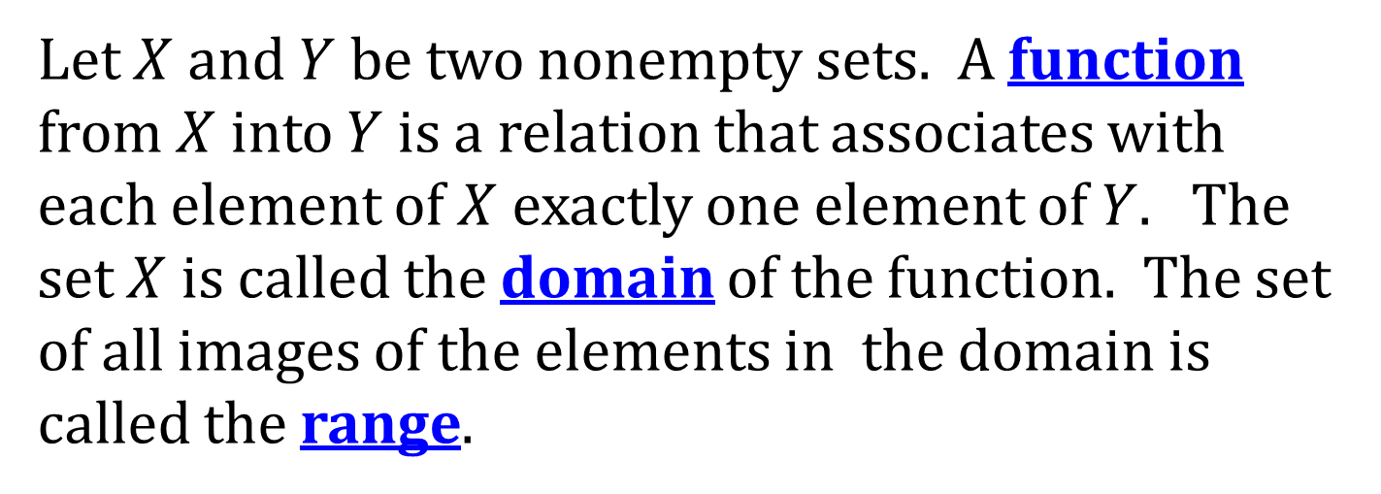
FUNCTIONS
Let $X$ and $Y$ be two nonempty sets. A function from $X$ into $Y$ is a relation that associates with each element of $X$ exactly one element of $Y$. The set $X$ is called the domain of the function. The set of all images of the elements in the domain is called the range.

Slide 6
DETERMINING IF A RELATION IS A FUNCTION
To determine if a relation is a function check to see if the same $x$-value is always paired with the same $y$-value.

Slide 7
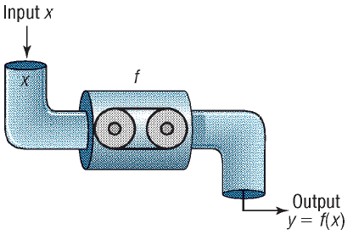
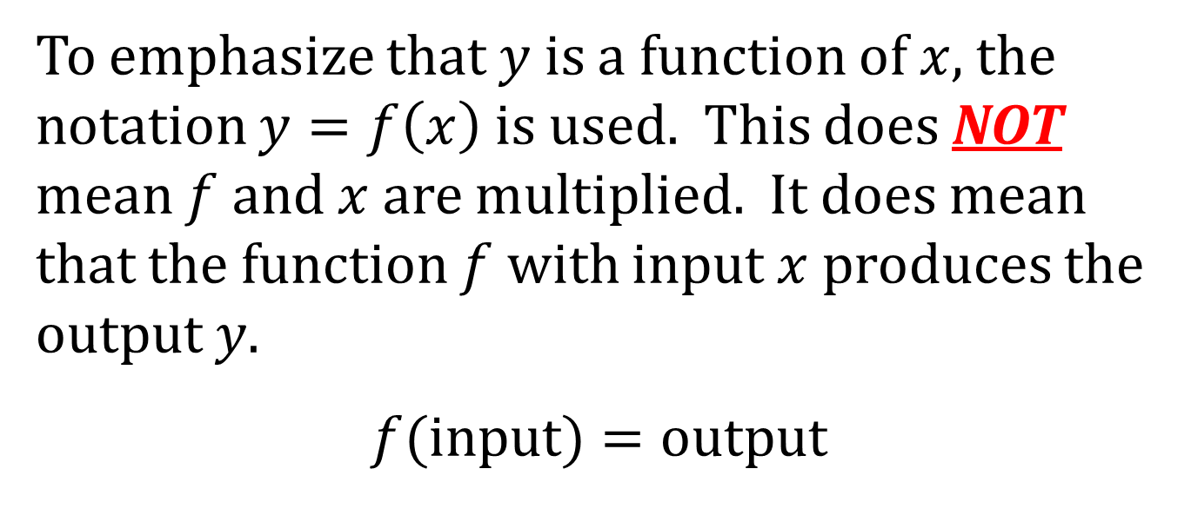
FUNCTION NOTATION
To emphasize that $y$ is a function of $x$, the notation $y=f\left(x\right)$ is used. This does NOT mean $f$ and $x$ are multiplied. It does mean that the function $f$ with input $x$ produces the output $y$.
$$f(input)=output$$

Slide 8
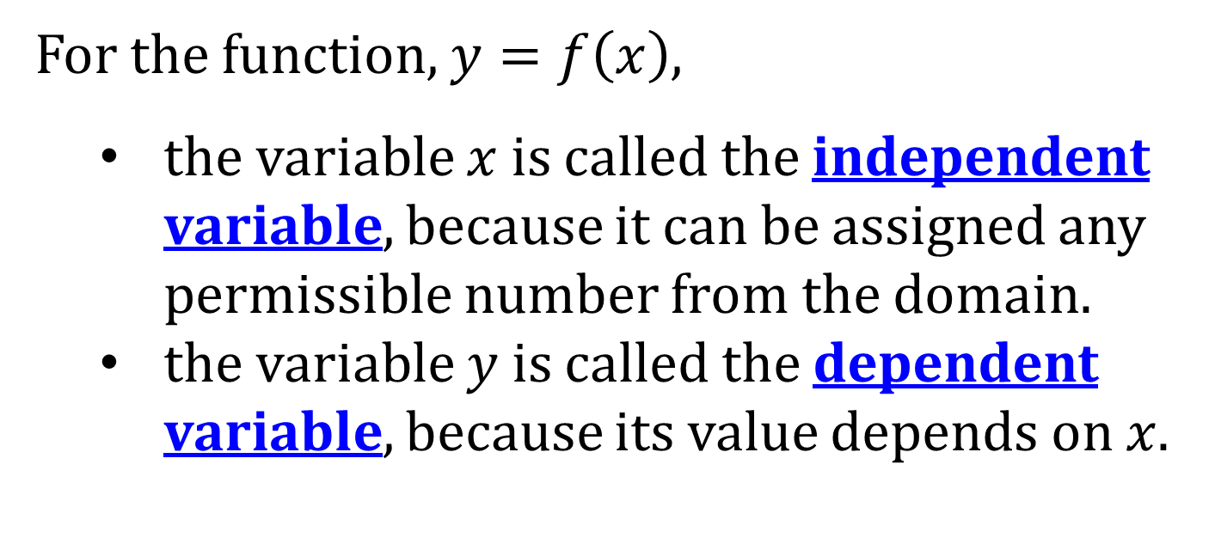
INDEPENDENT AND DEPENDENT VARIABLES
For the function, $y=f\left(x\right)$,
the variable $x$ is called the independent variable, because it can be assigned any permissible number from the domain.
the variable $y$ is called the dependent variable, because its value depends on $x$.
NOTE: The independent variable is also called the argument of the function.

Slide 9
THE DIFFERENCE QUOTIENT
The expression
$$\frac{f\left(x+h\right)−f\left(x\right)}{h}, h≠0$$
is called the difference quotient. It is used in Calculus to study how a function value changes as the independent variable changes.

Slide 10
DETERMINING IF AN EQUATION IS A FUNCTION
To determine if an equation represents a function, solve the equation for $y$ to see if there are two $y$-values for one $x$-value

Slide 11
DOMAIN AND RANGE
The domain can be thought of as the set of acceptable inputs of a function.
The range is the set of outputs.

Slide 12
DETERMINING DOMAIN FROM EQUATIONS
To find the domain given an equation, look for acceptable inputs.
Common Examples:
Fractions: all numbers except those that make the denominator zero.
Even Roots: all numbers that make the radicand zero or positive.

Slide 13
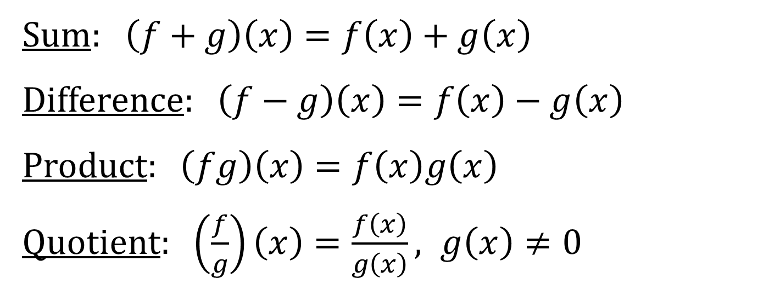
OPERATIONS ON FUNCTIONS
Sum: $\left(f+g\right)\left(x\right)=f\left(x\right)+g\left(x\right)$
Difference: $\left(f−g\right)\left(x\right)=f\left(x\right)−g\left(x\right)$
Product: $\left(fg\right)\left(x\right)=f\left(x\right)g\left(x\right)$
Quotient: $\left(\frac{f}{g}\right)\left(x\right)=\frac{f\left(x\right)}{g\left(x\right)}, g\left(x\right)≠0$

Slide 14
DOMAINS
The domain for $f+g, f−g,$ and $fg$ is the intersection of the domains of $f$ and $g$; that is, $D_{f}∩D_{g}$.
The domain for $f/g$ is the intersection of the domains of $f$ and $g$, except for those numbers $x$ such that $g\left(x\right)=0$; that is, $D_{f}∩D_{g}−\left\{x | g\left(x\right)=0\right\}$.

