Slide 1
Section 2.5
Variation

Slide 2
DIRECT VARIATION
Let $x$ and $y$ denote two quantities. Then $y$ varies directly with $x$, or $y$ is directly proportional to $x$, if and only if
$$y=kx$$
The number $k$ is called the constant of proportionality.

Slide 3
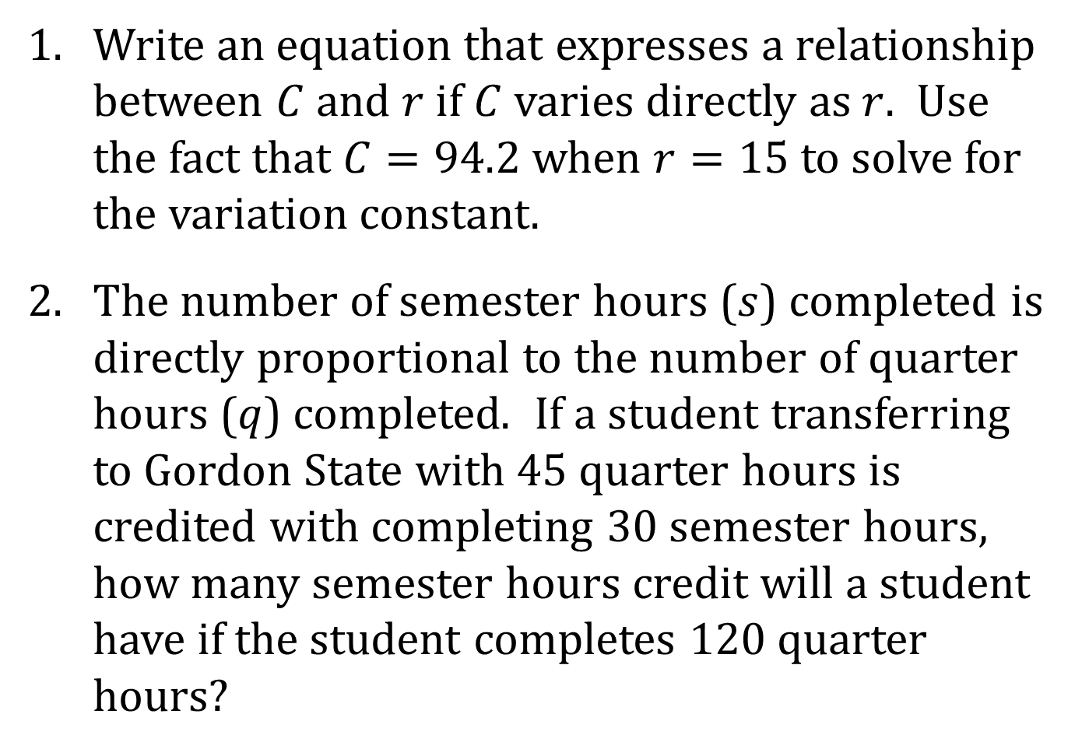
EXAMPLES
Write an equation that expresses a relationship between $C$ and $r$ if $C$ varies directly as $r$. Use the fact that $C=94.2$ when $r=15$ to solve for the variation constant.
The number of semester hours ($s$) completed is directly proportional to the number of quarter hours ($q$) completed. If a student transferring to Gordon State with 45 quarter hours is credited with completing 30 semester hours, how many semester hours credit will a student have if the student completes 120 quarter hours?

Slide 4
DIRECT VARIATION WITH THE n^{th} POWER
Let $x$ and $y$ denote two quantities. Then $y$ varies directly with the n^{th} power of $x$ if there is a constant $k$ such that
$$y=kx^{n}$$

Slide 5
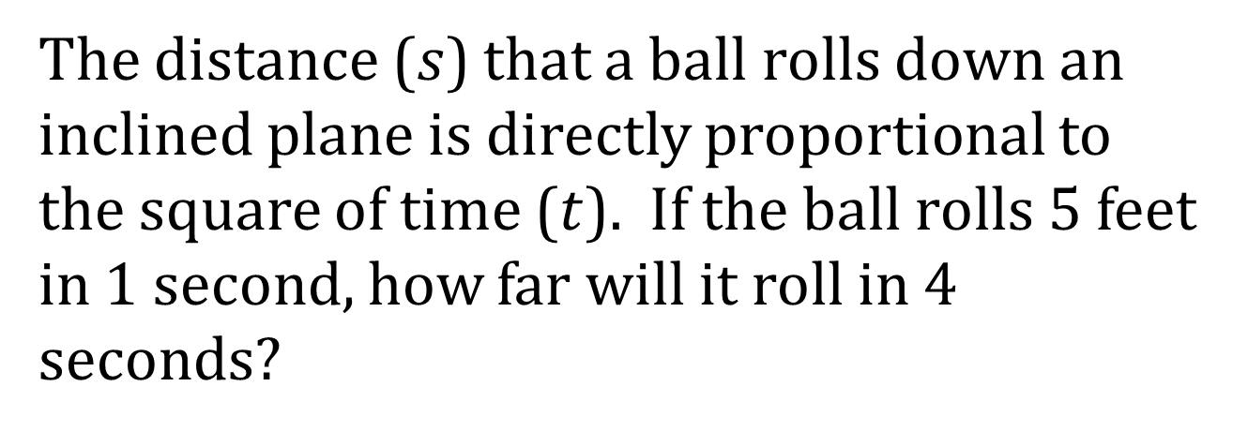
EXAMPLE
The distance ($s$) that a ball rolls down an inclined plane is directly proportional to the square of time ($t$). If the ball rolls 5 feet in 1 second, how far will it roll in 4 seconds?

Slide 6
INVERSE VARIATION
Let $x$ and $y$ denote two quantities. Then $y$ varies inversely with $x$, or $y$ is inversely proportional to $x$, if there is a constant $k$ such that
$$y=\frac{k}{x}$$

Slide 7
EXAMPLE
The speed ($v$) of a gear varies inversely as the number of teeth ($t$). If a gear that has 48 teeth makes 20 revolutions per minute, how many revolutions per minute will a gear that has 30 teeth make?

Slide 8
JOINT VARIATION
Let $x$, $y$, and $z$ denote three quantities. Then $z$ varies jointly with $x$ and $y$ if there is a constant $k$ such that
$$z=kxy$$

Slide 9
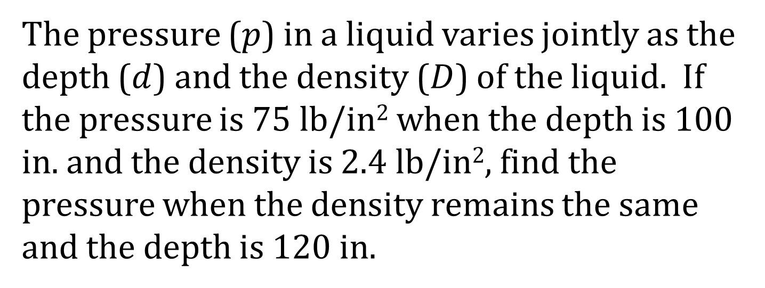
EXAMPLE
The pressure ($p$) in a liquid varies jointly as the depth ($d$) and the density ($D$) of the liquid. If the pressure is 75 lb/in² when the depth is 100 in. and the density is 2.4 lb/in², find the pressure when the density remains the same and the depth is 120 in.

Slide 10
COMBINED VARIATION
Combined variation is a combination of two or more of the types of variation already discussed.

Slide 11
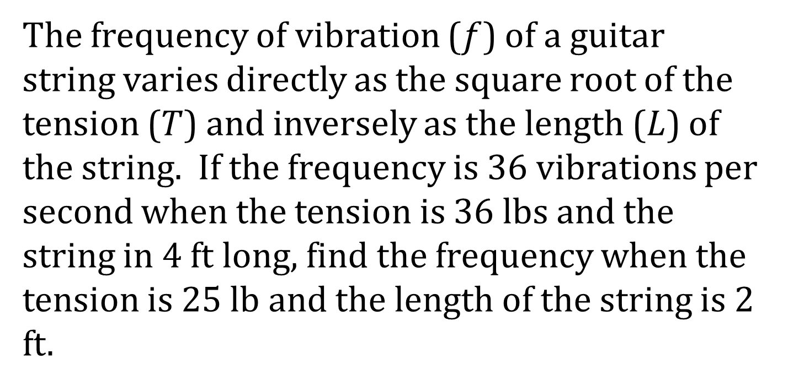
EXAMPLE
The frequency of vibration ($f$) of a guitar string varies directly as the square root of the tension ($T$) and inversely as the length ($L$) of the string. If the frequency is 36 vibrations per second when the tension is 36 lbs and the string in 4 ft long, find the frequency when the tension is 25 lb and the length of the string is 2 ft.

