Slide 1
Section 2.4
Circles

Slide 2
DEFINITION OF A CIRCLE
A circle is a set of points in the $xy$-plane that are a fixed distance $r$ from a fixed point $\left(h, k\right)$. The fixed distance $r$ is called the radius, and the fixed point $\left(h,k\right)$ is called the center of the circle.

Slide 3
STANDARD FORM OF AN EQUATION OF A CIRCLE
The standard form of an equation of a circle with radius $r$ and center $\left(h, k\right)$ is
$${\left(x−h\right)}^{2}+{\left(y−k\right)}^{2}=r^{2}$$

Slide 4
CIRCLES WITH CENTER AT THE ORIGIN
Theorem: The standard form of an equation of a circle of radius $r$ with center at the origin $\left(0,0\right)$ is
$$x^{2}+y^{2}=r^{2}$$
Definition: If the radius $r=1$, the circle whose center is at the origin is called the unit circle and has equation
$$x^{2}+y^{2}=1$$

Slide 5
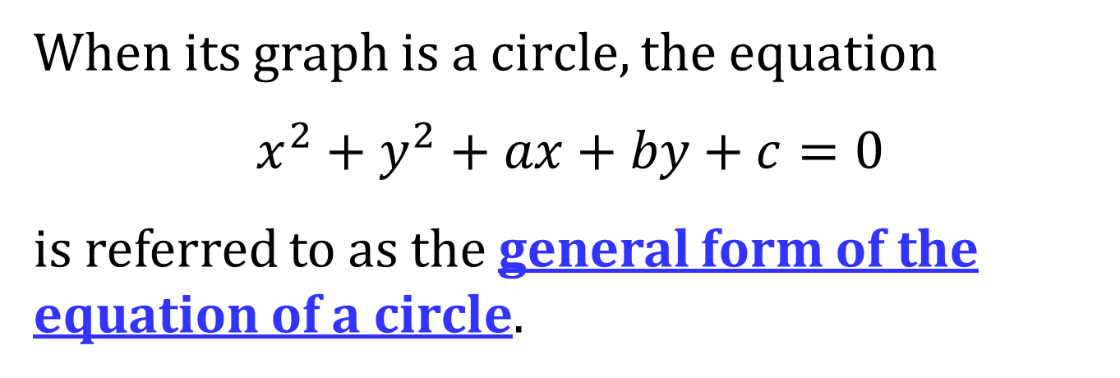
GENERAL FORM OF THE EQUATION OF A CIRCLE
When its graph is a circle, the equation
$$x^{2}+y^{2}+ax+by+c=0$$
is referred to as the general form of the equation of a circle.

Slide 6
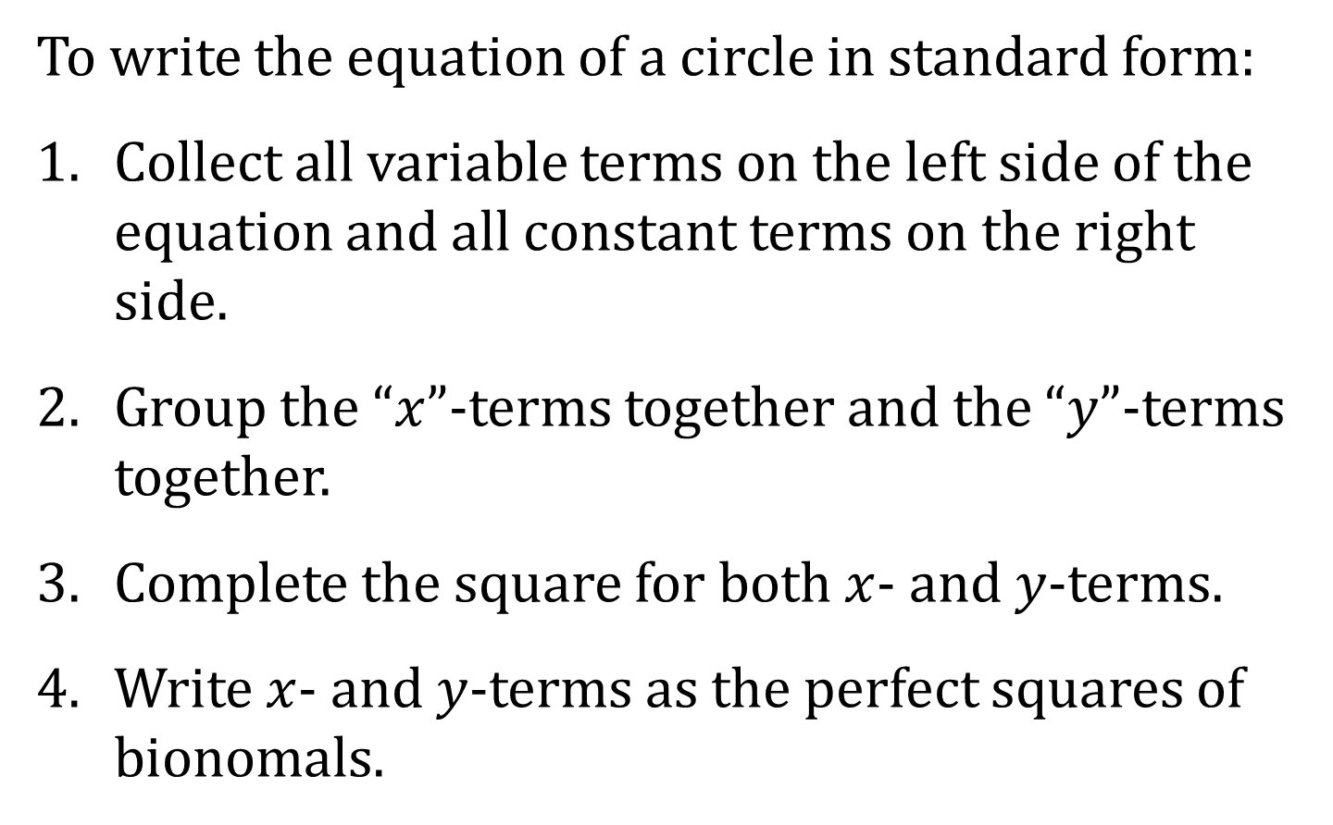
WRITING AN EQUATION OF A CIRCLE IN STANDARD FROM
To write the equation of a circle in standard form:
Collect all variable terms on the left side of the equation and all constant terms on the right side.
Group the “$x$”-terms together and the “$y$”-terms together.
Complete the square for both $x$- and $y$-terms.
Write $x$- and $y$-terms as the perfect squares of bionomals.

