Slide 1
Section 2.3
Lines

Slide 2
SLOPE OF A LINE
Let $P=\left(x1, y1\right)$ and $Q=\left(x2, y2\right)$ be two distinct points. If $x1≠x2$, the slope m of the nonvertical line $L$ containing $P$ and $Q$ is defined by the formula
$$m=\frac{y_{2}−y_{1}}{x_{2}−x_{1}}, x_{1}≠x_{2}$$
If $x1=x2$, $L$ is a vertical line and the slope $m$ of $L$ is undefined (since this results in division by 0).

Slide 3
OTHER WAYS TO REMEMBER THE SLOPE FORMULA
The slope formula is some times remembered as
$$m=\frac{rise}{run}$$
or
$$m=\frac{change in y}{change in x}=\frac{Δy}{Δx}$$

Slide 4
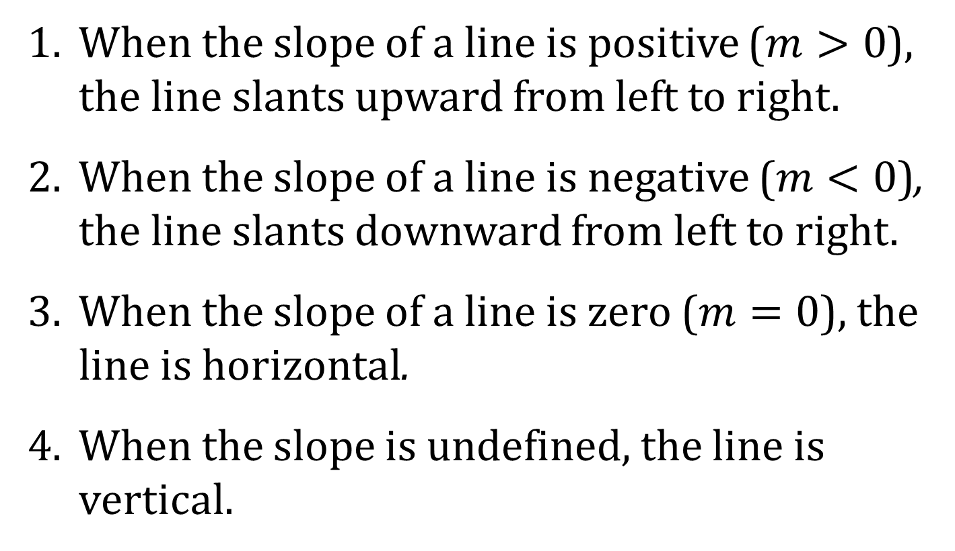
SLOPE AND THE SHAPE OF A LINE
1. When the slope of a line is positive ($m>0$), the line slants upward from left to right.
2. When the slope of a line is negative ($m<0$), the line slants downward from left to right.
3. When the slope of a line is zero ($m=0$), the line is horizontal.
4. When the slope is undefined, the line is vertical.

Slide 5
EQUATION OF A VERTICAL LINE
A vertical line is given by an equation of the form
$$x=a$$
where $a$ is the $x$-intercept.

Slide 6
POINT-SLOPE EQUATION OF A LINE
An equation of a nonvertical line with slope $m$ that contains the point $\left(x1, y1\right)$ is
$$y−y1=m\left(x−x_{1}\right)$$

Slide 7
EQUATION OF A HORIZONTAL LINE
A horizontal line is given by an equation of the form
$$y=b$$
where $b$ is the $y$-intercept.

Slide 8
SLOPE-INTERCEPT FORM OF AN EQUATION FOR A LINE
An equation of a line with slope $m$ and $y$-intercept $b$ is
$$y=mx+b$$

Slide 9
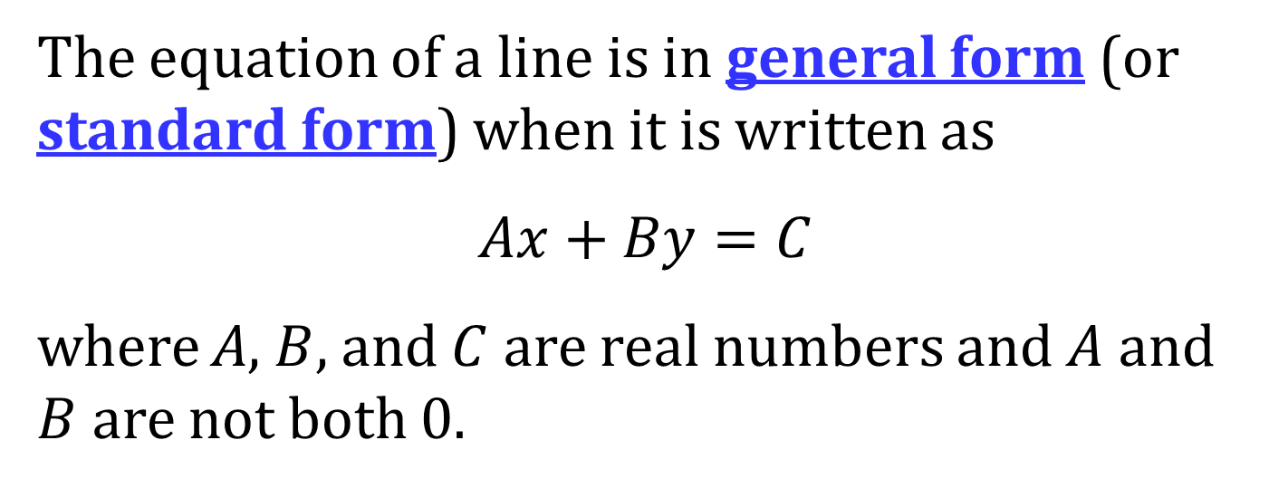
GENERAL FORM OF AN EQUATION OF A LINE
The equation of a line is in general form (or standard form) when it is written as
$$Ax+By=C$$
where A, $B$, and $C$ are real numbers and $A$ and $B$ are not both 0.

Slide 10
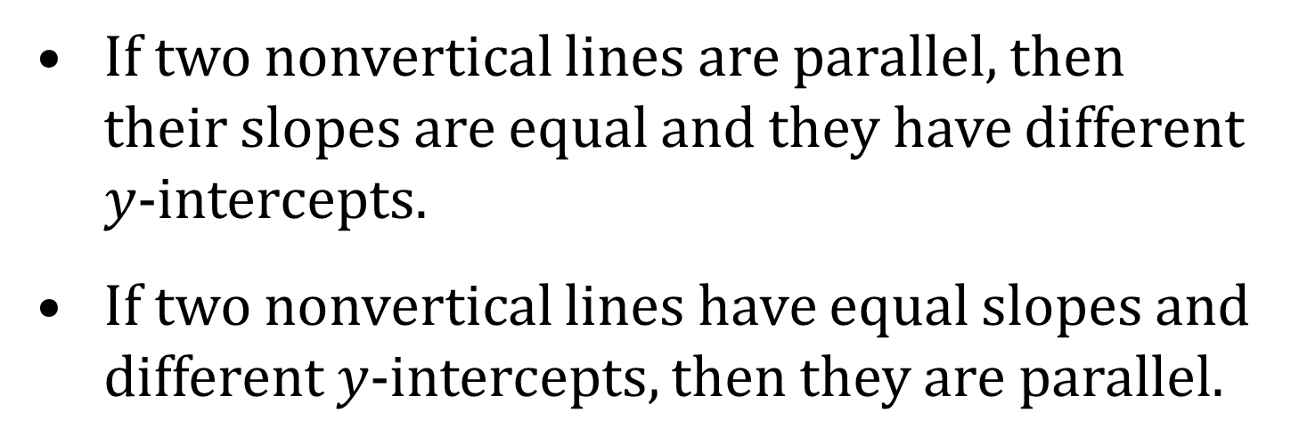
PARALLEL LINES
Criterion for Parallel Lines: Two nonvertical lines are parallel if and only if their slopes are equal and they have different $y$-intercepts.
If two nonvertical lines are parallel, then their slopes are equal and they have different $y$-intercepts.
If two nonvertical lines have equal slopes and different $y$-intercepts, then they are parallel.

Slide 11
PERPENDICULAR LINES
Criterion for Perpendicular Lines: Two nonvertical lines are perpendicular if and only if the product of their slopes is −1.
If two nonvertical lines are perpendicular, then the product of their slopes is −1.
If two nonvertical lines have slopes whose product is −1, then they are perpendicular.

