Slide 1
Section 2.2
Graphs of Equations in Two Variables; Intercepts; Symmetry

Slide 2
THE GRAPH OF AN EQUATION
The graph of an equation in the two variables $x$ and $y$ is the set of all points whose coordinates satisfy the equation.

Slide 3
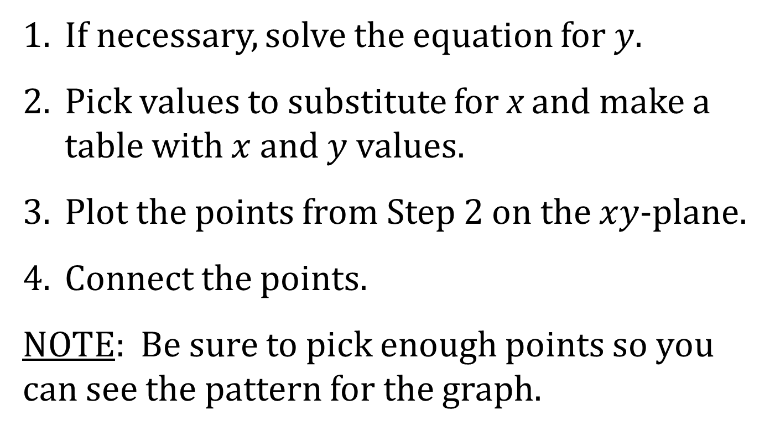
PROCEDURE FOR GRAPHING AN EQUATION
1. If necessary, solve the equation for $y$.
2. Pick values to substitute for x and make a table with $x$ and $y$ values.
3. Plot the points from Step 2 on the $xy$-plane.
4. Connect the points.
NOTE: Be sure to pick enough points so you can see the pattern for the graph.

Slide 4
INTERCEPTS
Some important points in a graph are the $x$- and $y$-intercepts. The $x$-intercept of a graph is a place where the graph intersects the $x$-axis. The $y$-intercept of a graph is a place where the graph intersects the $y$-axis.
To find the $x$-intercept(s), if any, of the graph of an equation, let $y=0$ in the equation and solve for $x$, where $x$ is a real number.
To find the y-intercept(s), if any, of the graph of an equation, let $x=0$ in the equation and solve for $y$, where $y$ is a real number.

Slide 5
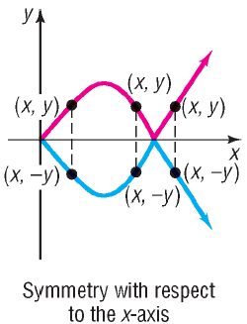
SYMMETRY WITH RESPECT TO THE x-AXIS
A graph is said to be symmetric with respect to the x-axis if, for every $\left(x,y\right)$ on the graph, the point $(x,−y)$ is also on the graph.

Slide 6
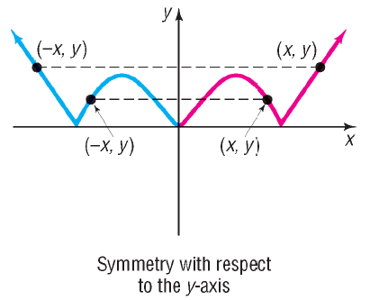
SYMMETRY WITH RESPECT TO THE y-AXIS
A graph is said to be symmetric with respect to the y-axis if, for every $\left(x,y\right)$ on the graph, the point $\left(−x, y\right)$ is also on the graph.

Slide 7
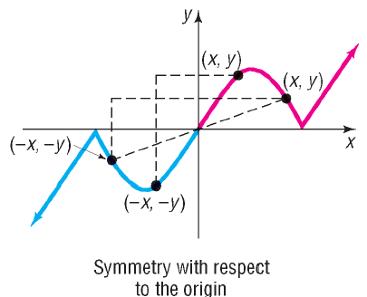
SYMMETRY WITH RESPECT TO THE ORIGIN
A graph is said to be symmetric with respect to the origin if, for every $\left(x,y\right)$ on the graph, the point $\left(−x,−y\right)$ is also on the graph.

Slide 8
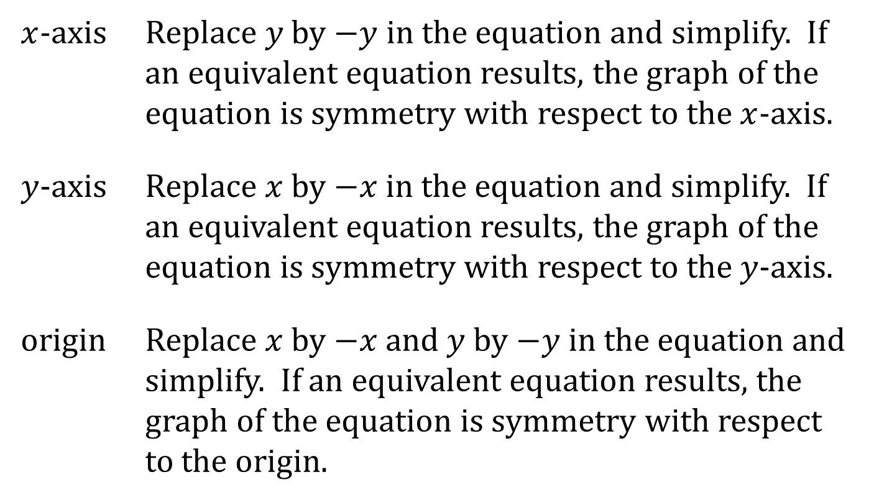
TESTS FOR SYMMETRY
To test the graph of an equation for symmetry with respect to
$x$-axis | Replace $y$ by $−y$ in the equation and simplify. If an equivalent equation results, the graph of the equation is symmetry with respect to the $x$-axis.
$y$-axis | Replace $x$ by $−x$ in the equation and simplify. If an equivalent equation results, the graph of the equation is symmetry with respect to the $y$-axis.
origin | Replace $x$ by $−x$ and $y$ by $−y$ in the equation and simplify. If an equivalent equation results, the graph of the equation is symmetry with respect to the origin.

