Slide 1
Section 2.1
The Distance and Midpoint Formulas

Slide 2
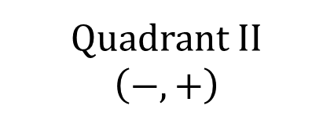
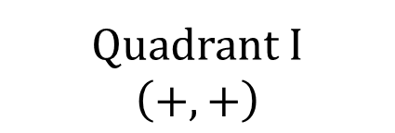
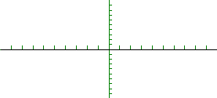
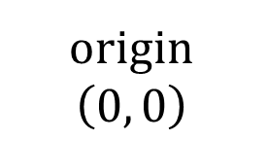
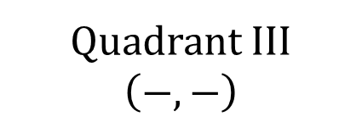
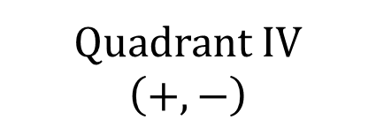
THE CARTESIAN COORDINATE SYSTEM
y
x

Slide 3
THE DISTANCE FORMULA
The distance between two points $P_{1}=\left(x_{1},y_{1}\right)$ and $P_{2}=\left(x_{2}, y_{2}\right)$, denoted by $d\left(P_{1},P_{2}\right)$, is
$$d\left(P_{1},P_{2}\right)=\sqrt{{\left(x_{2}−x_{1}\right)}^{2}+{\left(y_{2}−y_{1}\right)}^{2}}$$
To compute the distance between two points, find the difference in the $x$-coordinates, square it, and add this to the square of the difference of the $y$-coordinates. The square root of this sum is the distance.

Slide 4
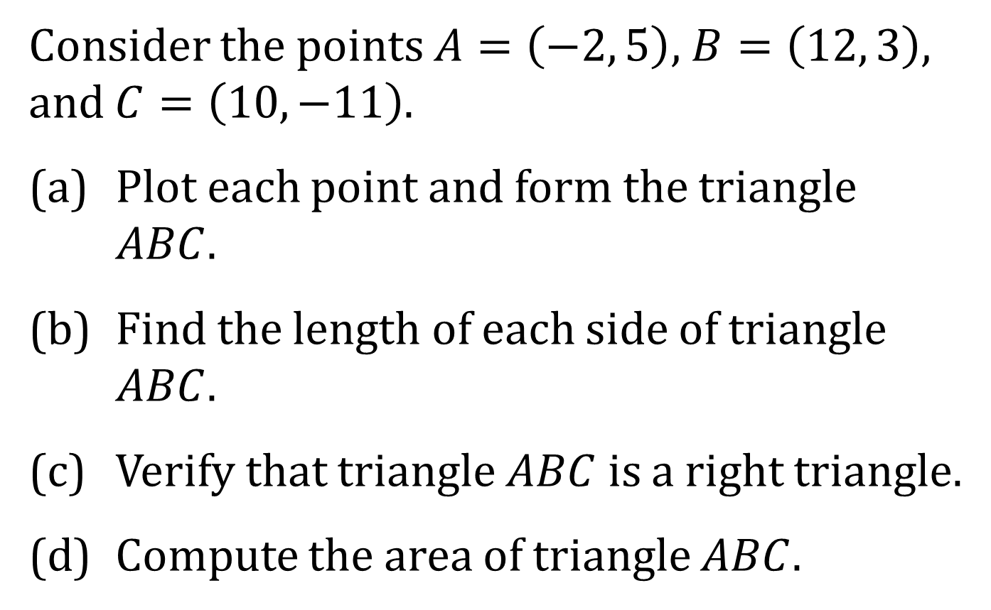
EXAMPLE
Consider the points $A=\left(−2, 5\right)$, $B=\left(12, 3\right)$, and $C=\left(10, −11\right)$.
(a) Plot each point and form the triangle $ABC$.
(b) Find the length of each side of triangle $ABC$.
(c) Verify that triangle $ABC$ is a right triangle.
(d) Compute the area of triangle $ABC$.

Slide 5
THE MIDPOINT FORMULA
The midpoint $M=\left(x, y\right)$ of the line segment from $P_{1}=\left(x_{1},y_{1}\right)$ and $P_{2}=\left(x_{2}, y_{2}\right)$ is given by
$$M=\left(x,y\right)=\left(\frac{x_{1}+x_{2}}{2},\frac{y_{1}+y_{2}}{2}\right)$$
To find the midpoint of a line segment, average the $x$-coordinates of the endpoints, and average the $y$-coordinates of the endpoints.

