Slide 1
Section 12.1
Systems of Linear Equations:
Substitution and Elimination

Slide 2
SYSTEM OF EQUATIONS
In general, a system of equations is a collection of two or more equations, each containing two or more variables.

Slide 3
SOLUTION OF A SYSTEM OF EQUATIONS
A solution of a system of equations consists of values for the variables that are solutions of each equation in the system. To solve a system of equations means to find all solutions to the system.

Slide 4
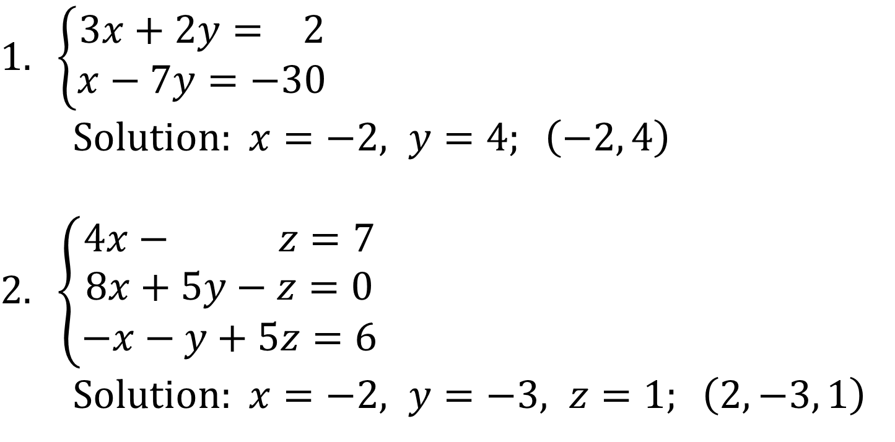
EXAMPLES
$$1. \left\{\begin{matrix}3x+2y= 2 \\ x−7y=−30\end{matrix}\right.$$
Solution: $x=−2, y=4; \left(−2, 4\right)$
$$2. \left\{\begin{matrix}4x− z=7 \\ 8x+5y−z=0 \\ −x−y+5z=6\end{matrix}\right.$$
Solution: $x=−2, y=−3, z=1; \left(2, −3, 1\right)$

Slide 5
CONSISTENT AND INCONSISTENT SYSTEMS
When a system of equations has at least one solution, it is said to be consistent; otherwise, it is called inconsistent.

Slide 6
SYSTEMS OF LINEAR EQUATIONS
An equation is $n$ variables is said to be linear if it is equivalent to an equation of the form
$$a_{1}x_{1}+a_{2}x_{2}+⋯+a_{n}x_{n}=b$$
where $x1, x2, …, xn$ are $n$ distinct variables, $a1, a2, …, a_{n}, b$ are constants, and at least one of the $a$’s is not 0.
If each equation in a system of equations is linear, we have a system of linear equations.

Slide 7
LINEAR SYSTEMS WITH TWO EQUATIONS AND TWO VARIABLES
In a linear system of equations with two variables and two equations, the graph of each equation in the system is a line. The two lines either:
(a) intersect
(b) are parallel
(c) are coincident (that is, identical)

Slide 8
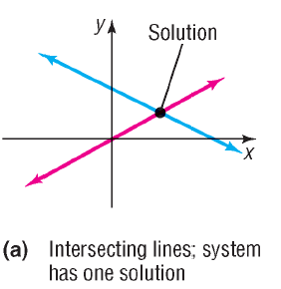
A CONSISTENT SYSTEM
If the lines intersect, the system of equations has one solution, given by the point of intersection. The system is consistent and the equations are independent.

Slide 9
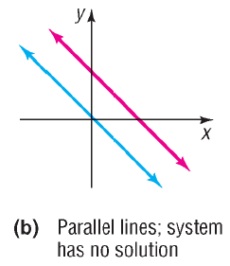
AN INCONSISTENT SYSTEM
If the lines are parallel, the system of equations has no solution, because the lines never intersect. The system is inconsistent.

Slide 10
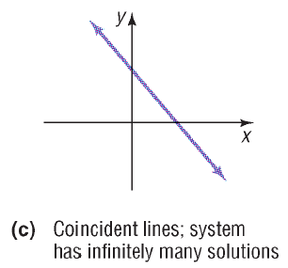
A DEPENDENT SYSTEM
If the lines are coincident, the system of equations has infinitely many solutions, represented by the totality of the points on the line. The system is consistent and the equations are dependent.

Slide 11
SOLVING A SYSTEM BY SUBSTITUTION
Step 1: Pick one of the equations and solve for one of the variables in terms of the remaining variables.
Step 2: Substitute the result into the remaining equations.
Step 3: If one equation in one variable results, solve this equation. Otherwise repeat Steps 1 and 2 until a single equation with one variable remains.
Step 4: Find the values of the remaining variables by back substitution.
Step 5: Check the solution found.

Slide 12
RULES FOR OBTAINING AN EQUIVALENT SYSTEM OF EQUATIONS
Interchange any two equations of the system.
Multiply (or divide) each side of an equation by the same nonzero constant.
Replace any equation in the system by the sum (or difference) of that equation and a nonzero multiple of any other equation in the system.

Slide 13
SOLVING A SYSTEM BY THE METHOD OF ELIMINATION
Step 1: Multiply both sides of two equations by a suitable real number so that one of the variables will be eliminated by addition of the equations. (This step may not be necessary.)
Step 2: Add the equations together.
Step 3: If one equation in one variable results, solve this equation. Otherwise repeat Steps 1 and 2 until the entire system has one less variable.
Step 4: Find the value of the remaining variables by back-substitution.
Step 5: Check the solution found.

Slide 14
A THREE-VARIABLE CONSISTENT SYSTEM WITH ONE SOLUTION

Slide 15
THREE-VARIABLE CONSISTENT SYSTEMS WITH INFINITELY MANY SOLUTIONS

Slide 16
THREE-VARIABLE INCONSISTENT SYSTEMS

Slide 17
SOLVING THREE-VARIABLE LINEAR SYSTEMS
Three-variable linear systems can be solved by the same two methods used to solve two-variable linear systems.
Method of Substitution
Method of Elimination

