Slide 1
Section 1.6
Equations and Inequalities Involving Absolute Value

Slide 2
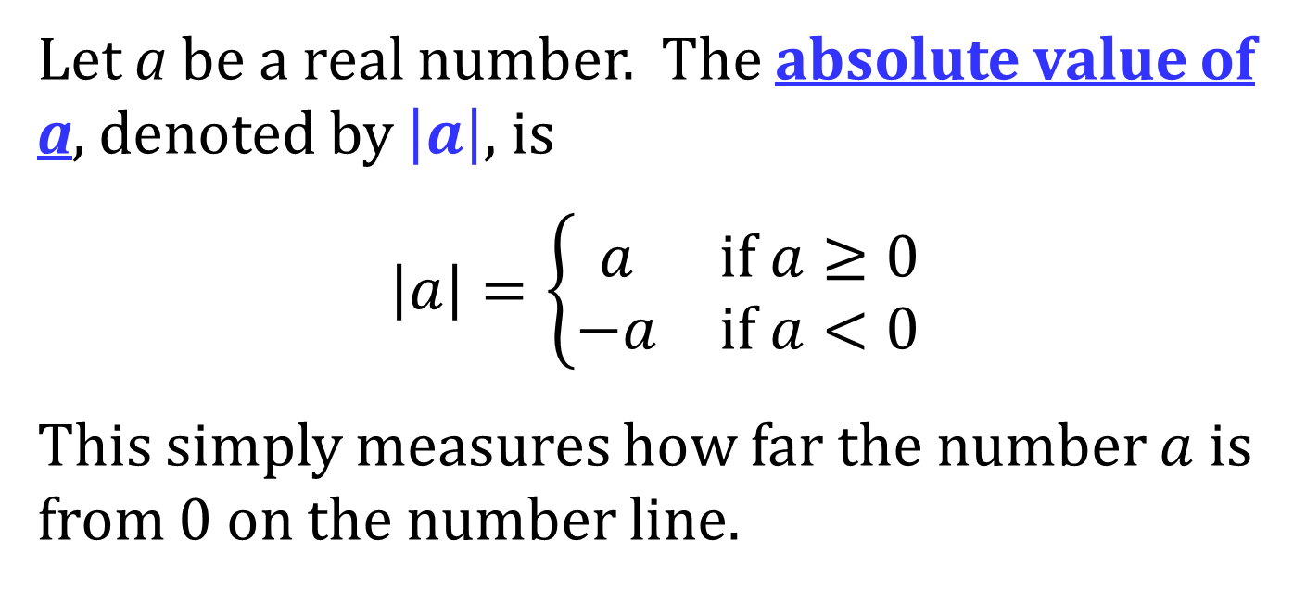
ABSOLUTE VALUE
Let a be a real number. The absolute value of a, denoted by $\left|a\right|$, is
$$\left|a\right|=\left\{\begin{matrix}a & if a≥0 \\ −a & if a<0\end{matrix}\right.$$
This simply measures how far the number $a$ is from 0 on the number line.

Slide 3
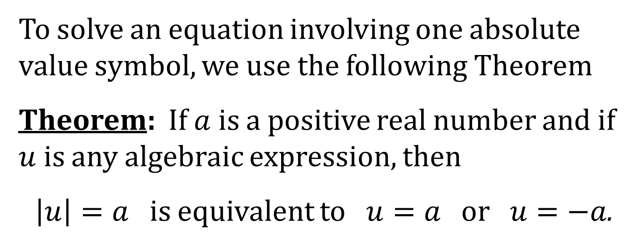
SOLVING EQUATIONS INVOLVING ABSOLUTE VALUE
To solve an equation involving one absolute value symbol, we use the following Theorem
Theorem: If $a$ is a positive real number and if $u$ is any algebraic expression, then
$\left|u\right|=a$ is equivalent to $u=a$ or $u=−a$.

Slide 4
SOLVING ABSOLUTE VALUE INEQUALITIES
To solve an inequality involving one absolute value symbol, we use one of the following Theorems.

Slide 5
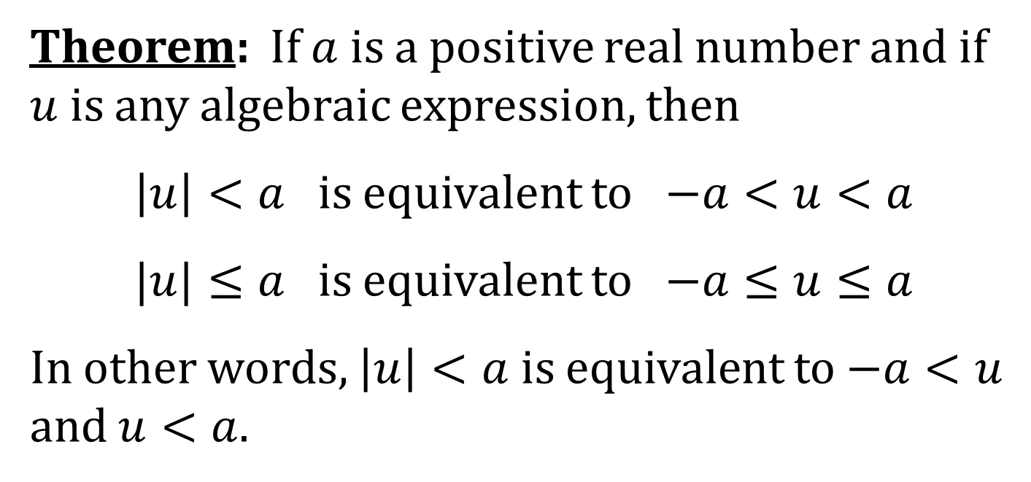
Theorem: If $a$ is a positive real number and if $u$ is any algebraic expression, then
$\left|u\right|<a$ is equivalent to $−a<u<a$
$|u|≤a$ is equivalent to $−a≤u≤a$
In other words, $\left|u\right|<a$ is equivalent to $−a<u$ and $u<a$.

Slide 6
Theorem: If $a$ is a positive real number and if $u$ is any algebraic expression, then
$\left|u\right|>a$ is equivalent to $u<−a$ or $u>a$
$\left|u\right|≥a$ is equivalent to $u≤−a$ or $u≥a$

