Slide 1
Section 1.5
Solving Inequalities

Slide 2
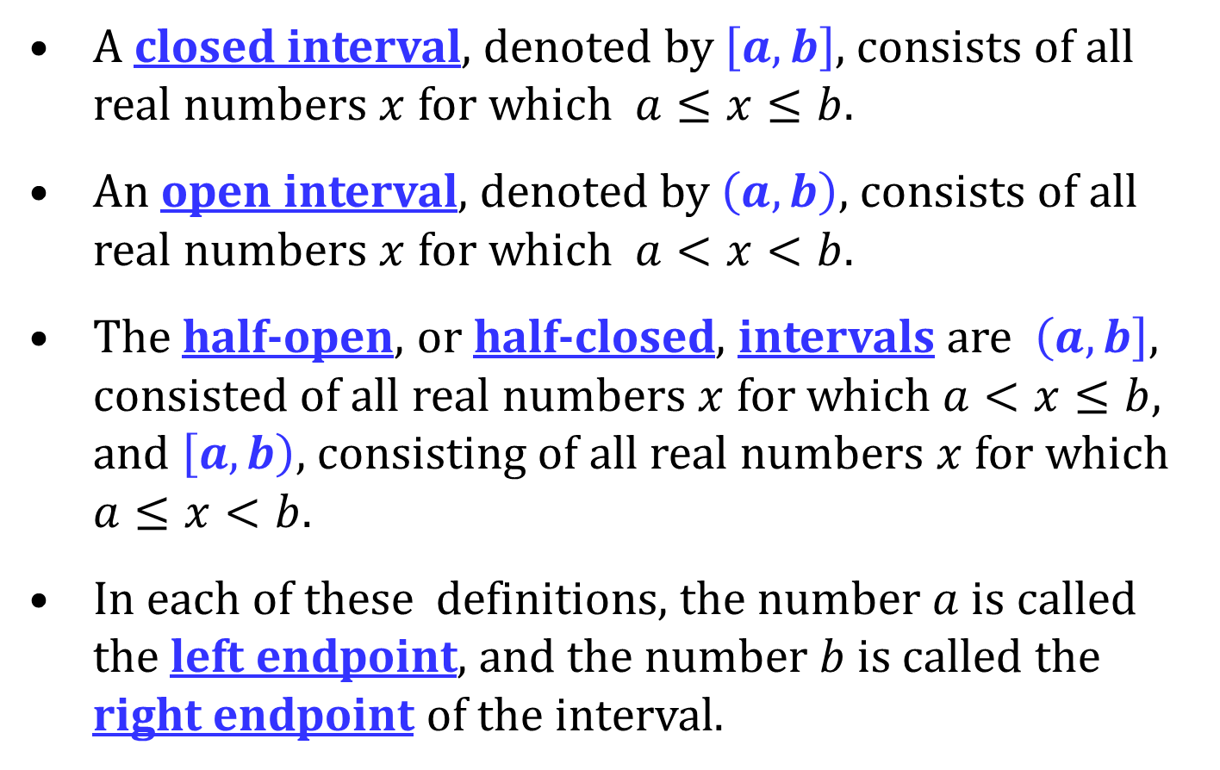
INTERVALS
A closed interval, denoted by $\left[a, b\right]$, consists of all real numbers $x$ for which $a≤x≤b$.
An open interval, denoted by $\left(a, b\right)$, consists of all real numbers $x$ for which $a<x<b$.
The half-open, or half-closed, intervals are $\left(a, b\right]$, consisted of all real numbers $x$ for which $a<x≤b$, and $\left[a, b\right)$, consisting of all real numbers $x$ for which $a≤x<b$.
In each of these definitions, the number $a$ is called the left endpoint, and the number $b$ is called the right endpoint of the interval.

Slide 3
NONNEGATIVE PROPERTY OF INEQUALITIES
For any real number a,
$$a2≥0$$

Slide 4
ADDITION PROPERTY OF INEQUALITIES
For real numbers $a$, $b$, and $c$,
If $a<b$, then $a+c<b+c$.
If $a>b$, then $a+c>b+c$.
This property says that the direction of the inequality remains unchanged if the same number is added to each side. The same is true for subtracting a number since subtracting is equivalent to adding a negative number.

Slide 5
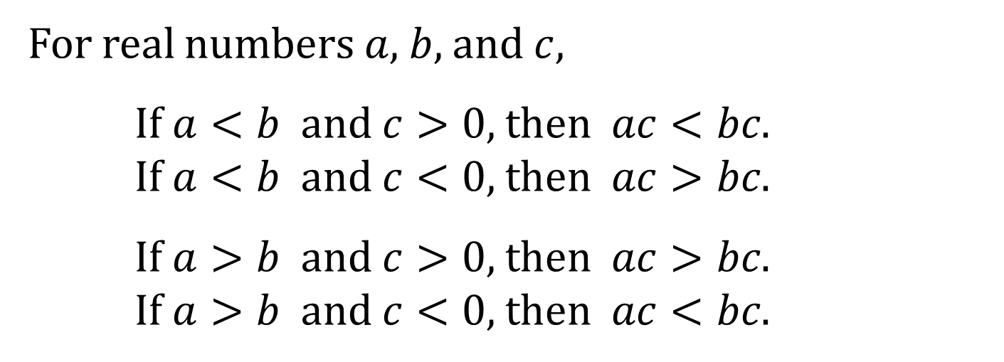
MULTIPLICATION PROPERTY FOR INEQUALITIES
For real numbers $a$, $b$, and $c$,
If $a<b$ and $c>0$, then $ac<bc$.
If $a<b$ and $c<0$, then $ac>bc$.
If $a>b$ and $c>0$, then $ac>bc$.
If $a>b$ and $c<0$, then $ac<bc$.
This property says that if the inequality is multiplied by a positive number the inequality sign stays the same. If it is multiplied by a negative number, the direction of the inequality sign changes.

Slide 6
RECIPROCAL PROPERTY FOR INEQUALITIES
If $a>0$, then $\frac{1}{a}>0$. If $\frac{1}{a}>0$, then $a>0$.
If $a<0$, then $\frac{1}{a}<0$. If $\frac{1}{a}<0$, then $a<0$.
This property says that the reciprocal of a positive real number is positive and the reciprocal of a negative real number is negative.

Slide 7
PROCEDURES THAT LEAVE INEQUALITY SYMBOL UNCHANGED
Simplify both sides of the inequality by combining like terms and eliminating parentheses.
Add or subtract the same expression on both sides of the inequality.
Multiply or divide both sides of the inequality by the same positive expression.

Slide 8
PROCEDURES THAT REVERSE THE SENSE OR DIRECTION OF THE INEQUALITY SYMBOL
Interchange the two sides of the inequality.
Multiply or divide both sides of the inequality by the same negative expression.
If you take the reciprocal of both sides of an inequality.

