Slide 1
Section 1.2
Quadratic Equations

Slide 2
QUADRATIC EQUATIONS
A quadratic equation is an equation equivalent to one of the form
$$ax2+bx+c=0$$
where $a$, $b$, and $c$ are real numbers and $a≠0$.
The form above is called the standard form of a quadratic equation.
A quadratic equation is also called a second-degree equation.

Slide 3
SOLVING QUADRATIC EQUATIONS
Quadratic equations can be solved by several methods.
By factoring and using the Zero-Product Property
By taking square roots
By completing the square
By using the Quadratic Formula

Slide 4
SOLVING A QUADRATIC EQUATION BY FACTORING
Write the quadratic equation in standard form.
Factor the quadratic expression.
Use the Zero-Product Property to set each factor equal to 0.
Solve the linear equations resulting from Step 3.
Check your solution(s).

Slide 5
REPEATED SOLUTIONS
When the left side factors into two linear equations with the same solution, the quadratic equation is said to have a repeated solution. We also call this solution a root of multiplicity 2, or a double root.

Slide 6
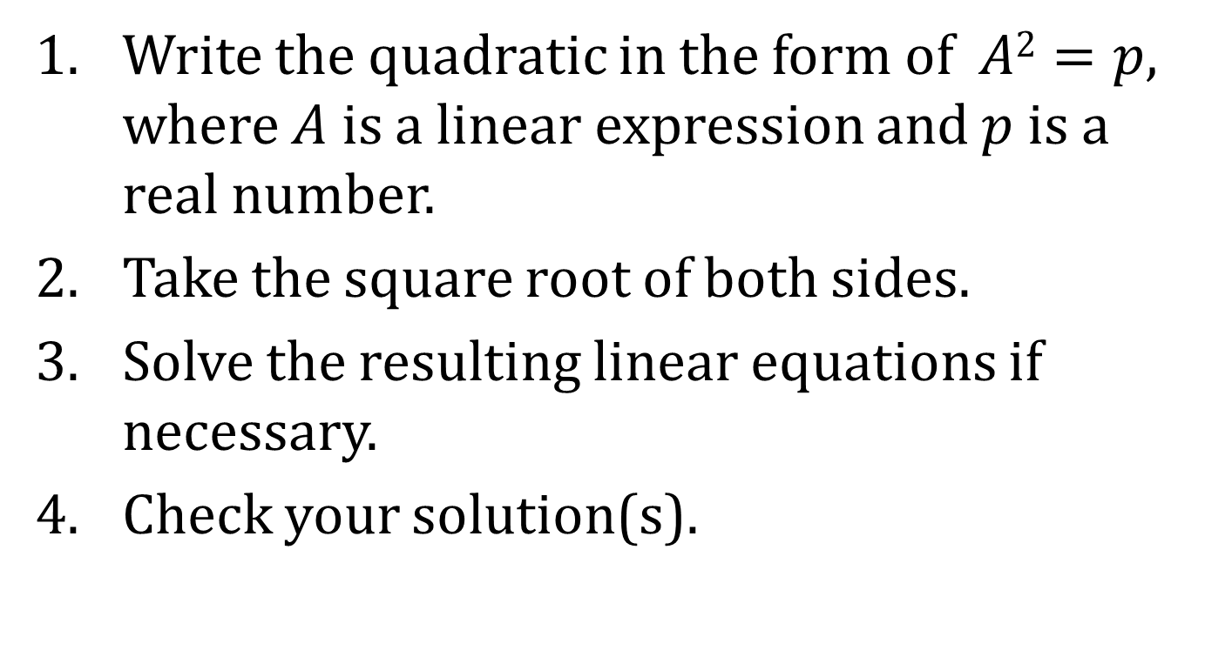
SOLVING BY THE SQUARE ROOT METHOD
Write the quadratic in the form of $A2=p$, where $A$ is a linear expression and $p$ is a real number.
Take the square root of both sides.
Solve the resulting linear equations if necessary.
Check your solution(s).

Slide 7
SQUARES OF A BINOMIAL
Square of a Binomial | Perfect-Square Trinomial
$${\left(x+5\right)}^{2}$$ | $$x2+10x+25$$
$$(x−4)2$$ | $$x^{2}−8x+16$$
In each perfect-square trinomial, the coefficient of $x2$ is 1, and the constant term of the perfect-square trinomial is the square of half the coefficient of its $x$ term.

Slide 8
COMPLETING THE SQUARE
Adding, to a binomial of the form $x2+bx$, the constant that makes the binomial a perfect square trinomial is called completing the square.
To complete the square,
1. Divide the coefficient of $x$ by 2; that is, $\frac{b}{2}$.
2. Square the result of Step 1.
3. Add the result of Step 2.
The resulting trinomial is a perfect square.

Slide 9
SOLVING A QUADRATIC EQUATION BY COMPLETING THE SQUARE
Write the quadratic equation in the form $ax2+bx=c$.
Factor the coefficient of $x2$ out of the left side of the equation.
Complete the square of the resulting binomial. Be sure to maintain equality by adding the same quantity to both sides.
Solve the equation resulting from Step 3 by the Square Root Method.
Check your solution(s).

Slide 10
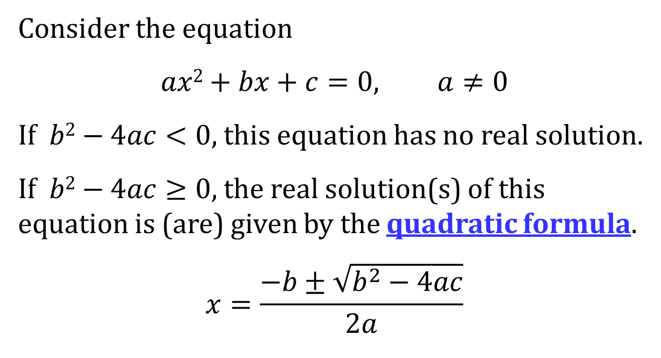
SOLVING A QUADRATIC EQUATION BY THE QUADRATIC FORMULA
Consider the equation
$$ax2+bx+c=0, a≠0$$
If $b2−4ac<0$, this equation has no real solution.
If $b2−4ac≥0$, the real solution(s) of this equation is (are) given by the quadratic formula.
$$x=\frac{−b±\sqrt{b^{2}−4ac}}{2a}$$

Slide 11
THE DISCRIMINANT
In the Quadratic Formula, the quantity
$b2−4ac$ is called the discriminant.
This discriminant can tell us if the equation has real solutions and how many to expect.

Slide 12
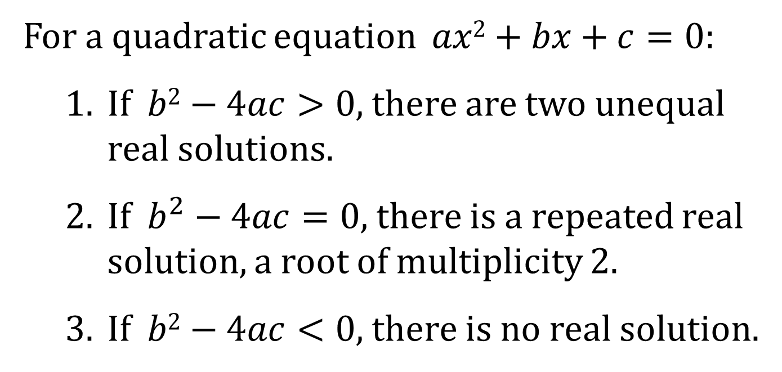
USING THE DISCRIMINANT
For a quadratic equation $ax2+bx+c=0$:
1. If $b2−4ac>0$, there are two unequal real solutions.
2. If $b^{2}−4ac=0$, there is a repeated real solution, a root of multiplicity 2.
3. If $b2−4ac<0$, there is no real solution.

