Slide 1
Section 1.1
Linear Equations

Slide 2
TERMINOLOGY
An equation in one variable is a (mathematical) statement in which two expressions, at least one of which contains a variable are equal.
To solve an equation means to find all the values of the variable that satisfy the equation. These values are called solutions or roots.
EXAMPLE: $3x+1=7$

Slide 3
TERMINOLOGY (CONTINUED)
Often we write the solution of an equation as a solution set. For example, the solution set of $x^{2}−16=0$ is $\left\{−4, 4\right\}$.
An equation that is satisfied for every value of the variable for which both sides are defined is called an identity. For example.
$$3x+2=4x−3−x+5$$
is an identity because this statement is true for any real number $x$.

Slide 4
SOLVING AN EQUATION
One method for solving an equation is to replace the original equation by a succession of equivalent equations until an equation with an obvious solution is obtained.
Equivalent equations are equations that have exactly the same solution set.

Slide 5
PROCEDURES THAT RESULT IN EQUIVALENT EQUATIONS
Interchange the two sides of an equation.
Simplify the sides of an equation by combining like terms, eliminating parentheses, etc.
Add or subtract the same expression from both sides of the equation.
Multiply or divide both sides of the equation by the same nonzero expression.
If one side of the equation is 0 and the other side can be factored, then we may use the Zero-Product Property and set each factor equal to 0.

Slide 6
ZERO-PRODUCT PROPERTY
Let $A$ and $B$ be algebraic expressions. If $AB=0$, then $A=0$ or $B=0$ or both equal 0.

Slide 7
STEPS FOR SOLVING EQUATIONS
List any restrictions on the domain of the variable.
Simplify the equation by replacing the original equation by a succession of equivalent equations following the procedures listed earlier.
If the result of Step 2 is a product of factors equal to 0, use the Zero-Product Property and set each factor equal to 0.
Check your solution(s).

Slide 8
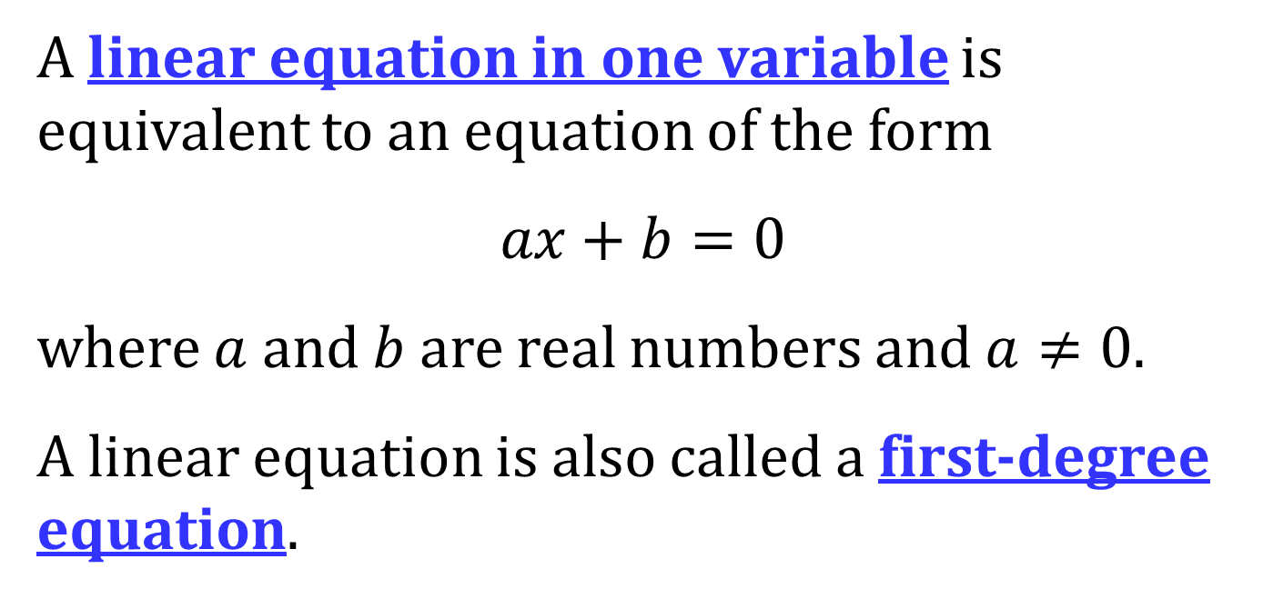
LINEAR EQUATIONS
A linear equation in one variable is equivalent to an equation of the form
$$ax+b=0$$
where $a$ and $b$ are real numbers and $a≠0$.
A linear equation is also called a first-degree equation.

Slide 9
STEPS FOR SOLVING A LINEAR EQUATON
List any restrictions on the domain of the variable.
If necessary, clear the equation of fractions by multiplying both sides by the least common multiple (LCM) of all the denominators of all the fractions.
Remove all parentheses and simplify.
Collect all terms containing the variable on one side of the equation and all remaining terms on the other side.
Simplify and solve.
Check your solution(s).

